Slide 1
Gizi Kebugaran
Mury Kuswari | Nazhif Gifari
Pertemuan 12

Slide 2
VEGETARIAN ATHLETES

Slide 3
CARL LEWIS
One of history’s most talked about Olympians vegan or otherwise is hands down Carl Lewis. In his track career, he won 10 medals nine of them gold

Slide 4
WHY VEGETARIAN?
Athletes may elect to follow vegetarian diets for health, ethical (animal rights), ecological, environmental, religious, or spiritual reasons

Slide 5
TYPES OF VEGETARIANS
Lacto-Ovo Vegetarian: does not eat meat, fish or fowl. Eats dairy and egg products. Most popular.
Ovo Vegetarian: does not eat meat, fish, fowl or dairy products. Eats egg products.
Lacto Vegetarian: does not eat meat, fish, fowl or eggs. Eats dairy products.
Vegan: does not eat any animal products including meat, fish, fowl, eggs, dairy, honey, etc. Most vegans do not use any animal products such as silk, leather, wool, etc. as well

Slide 6
CARBOHYDRATE: THE FUEL OF CHOICE
Carbohydrate should make up the bulk of the athlete’s diet.
Carbohydrate is needed to feed our muscles and brain.
Research shows that carbohydrate which is converted to instant fuel helps athletes perform their best
A vegetarian diet is naturally carbohydrate-rich with whole grains, pasta, rice, bread, cereal, vegetables (including high starch vegetables like corn, winter squash and sweet potatoes), and fresh and dried fruit.
All of these carbohydrates should be a part of an athlete’s diet.

Slide 7
DIETARY FAT
Fat serves as an important fuel for low-intensity and prolonged exercise, and is necessary for overall health.
Pre-exercise meals, however, should not be heavy in fat as it slows digestion
Athletes should follow the same guidelines recommended for Americans and consume between 20 and 35% of total daily calories from fat
An easy way to balance fat and carbohydrates is to add small amounts of plant-based fat sources like nuts, seeds, avocado, olives, olive oil, canola oil, and soy foods to carbohydrate foods.

Slide 8
PROTEIN
Intense or prolonged exercise increases protein needs because protein is needed to build muscle and to repair small muscle tears that happen during exercise.
Vegetarian athletes can easily meet protein needs as long as the diet meets energy (calorie) needs and contains a variety of protein-rich plant foods such as legumes, soy foods, nuts, seeds and whole grains
All athletes should eat a snack or meals rich in protein and carbohydrates after hard training to enhance recovery and replace glycogen stores.

Slide 9
PROTEIN FOR RECOVERY
Consumption of protein-rich foods along with carbohydrate foods in the 30 minutes after strenuous exercise may enhance recovery

Slide 10
WATER, ELECTROLYTES AND CARBOHYDRATES BEFORE, DURING AND AFTER EXERCISE
Knowing fluid losses is important because we do not always feel thirsty during exercise.
Dehydration and overhydration both decrease performance and can be dangerous.
Although drinking plain water is fine for most sporting events, beverages containing carbohydrates and electrolytes, including sports drinks and diluted fruit juice with a pinch of salt, can help maintain fluid balance and may even increase exercise performance

Slide 11
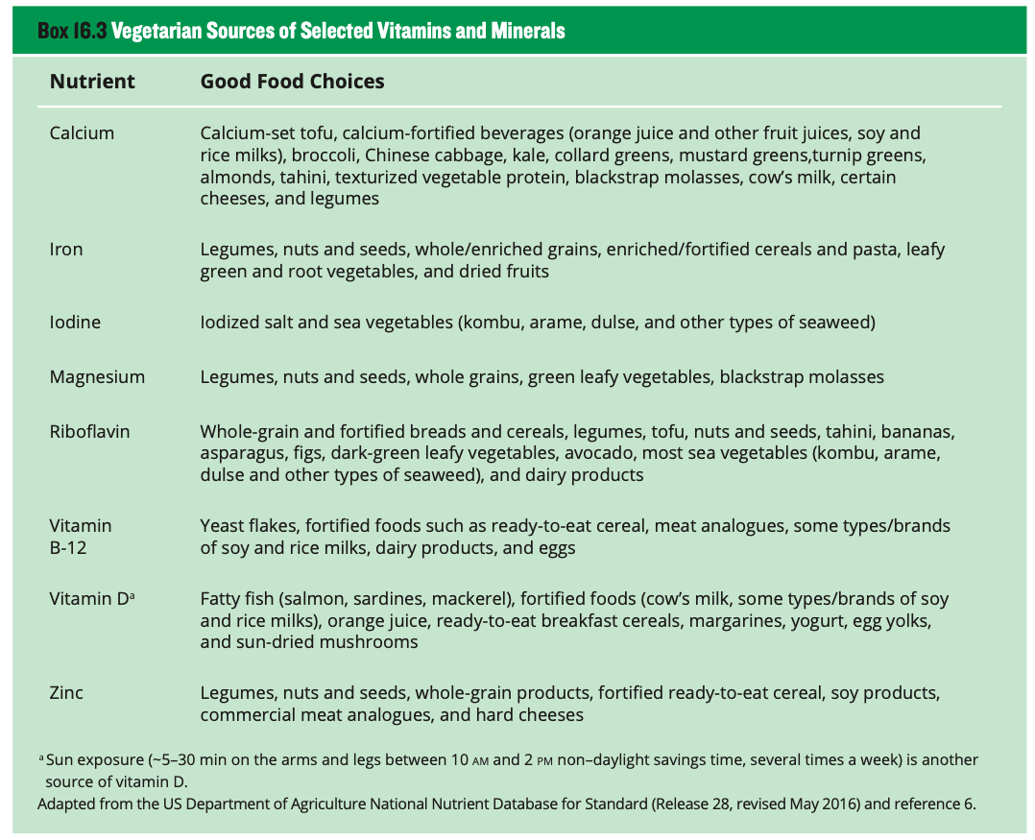
Micronutrients play important key to support an athlete’s performance

Slide 12
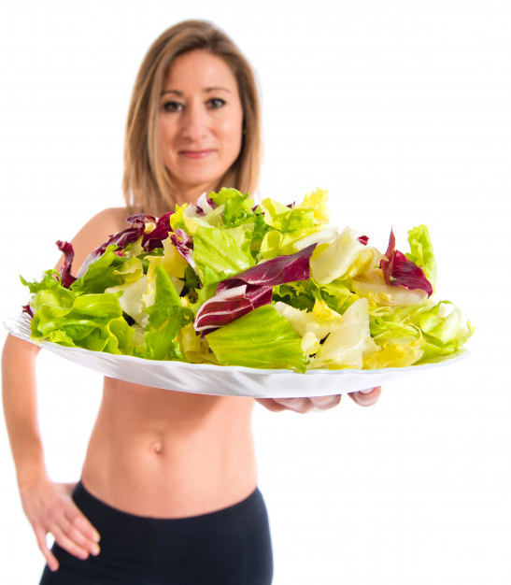
ATHLETE AND VEGETARIAN
Well-planned vegetarian diets are nutritionally adequate, appropriate for athletes at all levels from recreational to elite and provide health benefits in the prevention and treatment of chronic diseases
Like most athletes, vegetarian athletes may benefit from education about food choices to optimize their health and peak performance

Slide 13
VARIETY FOOD FOR VEGETARIAN
Choose a variety of foods, including whole and enriched grains, fruits, vegetables, legumes, nuts, seeds, and, if desired, dairy products and eggs.

Slide 14
WELL BALANCED DIET
A varied and well-balanced diet rich in whole grains, legumes, nuts, seeds, dried fruits, iron-fortified cereals, and green leafy vegetables can help ensure vegetarian athletes meet their needs for most nutrients

Slide 15
EDUCATING FOR VEGETARIAN ATHLETES
Educating vegetarian athletes on food sources of carbohydrate, protein, fat, calcium, vitamin D, iron, zinc, iodine, riboflavin, and vitamin B-12 should help ensure adequate health and performance.

Slide 16
PROFESSIONAL NUTRITION EDUCATION
The role of the nutrition professional during counseling, nutrition education, and treatment is to work with the athlete to ensure adequate nutritional status given his or her lifestyle, income, and vegetarian belief system.

Slide 17
PROTEIN FOR VEGETARIAN

Slide 18
IRON FOR VEGETARIAN

Slide 19
ZINK FOR VEGETARIAN

Slide 20
OMEGA-3 FOR VEGETARIAN

Slide 21
THANK YOU

