Slide 1
KONDISI FISIK DAN PROGRAM LATIHAN
PERTEMUAN 13
Mury Kuswari & Nazhif Gifari
Ilmu Gizi & FIKES

Slide 2
WHAT IS BOOT CAMP?

Slide 3
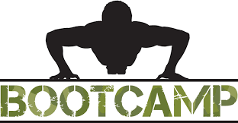

Slide 4
A fairly intense mix of strength training and aerobic elements (Mayo Clinic, 2016)
The movement can be pull-up, push-up, lunges, crunches, sprints and others.
WHAT IS BOOT CAMP?
Notes:
Bootcamp workouts can vary but generally include a fairly intense mix of strength training and aerobic elements. One bootcamp workout might stress calisthenics while another stresses military-style drills. Some even incorporate martial arts moves. In pretty much all cases, however, you can expect to do calisthenics, such as pullups, pushups, lunges and crunches, as well as drills and sprints. In essence, a boot camp workout is a type of interval training — bursts of intense activity alternated with intervals of lighter activity.

Slide 5
A military training approach was first introduced in 1888 at the Elmira Reformatory in Elmira, New York (Anderson et al., 1999).
This new training approach was implemented to invoke discipline and keep the inmates active, rather simply allow them to suffer boredom and inactivity. (Smith, 1988).
During the Spanish-American War (25 April 1898 to 12 August 1898), US sailors wore leggings called boots, which came to mean a Navy (or Marine) recruit. These recruits trained in “boot” camps (NHHC, 2013).
19th Century Beginnings

Slide 6
2000^{s} and Celebrity Boot Camps
Celebrity Fit Club
⇩
2002 to 2006 in UK
2005 to 2010 in US
⇩
Monitored and supervised by a team that included a nutritionist, a psychologist and a physical trainer
Notes:
Celebrity Fit Club was a reality television series that followed eight overweight celebrities as they tried to lose weight for charity.
Celebrity Fit Club aired in the UK from 2002 to 2006 and in the US from 2005 to 2010; the US version was called Celebrity Fit Club: Boot Camp from 2
As part of the process participants were monitored and supervised by a team that included a nutritionist, a psychologist and a physical trainer; the latter of which was former US Marine Harvey Walden IV.008.

Slide 7
British Military Fitness
Purpose → To provide people with an alternative to the gym with group, social and motivational elements as core alongside the fitness element (Startups, 2011).
2011 → BMF had over 25,000 members, spread across more than 120 parks covering the length and breadth of the UK (Startups, 2011).
BMF Website

Slide 8
WHY BOOT CAMP ATTRACT MANY PEOPLE TO TRY?
Offer a more challenging and varied workout
Require little or no special equipment
Creat a sense of camaraderie among the participants.
Notes:
Program ini dirancang untuk membangun kekuatan dan kebugaran, dan membantu orang-orang masuk kerutinitas olahraga yang teratur. Program ini juga melakukan pelatihan fisik dengan atau tanpa alat bantu seperti tali tambang untuk memanjat dan tarik menarik.

Slide 9
THE BENEFIT OF BOOT CAMP
Push yourself harder
Develop group coordination
It’s cheaper
Help you to get and maintain the ideal weight
Notes:
Program ini dirancang untuk membangun kekuatan dan kebugaran, dan membantu orang-orang masuk kerutinitas olahraga yang teratur. Program ini juga melakukan pelatihan fisik dengan atau tanpa alat bantu seperti tali tambang untuk memanjat dan tarik menarik.

Slide 10
BOOT CAMP
Performed regularly for 4 weeks straight
2 – 3 times a week
50 – 60 minutes per session
In park, hills or another public space

Slide 11
MILITARY BOOTCAMP
Types Of Boot Camps
It provides advanced training to individuals, which consist of survival training and exercises that helps in gaining a lean and strong body. It is also comprised of a ‘test program’, which intensifies the entire agenda of exercising.

Slide 12
FITNESS BOOTCAMP
This exercise program tends to educate people about the benefits and discipline of military workout.

Slide 13
TEEN BOOTCAMP
Teen bootcamp is an exercising program that encourages teens to pursue a healthy life and be conscious of the diminishing effects of drugs.
Notes:
Its motto is to raise the kids in the value of discipline. It naturally continues for six to eight weeks, but the program can be extended to support the needs of a special child.

Slide 14
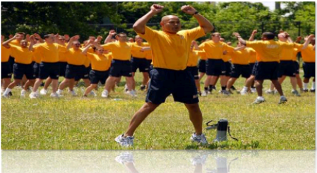
CAREER BOOTCAMPS
Career bootcamps are specifically designed for the people working in the corporate world. This workout program has been working wonders with unhealthy workaholics since its
appearance.
Notes:
Its aim is to get people out of the sedentary lifestyle and motivate them to obtain a healthy life.

Slide 15
THE MOVEMENT IN BOOTCAMP

Slide 16
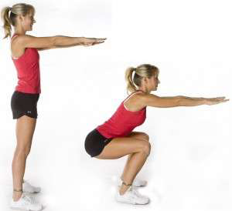
EXAMPLE MOVEMENT OF BOOTCAMP
Squats
This type of exercise has proved to be the most efficient way of strengthening the lower body and burning excess fat. Our lower abdomen and leg muscles play a major part in controlling our blood flow and vitality consequently, slimming us down naturally. This exercise helps the muscles to absorb more oxygen and provides us a muscular look and helps us to develop core strength.

Slide 17
Burpees
Burpees is not a single but a combination of exercises that is comprised of strength training and aerobic workouts. Knee-push, jump-up, long jump, box-jump and one-armed exercising methods improves our cardiovascular strength and increases blood flow.

Slide 18
LUNGES
Lunges is a strength training exercise that enhances quadriceps, gluteal muscles, and biceps femoris muscles. These muscles take part in sending the energy flow to the entire body. Therefore, by increasing their power this exercise improves agility and reduces fat eventually.

Slide 19
The plank
This is the most modern form of exercise that drives
our isometric core to maintain balance in difficult
places. It depends on forearms, elbows and toes to
raise one’s body weight. Doing this exercise for one
minute burns the excess fat and improves our muscle strength.

Slide 20
Sit-ups
This exercise is to increase abdominal strength by using the core muscles to carry the weight of upper body. This workout method reduces stress and maintains the flow of spinal fluid through the vertebrae. By empowering the nervous system, it increases our metabolism, which burns fat tissues and gives us a lean body.

Slide 21
Frankensteins
It is also called monster walk as this exercise draws a lot of energy to leg muscles and transforms the calf muscles into power house. This helps the energy of our body to be distributed equally in every body part and helps us to lose fat.

Slide 22
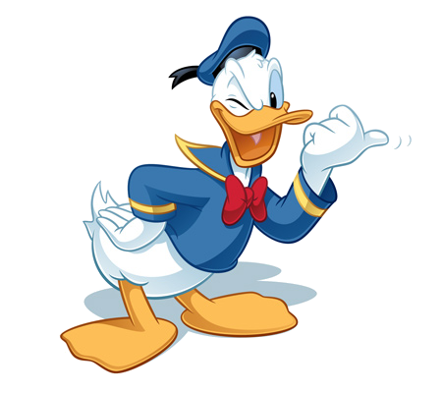
WANT TO TRY THE BOOT CAMP WORKOUT PROGRAM?

Slide 23
THE CONCLUSION
Boot camp is a fairly intense mix of strength training and aerobic elements.
Boot camp can be fun because is not just about sport, but also about friendship
Some examples movement are lunges, burpees, push-up, squad and others.

Slide 24
JUDUL
BOOT CAMP WORKOUT
TUJUAN
The students know the definition of boot camp
The students know the example of movement in boot camp workout
The student know where they can join boot camp in Jakarta

Slide 25
Anderson, J.F., Dyson, L. & Burns, J.C. 1999. Boot Camps: An Intermediate Sanction. Lanham, Maryland: University Press of America
BMF (British Military Fitness) . 2012 . How It Started. Available in http://www.britmilfit.com/about-bmf/how-it-started/ [Accessed: 03 October, 2017]
NHHC (Naval History & Heritage Command) . 2013 . Navy Traditions and Customs. Available in http://www.history.navy.mil/trivia/trivia03.htm [Accessed: 03 October, 2012]
Startups (2011) Robin Cope: British Military Fitness: The Ex-officer Tells Us How He Used The Forces to Create a New Kind of Exercise Class. Available in http://www.startups.co.uk/robin-cope-british-military-fitness.html [Accessed: 08 November, 2012].
Smith, B.A. 1988. Military Training at New York’s Elmira Reformatory 1888-1920. Federal Probation. 52(1), pp.33-40.
What’s New Jakarta. 2016. 5 Boot Camp Communities in Jakarta. Available in http://www.whatsnewjakarta.com/boot-camp-cross-fit-communities-in-jakarta/ [Accessed: 03 October 2017]
DAFTAR PUSTAKA

