Slide 1
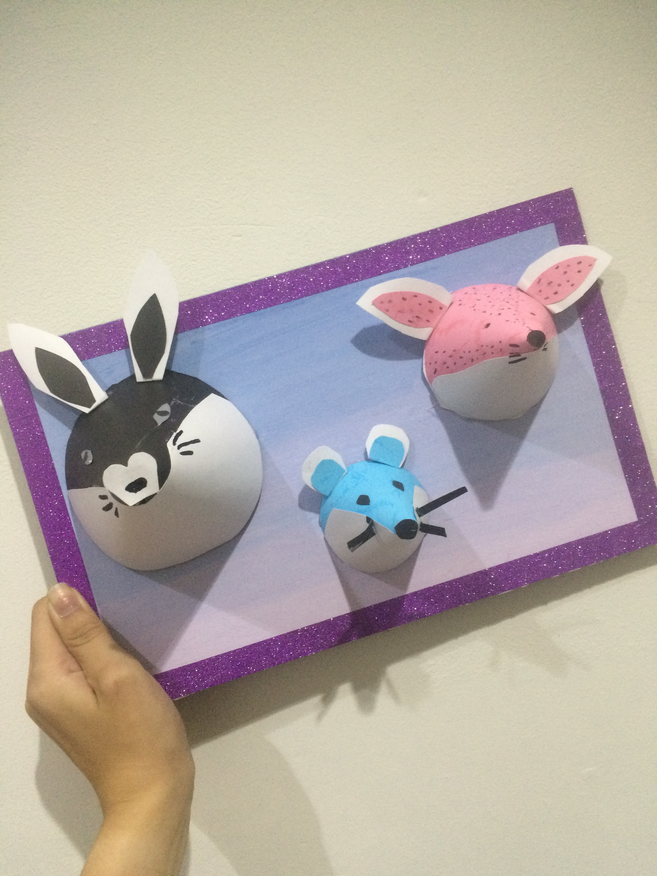
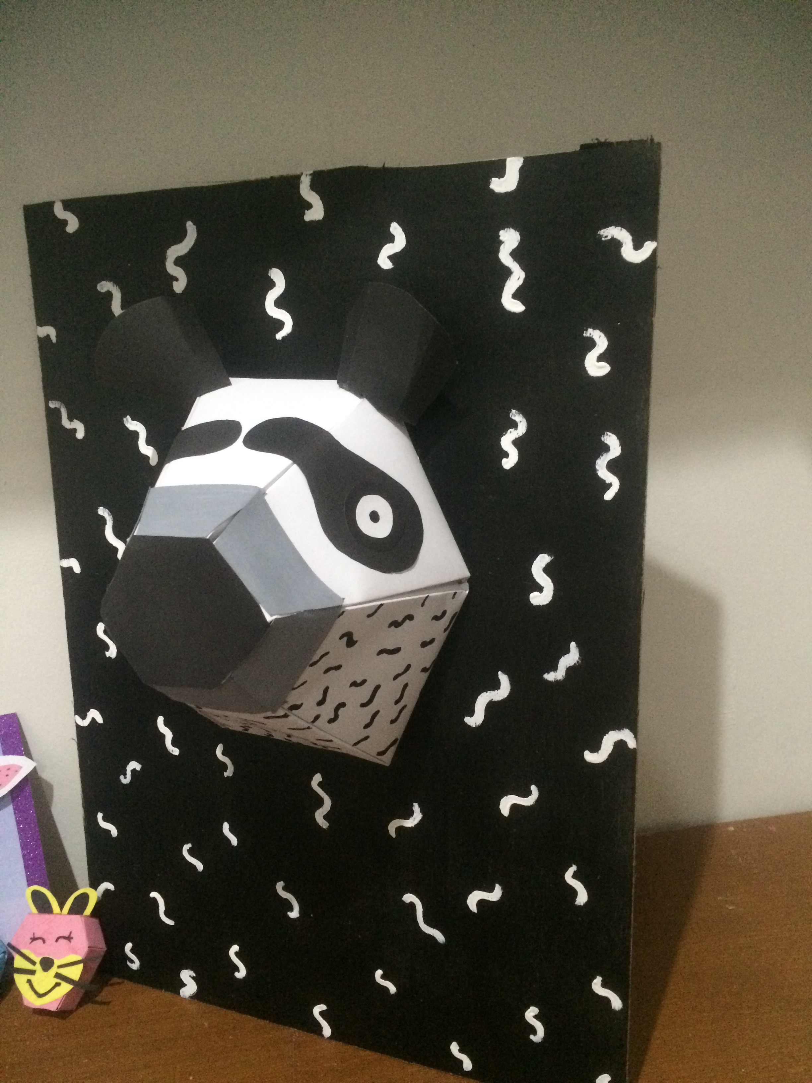
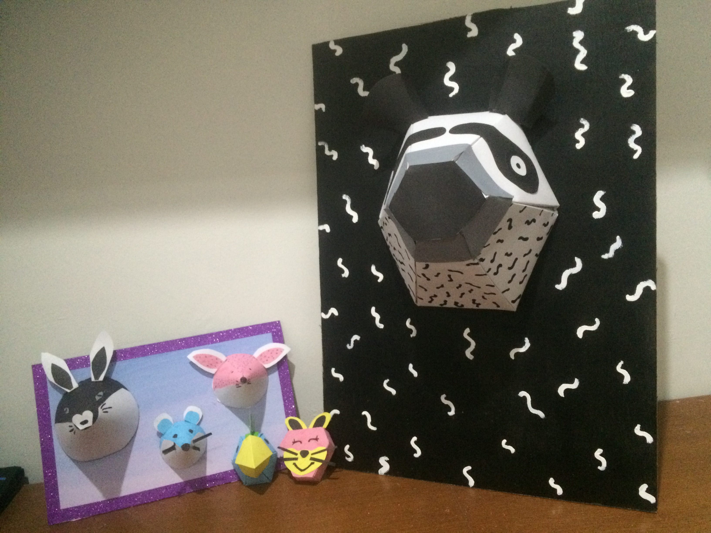
ROAR
3D ART FOR WALL DECOR
ANGELINE JANUAR (2015-24-002)
PRODUCT DESIGN
ESA UNGGUL UNIVERSITY

Slide 2
WHAT IS ROAR ?
ORNAMENT
CUTE
3D

Slide 3
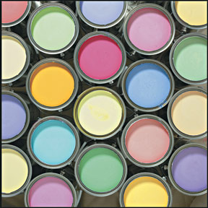
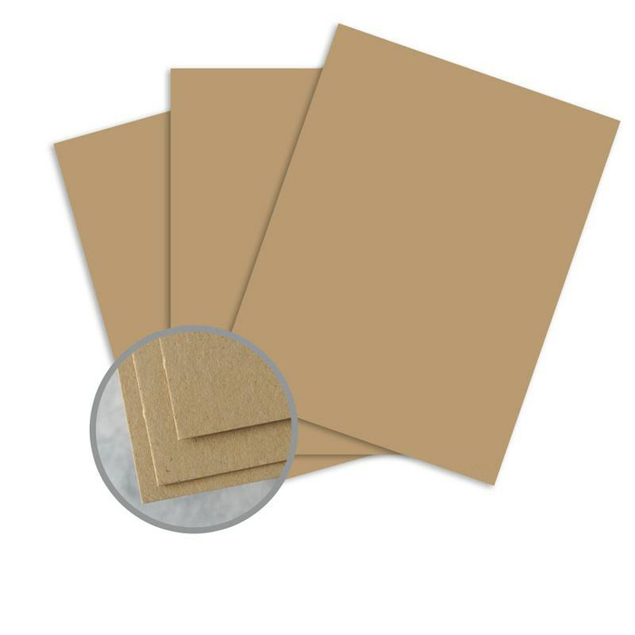
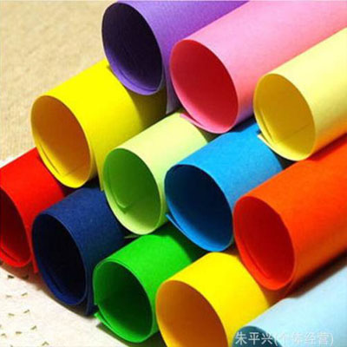
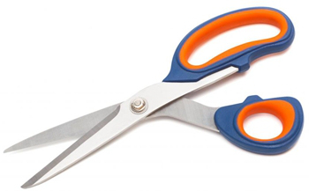
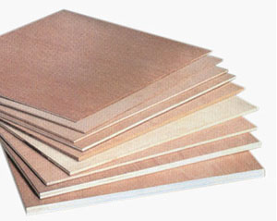
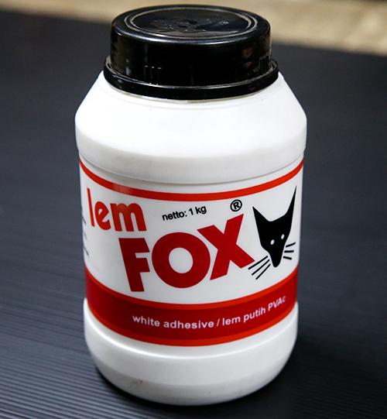
MATERIAL

Slide 4
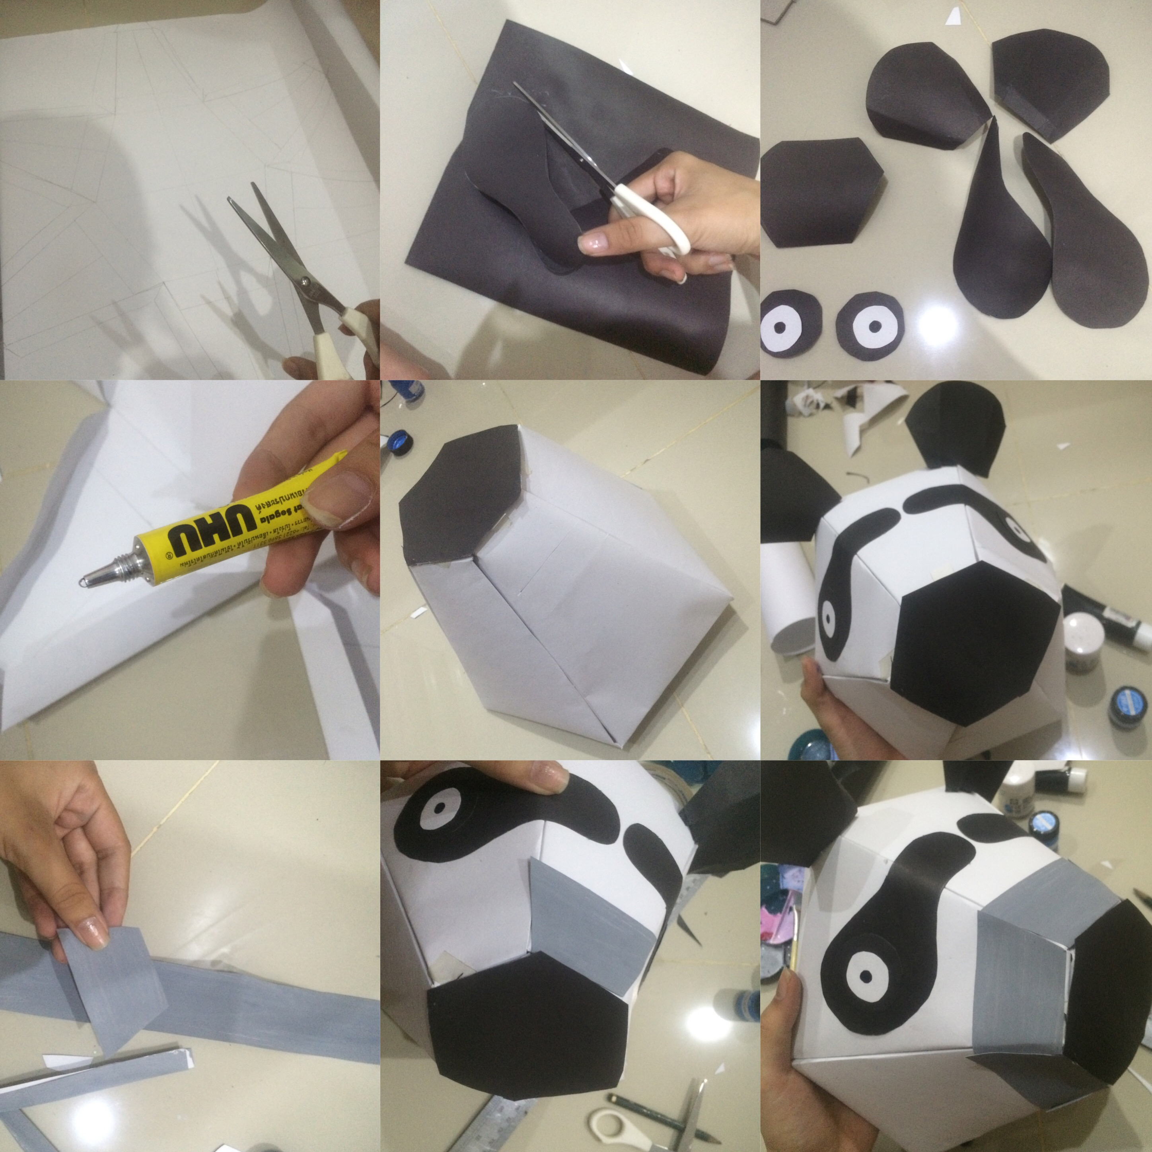
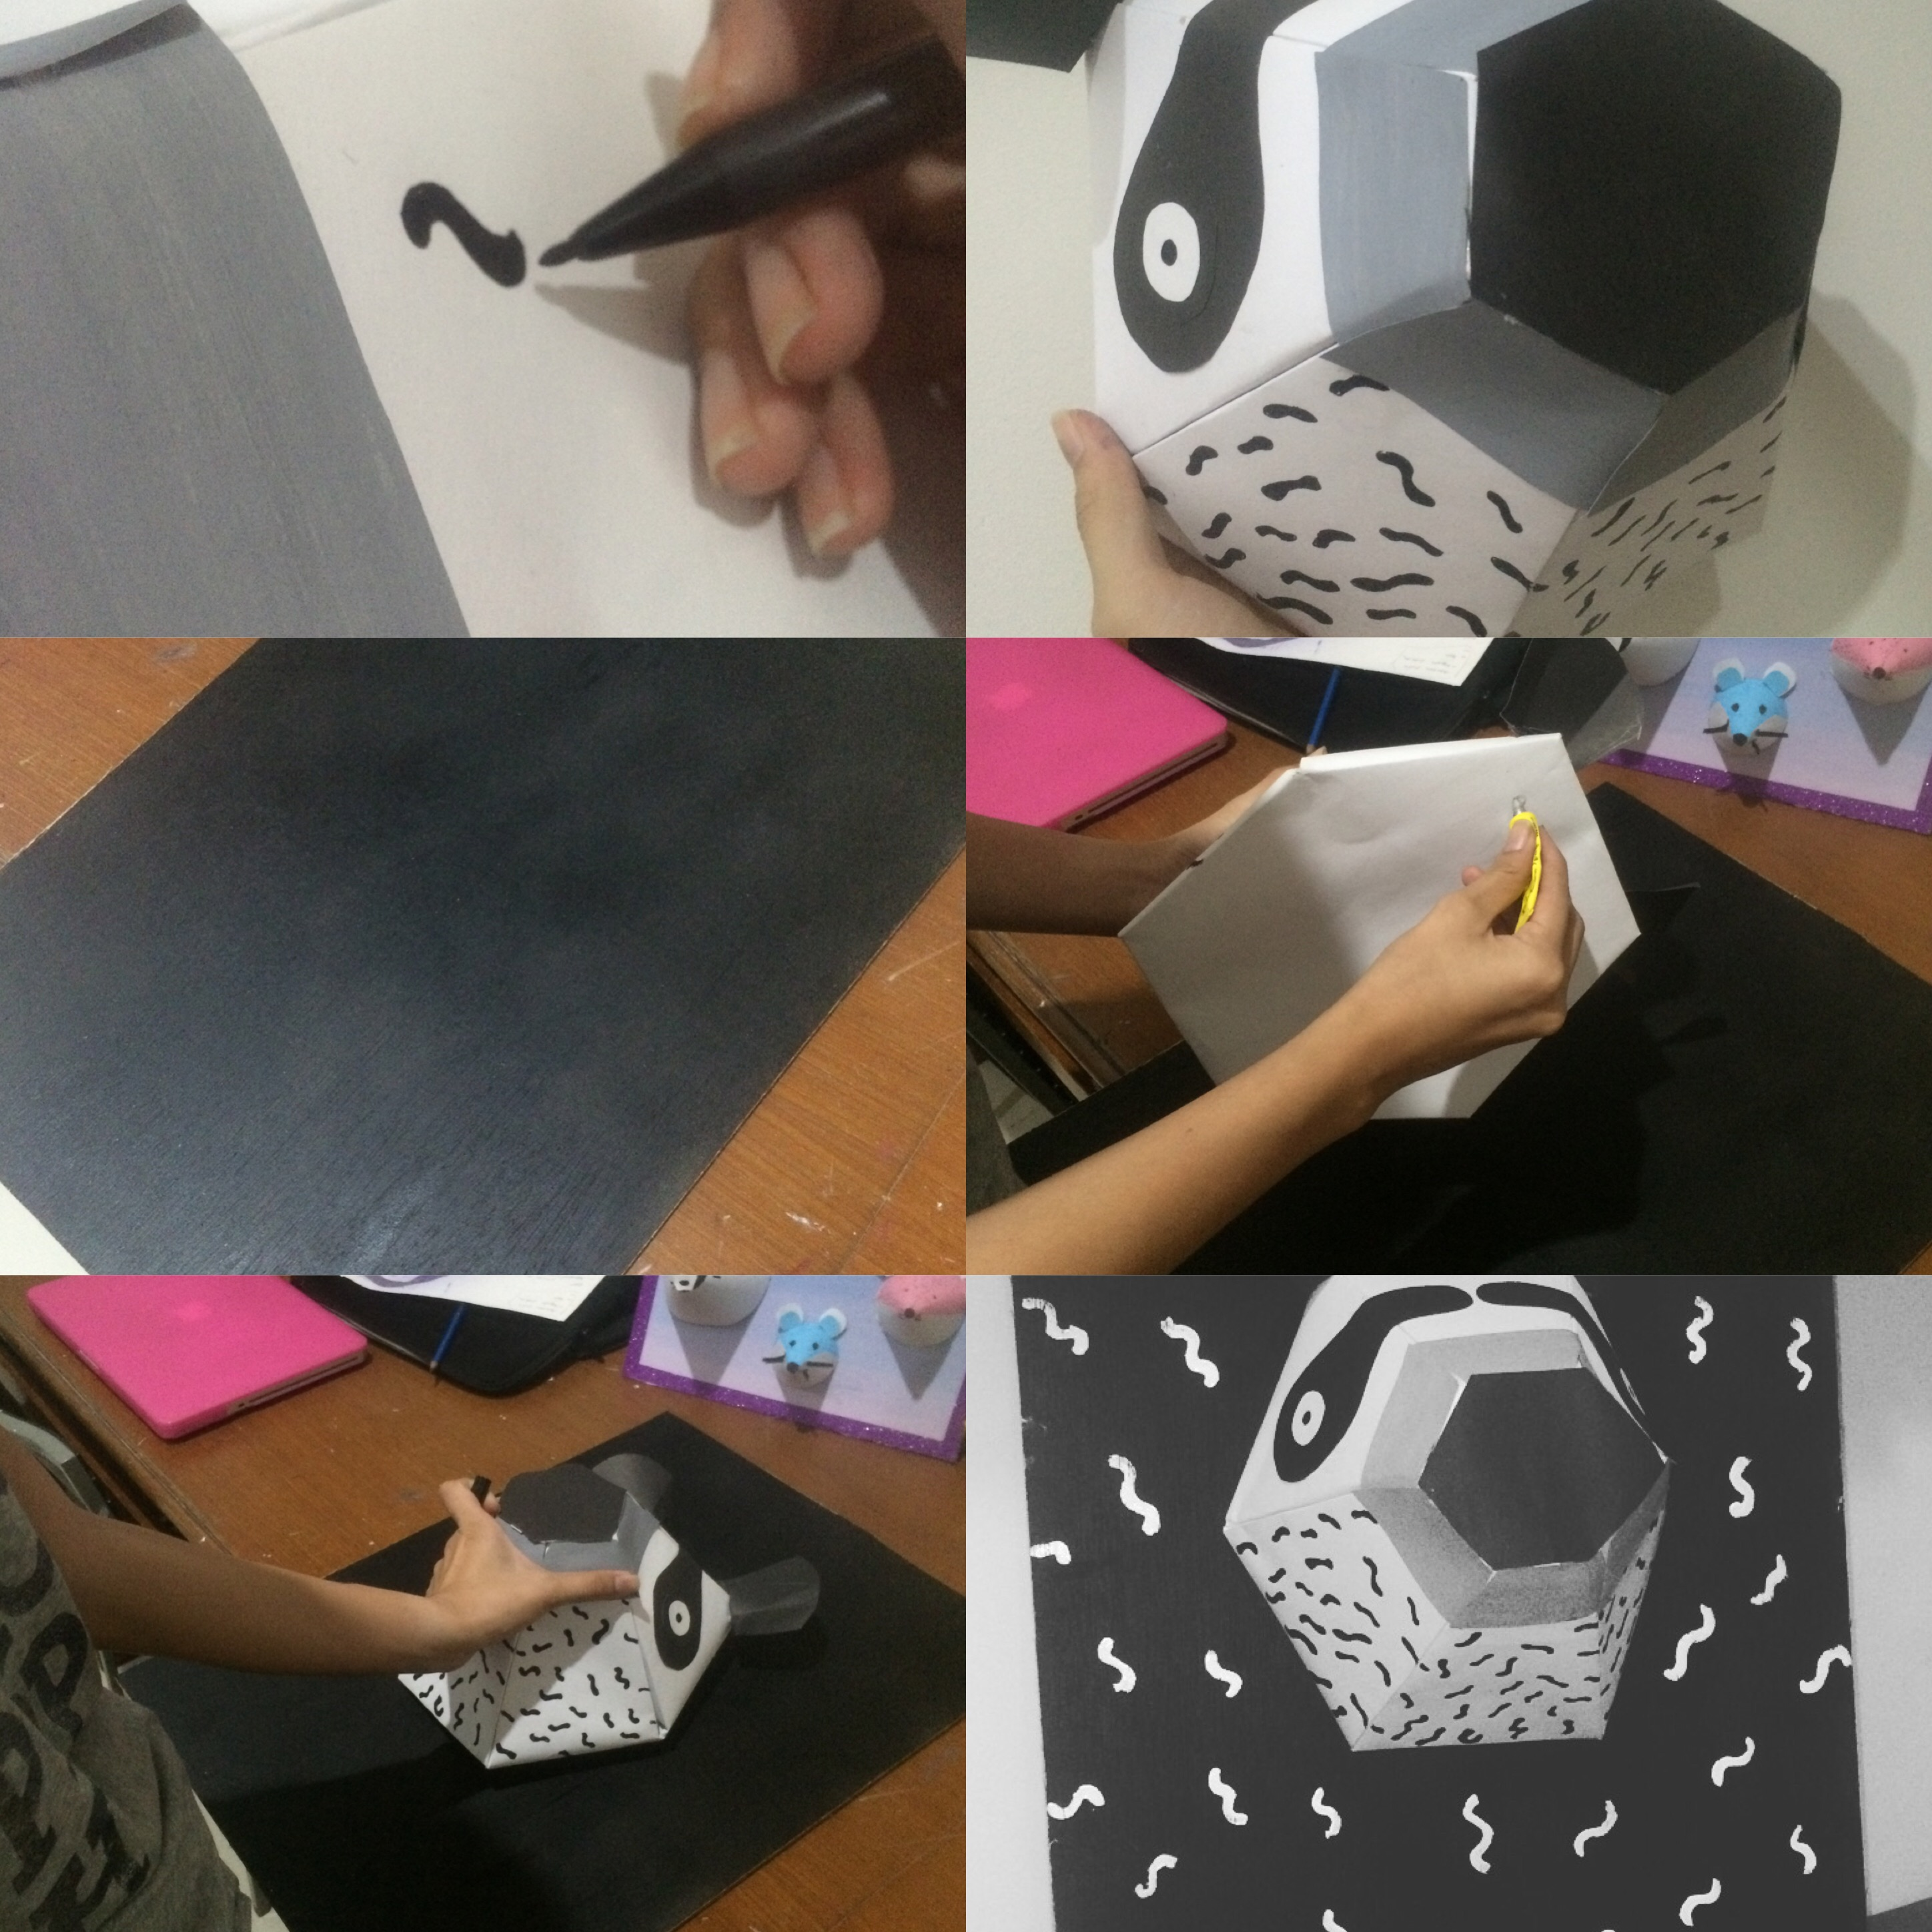
HOW TO MAKE A ROAR
1
2
3
10
11
4
5
6
12
13
7
14
8
9

Slide 5
PRICE OF ROAR
PROMO !!!!
BUY 1 GET 1
FREE
ONLY
IDR 75.000

Slide 6
HOW TO BUY
WWW.ROARINDONESIA.COM
081546052419
ROARIND

Slide 7
