Slide 1
ERGOGENIC AIDS AND SUPPLEMENTS
By: Nazhif Gifari

Slide 2
Categories of Ergogenic Aids
Nutritional aids
Pharmacological aids
Physiological aids
Psychological aids
Mechanical or biomechanical aids

Slide 3
ERGOGENIC AIDS
Better shoes
Better equipment
Aerodynamic swimsuits
Aerodynamic bicycles
Tinted Contact lens
Lasix Surgery
Supplements

Slide 5
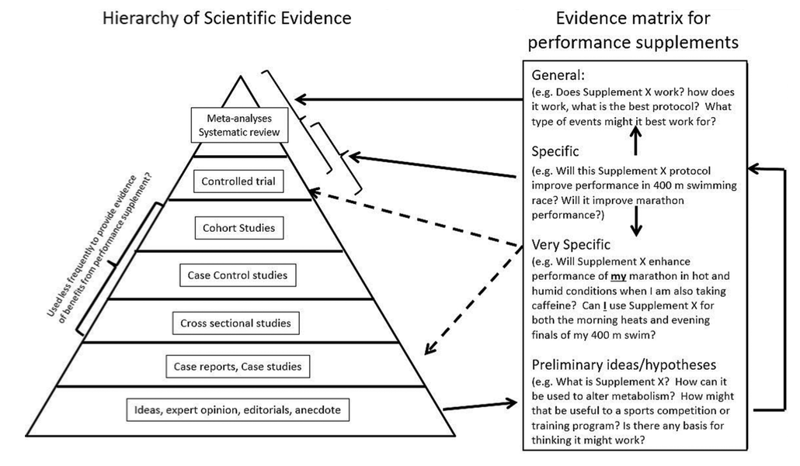

Slide 6
ALAT BANTU GIZI
Caffeine comes from a group of lipid-soluble compounds called purines.
They are found naturally in coffee beans, chocolate, cocoa beans, tea leaves, and cola nuts which are often added to carbonated beverages and nonprescription medicines
63 plant species contain caffeine in their leaves, fruits or seeds

Slide 7
Ergogenic Effects
Electrolyte balance and glucose availability are key factors that influence caffeine’s ergogenic effect.
An ergogenic effect occurs with caffeine ingestion prior to exercising.
Consuming caffeine before exercise increased fat catabolism and reduced carbohydrate oxidation based on plasma glycerol and free fatty acid levels.

Slide 8
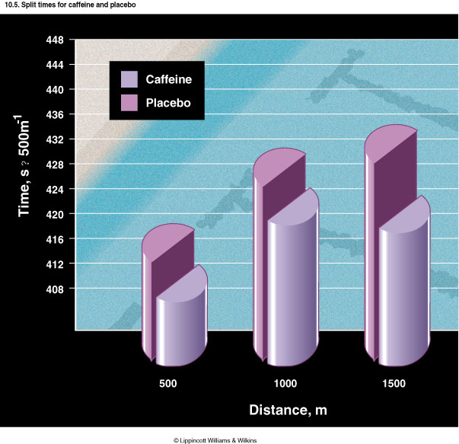

Slide 9
Proposed Mechanism for Ergogenic Action
Caffeine acts in two ways:
Directly on adipose and peripheral vascular tissues.
Indirectly from caffeine’s stimulating epinephrine release from the adrenal medulla; epinephrine the acts as an antagonist of the adenosine receptors on adipocyte cells.

Slide 10
Warning about Caffeine
People who don’t usually consume caffeine may experience undesirable side effects.
Caffeine stimulates the central nervous system and causes headache, nervous irritability, insomnia, tremulousness, muscle twitching, elevated heart rate and blood pressure, and trigger premature left ventricular contractions.

Slide 12
Amino Acid Supplements and Other Dietary Strategies for an Anabolic Effect
Body builders, weight lifters, and fitness enthusiasts use amino acid supplements believing they boost the body’s natural production of the anabolic hormones testosterone, growth hormone, insulin, or insulin-like growth factor to improve muscle size and strength to decrease body fat.

Slide 13
A Prudent Means To Possibly Augment an Anabolic Effect
Within exercised muscle fibers, resistance training generally stimulates both protein degradation and protein synthesis.
Dietary modifications that increase amino acid transport into muscle raise energy availability, or increase anabolic hormones would theoretically augment the training effect within muscle by increasing the rate of anabolism or depressing catabolism.

Slide 14
L-Carnitine
It is a short chain of coboxylic acid that contains nitrogen.
It is a vitamin like compound found mostly in meat and dairy products.
L-carnitine is vital for Norman metabolism; carnitine facilitates the influx of long-chain fatty acids in to the mitochondrial matrix. It becomes synthesized in the body by the liver and kidneys from methionine and lysine. Carnitines’ function can stall the accumulation of lactic acid and enhance exercise performance.
About 95% of the body’s carnitine is located within muscle cells.

Slide 15
Rate of Fatty Acid Oxidation Affects Aerobic Exercise Intensity
Marketing for L-carnitine targets endurance athletes that believe “metabolic stimulators” enhances fat burning and spares glycogen.
Carnitine also appeals to body builders and other as a way to reduce body fat.
Increasing intracellular L-carnitine level through dietary supplementation should/may promote fat oxidation during exercise and elevate aerobic energy transfer from fat breakdown while conserving limited glycogen reserves.

Slide 16
WHAT ARE DIETARY SUPPLEMENTS?
Products other than tobacco that are taken by mouth and contain dietary ingredients.
Categorized as foods; not drugs or food additives (Intended to be ingested)
May not be represented as a conventional food or meal
Must be labeled as a “Dietary Supplement.”

Slide 17
TIPE DIETARY
SUPPLEMENTS
FORMS
Vitamins
Minerals
Sports nutrition supplements
Weight management products
Specialty supplements
Capsules
Softgels
Gelcaps
Tablets
Liquids/tinctures
6. Powders
7. Bars
8. Beverages

Slide 18
NUTRITIONAL SUPPLEMENTS & ERGOGENIC AIDS
Reasons for taking supplements:
to compensate for an inadequate diet
to meet unusual nutritional requirements
to improve performance above expectations

Slide 20
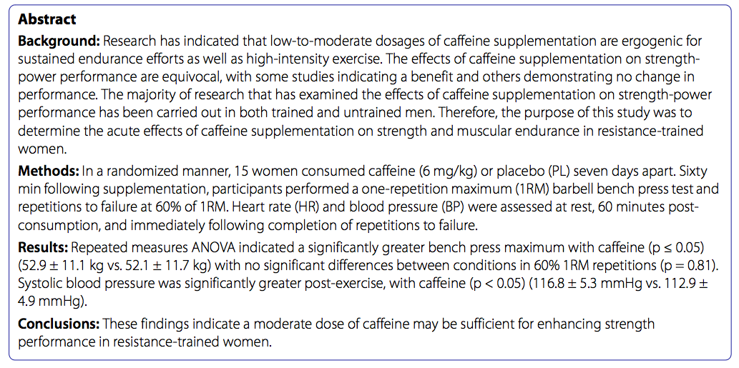

Slide 21
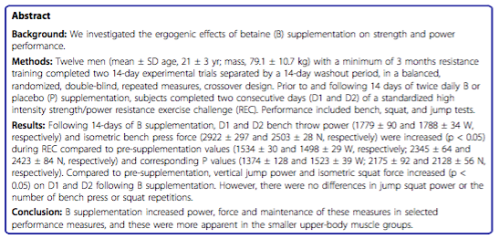

Slide 22
TERIMA KASIH

