Slide 1
Dr. Iphov Kumala Sriwana
Penelitian Operasional II
09
PROGRAMA DINAMIS

Slide 2
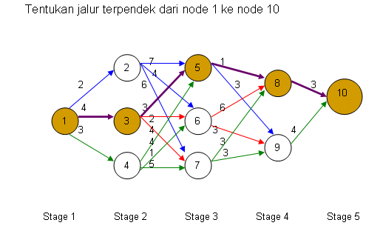
CONTOH 1 :

Slide 3
LANJUTAN CONTOH 1 :
STAGE 4
f4 (8) = 3
f4 (9) = 4
STAGE 3
f3 (5) = min C58 + f4 (8) = 1 + 3 = 4
= min C59 + f4 (9) = 3 + 4 = 7
f3 (6) = min C68 + f4 (8) = 6 + 3 = 9
= min C69 + f4 (9) = 3 + 4 = 7
f3 (7) = min C78 + f4 (8) = 3 + 3 = 6
= min C79 + f4 (9) = 3 + 4 = 7

Slide 4
LANJUTAN CONTOH 1 :
STAGE 2
f (2) = min C25 + f3 (5) = 7 + 4 = 11
= min C26 + f3 (6) = 4 + 7 = 11
= min C27 + f3 (7) = 6 + 6 = 12
f (3) = min C35 + f3 (5) = 3 + 4 = 7
= min C36 + f3 (6) = 2 + 7 = 9
= min C37 + f3 (7) = 4 + 6 = 10
f (4) = min C45 + f3 (5) = 4 + 4 = 8
= min C46 + f3 (6) = 1 + 7 = 8
= min C47 + f3 (7) = 5 + 6 = 11

Slide 5
LANJUTAN CONTOH 1 :
STAGE 1
f (1) = min C12 + f2 (2) = 2 + 11 = 13
= min C13 + f2 (3) = 4 + 7 = 11
= min C14 + f2 (4) = 3 + 8 = 11

Slide 6
Kesimpulan CONTOH 1:
Jalur terpendek dari node 1 ke node 10 adalah :1-3-5-8-10
Total jarak yang ditempuh adalah 11

Slide 7
CONTOH 2 :
Bulan | Demand | Ongkos | Ongkos
 |  | Variabel | Set-up
1 | 1 | $1/unit | $3
2 | 3 | $1/unit | $3
3 | 2 | $1/unit | $3
4 | 7 | $1/unit | $3

Slide 8
DATA-DATA CONTOH 2 :
Maksimum Inventory : 4 unit
Maksimum Produksi : 5 unit
Biaya Simpan : $0.5
Inventory awal ; 3
Ditanya :
Jadwal Produksi yang optimal

Slide 9
JAWAB :
f(t) : Minimum cost untuk memenuhi akhir atau total periode untuk on hand inventory (i)
C(x) : set-up cost + variabel cost (Cost untuk memenuhi x unit)
Bila x=0, maka C(x)=0
Bila x=x, maka C(x)=$3+X
Xt(i) = jumlah yang harus diproduksi pada periode t, bila pada periode sebelumnya on hand inventory (i)

Slide 10
PERIODE 4 :
f4 (3) = Ongkos Set-up + Ongkos Variabel
= $3 + ($1 * 1) = $ 4
X4 (3) = 1
f4 (4) = Ongkos Set-up + Ongkos Variabel
= $0 + ($1 * 0) = $ 0
X4 (4) = 0

Slide 11
PERIODE 4 :
Ongkos set up
f4 (0) = 3 + 4 = 7 ; X4 (0) = 4
f4 (1) = 3 + 3 = 6 ; X4 (1) = 3
f4 (2) = 3 + 2 = 5 ; X4 (2) = 2
f4 (3) = 3 + 1 = 4 ; X4 (3) = 1
f4 (4) = 0 ; X4 (4) = 0
Status inventory (i)

Slide 12
PERIODE 3 :
f3(0) = 0.5 (i+x-2) + C(x) + f4 (i+x-2)
Catatan : Inventory maksimum 4, produksi maksimum 2, ditotalkan jadi 6
LANJUTKAN !!!!!!!!!!!!!!!!!!!!

Slide 13
OUTPUT
Periode | Produksi | Inventory
1 | 1 | 0
2 | 5 | 2
3 | 0 | 0
4 | 4 | 0

Slide 14
ANALISA HASIL
Inventory pada periode 1 harus 0, sehingga f1(0)=20, X1(0)=1 atau total biaya $20 dan yang diproduksi=1, sehingga i+x-1 = 0+1-1 = 0, periode 1, inventory 0
Periode 2, f2(0)=16, X2(0) = 5, sehingga i+x-3 = 0+5-3 = 2, periode 2, inventory 2
Periode 3, f3(2)=7, X3(2) = 0, sehingga i+x-2 = 2+0-2 = 0, periode 3, inventory 0
Periode 4, f4(0)=12, X4(0) = 4, sehingga I = 0

Slide 15
Terima Kasih

