Slide 1
ITSM berbasis ITIL
PERTEMUAN 14
Yulhendri, S.T, M.T.
Sistem Informasi
FASILKOM

Slide 2
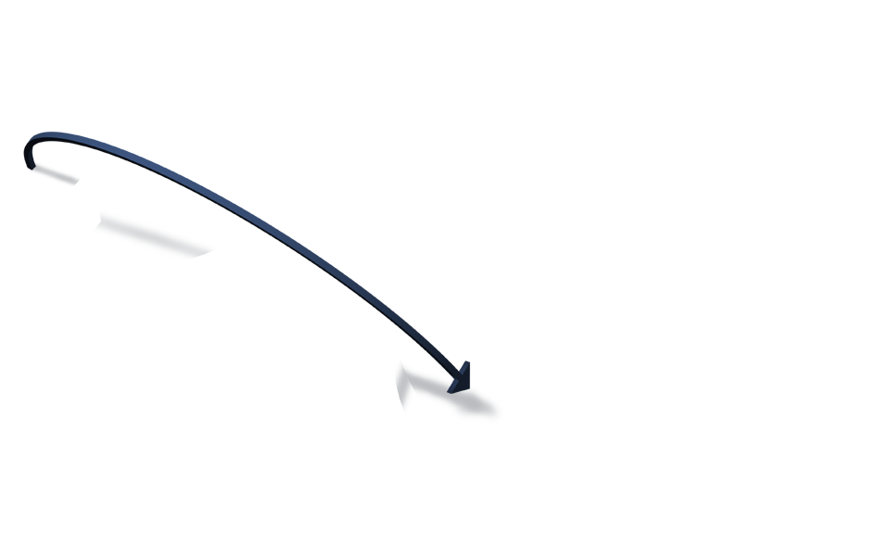
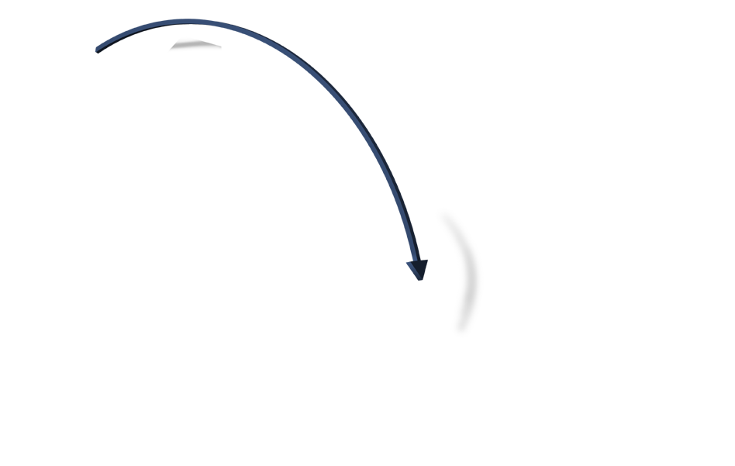
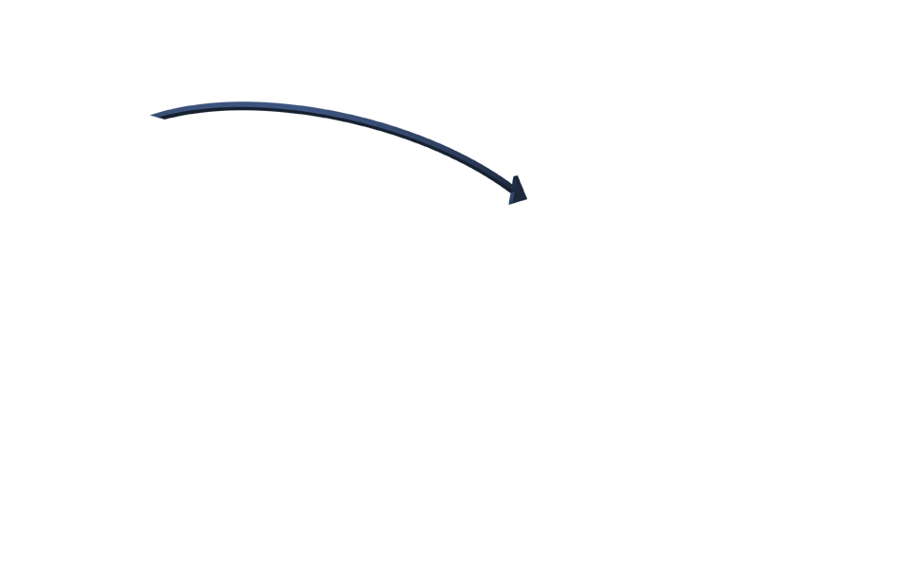
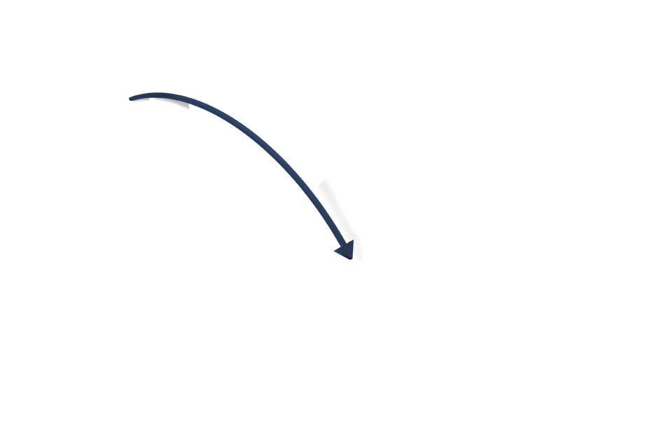
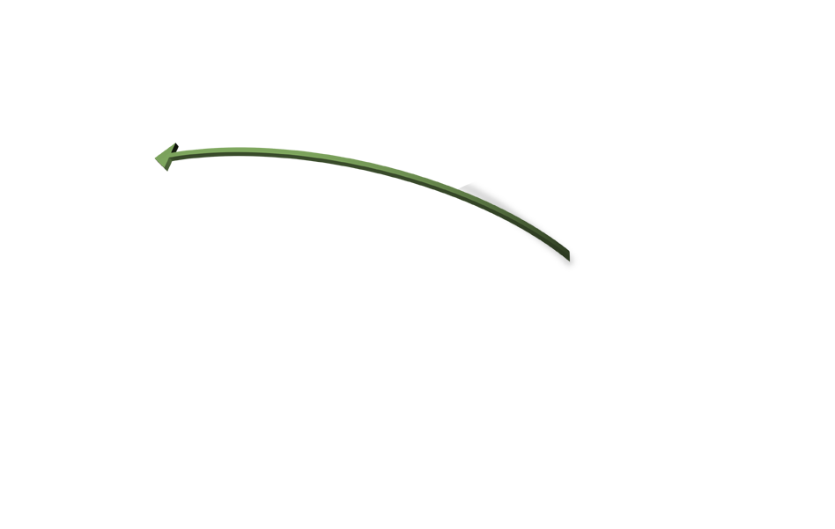
Obstacles Prevent Effective Engagement
Overwhelming Demand:
Unstructured capture of requests and ideas
No formal process for prioritization and trade-offs
Reactive vs. proactive
IT Seen as Black Box:
Business lacks visibility
Poor customer satisfaction
Notes:
Unfortunately, there are many obstacles preventing effective engagement.
As the arrows starting from the business and ending at IT indicate, every day, IT organizations face multiple and competing demands for services and projects from multiple lines of business.
OVERWHELMING DEMAND
Managing demand for most IT organizations is extremely difficult: demand comes from many different sources, is of vastly different levels of priority, from tactical to strategic, and because there’s no structured process in place to manage this demand.
Even if all the demand is captured, there is often no process by which to make trade-off decisions with the business in terms of priority, timing and budget. Instead, these decisions are often made based on who screams the loudest or who has most influence.
IT SEEN AS A BLACK BOX (LACK OF VISIBILITY)
Further compounding the engagement problem is the lack of visibility that IT’s customers have into the status of their approved initiatives. Often, IT appears as a black box to those who rely on IT for their business technology.
Finally, when IT does deliver new services to the business, there’s often a disconnect between what was envisioned and what was received. This results in customer satisfaction issues that can tarnish IT’s reputation in the organization.
CONCLUSION
No process, poor trade-off decisions, limited visibility and poor satisfaction all define an engagement process that is not working at its best.

Slide 3
Disparate Systems Reduce Efficiency
No Single System of Record for Decision Making
Relevant Metrics Hard to Obtain
Disparate Systems Costly to Maintain and Upgrade
Notes:
Now let’s take a look within IT and the efficiency challenges being faced there. As an IT leader you are responsible for:
- Delivering completed projects
- Managing to a fixed budget
- Managing people, whether within the IT org or outsourced
Most IT organizations already have systems to manage all 3 categories: they may be using spreadsheets, Microsoft Project, custom-built apps, whiteboards, and emails to manage and communicate within and outside the IT organization.
The problem is that these resources, systems, and applications are:
- Disparate systems
- not integrated
- not scalable
- lack a foundation of repeatable processes
which results in having no system of record or system of support for decision-making.
Once again, having no single system of record means no consolidated views, no control of your resources, and no way to make real-time intelligent decisions.
Without a unified (and simplified) system most IT organizations we speak to today look like this.

Slide 4
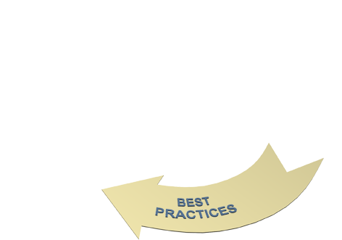
IT Governance Landscape
Notes:
What connects the business and IT is the process of IT Governance…
Strong engagement begins with a solid IT Governance process. A key component of IT Governance is Clarity’s Portfolio Management module.
Evaluating project and service requests in a systematic way that allows quick adaptation to changes in the business environment is not only good practice, its good governance.
These multiple inputs to the PfM come from Demand…
From the Business…
…from existing Services….
..and from within the IT organization, specifically from existing Projects…
…and from existing Applications…
Having the right facts is key and since all the Clarity modules are completely integrated, you are guaranteed that the facts you need to perform effective portfolio planning are accurate.
A strong Portfolio process also establishes the foundation for a clear investment model. A clear investment model helps you get control of the organization. For example, Clarity customers that have been able to get the buy in from both business and IT on an agreed upon investment model have been able to decrease incoming demand between 50-80%. How? Only the demand that fits into the agreed upon strategic objectives gets filtered into the portfolio.
Imagine how many hours and dollars that would save you per year!

Slide 5
Business and IT Alignment
Objectives:
Want to make a lot $$$
Want to have a good image and reputation
Organization
CORE Business Process
IT Service Organization
IT Service Management
IT Technical Activities
Retail (incl. POS)
Marketing
Buying & Procurement
Website, E-mail
Procurement System
Point of Sale (POS)
PCs, Networks, Servers
ITIL Framework
ITSM ensures Service Provision are:
What we need
Available when we need them
Provisioned at the right cost

Slide 6
The Multiple View of IT
IT
Component
Organization
Service
Asset
Component of systems
and processes
Capabilities and resources that provide a dependable
Streams of benefits
Internal unit/function of the enterprise with its own set of capabilities and resources
Type of shared service utillized by business units
Notes:
IT as an Organization: As an internal unit or function of the enterprise or commercial service provider, IT is an organization with its own set of capabilities and resources. IT organization can be various types such as business functions, shared services units and enterprise-level core units.
IT as a Component: As component of systems and processes, IT systems, applications and infrastructure are components or sub-assemblies of a larger product. They enable or are embedded in processes and services.
IT as a Service: IT may be a shared category of services utilized by business or by business units. These services are typically IT applications and infrastructure that are packaged and offered by internal IT organizations or by external service providers. IT costs are treated as business expenses.
IT as an Asset: As capabilities and resources that provide a dependable stream of benefit, IT is a category of business assets that provide a stream of benefits for theit owners, including, but not limited to, revenue, income, and profit. IT costs are treated as investments

Slide 7
Services?
Services are a means of delivering value to the customer by facilitating the outcomes customers want without the ownership of specific costs and risks

Slide 8
Service Management?
“A set of specialized organizational capabilities for providing value to customers in the form of services”
Notes:
Capabilities: The functions and processes utilized to manage services.
Capabilities are intangible assets of organization and cannot be purchased, but must be developed and matured over time
Without these capabilities, a service organization is merely a bundle of un-coordinated resources

Slide 9
IT Service Management?
“IT Service Management is the effective and efficient, process driven management of quality IT services”
Notes:
Capabilities: The functions and processes utilized to manage services.
Capabilities are intangible assets of organization and cannot be purchased, but must be developed and matured over time
Without these capabilities, a service organization is merely a bundle of un-coordinated resources

Slide 10
Sample Service Pattern
Storage service
Store what?
Store information
Store files
Store how?
Online database
Store equipment
Portable devices
Secure cabinets

Slide 11
Services – IT as a Service
Business Service A
Business Process 1
Business Process 2
Business Process 3
IT Service X
IT Service Y
IT Assets & Resources

Slide 12
Service Provider – IT as an Organization
Company
External Service Provider
Corporate
Business Unit A
Business Unit B
Shared Services Unit
Internal Service Provide A
Internal Service Provider B
3
2
1

Slide 13
Governance
Corporate
Governance
IT Governance
Other Governance
Finance Governance

Slide 14
ITIL & IT Service Management?
ITIL stands for IT Infrastructure Library
It is a ‘Good Practice’ Framework for IT Service Management
It is GUIDANCE rather than a standard
ADOPT & ADAPT
No such thing as ‘Compliance’

Slide 15
Why do you need Good Practice (ITIL)?
Increased dependency on IT services
Higher visibility of IT service failure
Increased complexity of IT services
Ever increasing customer expectations
IT is a commodity/Charging for IT services
No more money? No additional headcount?
The need to ‘work smarter’

Slide 16
Some Relevant Bodies
The UK Office of Government Commerce (OGC)
The Information System Examination Board (ISEB)
The IT Service Management Forum (itSMF)
The Examination Institute for Information Science (EXIN)

Slide 17
ITIL and Other Standards
COSO
COBIT
ISO 27000
ITIL
ISO 9000
WHAT
HOW
SCOPE OF COVERAGE
Notes:
Organisations will consider and use a variety of IT models, standards and best practices. These must be understood in order to consider how they can be used together, with COBIT acting as the consolidator (‘umbrella’).

Slide 18
Key Component of ITIL – V3
Complimentary Guidance
Continual Service Improvement
Quick Wins
Governance Methods
Service Design
Service
Design
Service Strategies
Service
Service Operation
ITIL
Study Aids
Case Studies
Service Transition
Qualifications
Value-added Products
Templates

Slide 19
Key Component of ITIL – V3
Service Strategy
Portfolio Management
Demand Management
Financial Management of IT Service
Service Design
Service Level Management
Service Transition
Change Management
Release & Deployment Management
Service Asset & Configuration Management
Knowledge Management
Service Operation
Event Management
Incident Management
Problem Management
Access Management
Continual Service Improvement
Measurement
Trends
Reporting & Analysis
Review
Assessment
Service Improvement
Service Catalogue Management
Capacity
Availability
IT Service Continuity
Security Management
Supplier Management
Request Management
Functions

Slide 20
Functions, Roles & Processes
Introduction to IT Service Management

Slide 21
What is Functions?
Functions are unit of organisations (e.g. a team department or group of people) specialised to perform certain type of work and responsible for specific outcomes
The Service Desk is an example of a Function
They are self-contained with capabilities and resources necessary for their performance and outcomes
They have their own body of knowledge, which accumulates from experience
Notes:
Functions provide structure and stability to organisations
They are means to structure organisations to implement the specialisation principle
Poor coordination between functions lead to functional silos that hinder the success of the organisation as a whole:
Process models helps avoid this problem by improving cross-functional coordination and control
Well-defined processes can improve productivity within and across functions

Slide 22
What is Process?
A set of coordinated activities combining and implementing resources and capabilities in order to produce an outcome which directly or indirectly creates to customer or stakeholder
Processes are strategic assets when they create competitive advantage and market differentiation

Slide 23
What is a Role?
“A set of responsibilities, activities and authorities granted to someone”
One person or team may have multiple roles
For example, the roles of Configuration Manager and Change Manager may be carried out by a single person
Roles are described within processes

Slide 24
Units of Organisation Structure
Team
People who work together to achieve a common objective, but not necessarily in the same organisation structure
Teams are part of departments
Group
A number of people who perform similar activities but may work in different departments, divisions or organisations
Department
A formal organisation structure which exists to perform a spesific set of defined activities on an ongoing basis
A department is made up of teams
Division
A number of departments that have been grouped together, often by geography or product line
Team carry out roles

Slide 25
The Service Lifecycle
IT Service Management as a Practice

Slide 26
The Service Lifecycle
SS
Is the axis around which the lifecycle rotates
Provides guidance on how to design, develop and implement service management not only as an organisational capability, but as a strategic asset
SD, ST & SO
It implement strategy
Strategic objectives are ultimately realized through service operations, therefore making it a critical capability
CSI
It occurs throughout the entire lifecycle
Helps place and priorities improvement programmes and projects based on strategic objectives

Slide 27
Service Lifecycle Governance Processes
Service Lifecycle Operational Processes
Continual Service Improvement Process
Service Strategy Processes
Service Design Processes
Service Transition Processes
Service Operation Processes
Service Measurement
Demand Management
Strategy Generation
Service Portfolio Management
Financial Management
Service Catalogue Management
Service Level Management
Capacity Management
Availability Management
Service Reporting
Service Continuity Management
Information Security Management
Supplier Management
Transition Planning & Support
Change Management
Service Asset & Configuration Management
Release & Deployment Management
Service Validation & Testing
Service Improvement
Evaluation
Knowledge Management
Event Management
Incident Management
Request Fulfillment
Problem Management
Access Management
Operation Management

Slide 28
Service Lifecycle Stages
Service Strategy
Service Design
Service Transition
Service Operation
Continual Service Improvement
Notes:
Service Value is modelled in Service Strategy
The cost of service is designed, predicted and validated in Service Design and Service Transition
Service Operation is where the value is actually seen (realised)
Measure for optimisation are identified in Continual Service Improvement

Slide 29
Service Lifecycle Decision Levels
Strategic
Service Strategy
Service Design
Continual Service Improvement
Tactical
Service Transition
Operational
Service Operation

Slide 30
Summary
For every stage within the Service Lifecycle we see an input/feedback into all other stages
Service Strategy
Feedback – lesson learnt
Service Design
Plan to create and Modify Services and Service Management processes
Strategies
Policies
Standards
for improvement
Service Transition
Manage transition of a New or changed Service or Service Management process into production
Service Operation
Day-to-day operations of Services and
Service Management processes
Output
Output
Output
Continual Service Improvement
Activities embedded within the Service Lifecycle

Slide 31
Customers & Consumer (User)
A customer is a recipient of a service - someone who deals with trader & habitually purchases from them
A user, in ITIL terms, is the person using the service on daily basis
The way in which service is delivered is dependent on the people delivering the service

Slide 32
What do customers want from IT? (Back to Basic)‏
Services are available WHEN THEY NEED THEM
Value for money
Services are Business Aligned
Their expectations are better managed
To be kept informed
Confidence in IT’s ability to deliver
A single point of contact & communication

Slide 33
What do IT Manager’s want?
To deliver a professional, stable & consistently improved service to the business
To demonstrate accountability and value for money
To build a flexible & scalable service department they & their team are proud of

Slide 34
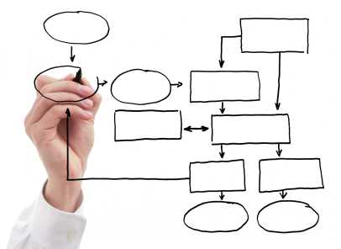
Process Improvement
Service Management implementation is a process improvement
The objective of process improvement is to improve the service
A Continual Service Improvement (CSI) is an ongoing initiatives

Slide 35
Management Commitment
Motivating & leading by example
Authority given to required decision makers
Sponsor & ITSM “champion” assigned
Training
Big picture & long term strategic solution
Realistic implementation timetable
Appropriate tools to support the process
Under Project Management

Slide 36
“A customer is the most important visitor on our premises. He is not dependent on us. We are dependent on him. He is not an interruption of our work. He is the purpose of it. He is not an outsider to our business. He is part of it. We are not doing him a favour by serving him. He is doing us a favour by giving us the opportunity to do so.”
Mahatma Gandhi

Slide 37
Service Culture
A culture is value and beliefs of organization
A service culture means orientation towards helping people
“people don’t care how much you know until they know how much you care”

Slide 38
Customer Service
Customer service is..
providing the right quality of services to meet the customer’s requirement
help customers make best use of these services
being receptive to customer’s needs and problems and provide them with effective support at all time
Tools: Customer profiling

