Slide 1
TEACHING READING FOR CHILDREN
SESSION 6
DR. FEBRIYANTINA ISTIARA,M.PD
PENDIDIKAN BAHASA INGGRIS, FKIP

Slide 2
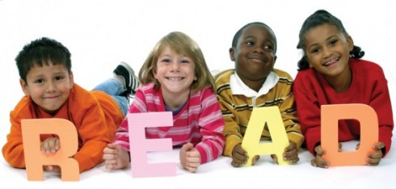
Teaching reading for children
Let’s read read and read !!!

Slide 3
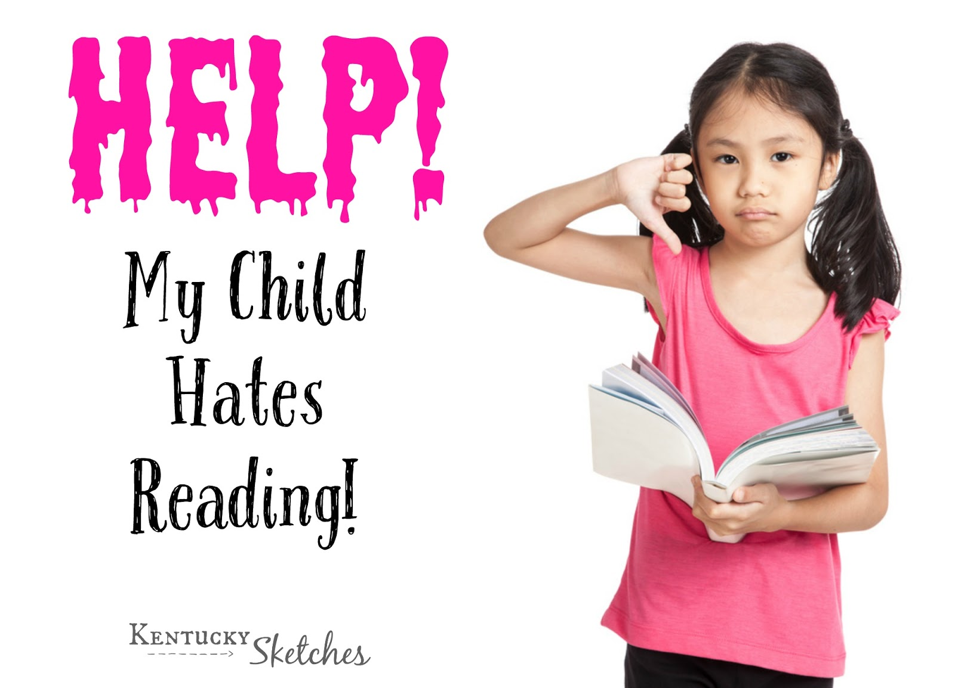

Slide 4
Definition Reading
LEARNING TO PRONOUNCE WORDS
LEARNING TO IDENTIFY WORDS AND GET THEIR MEANING
LEARNING TO BRING MEANING TO A TEXT IN ORDER TO GET MEANING FROM IT

Slide 6
Problems between reading for children
Read to slowly
Don’t have enough have vocabulary
Bored
Would rather watch video and youtube or games
Moody
there are some children who are difficult to manage

Slide 7
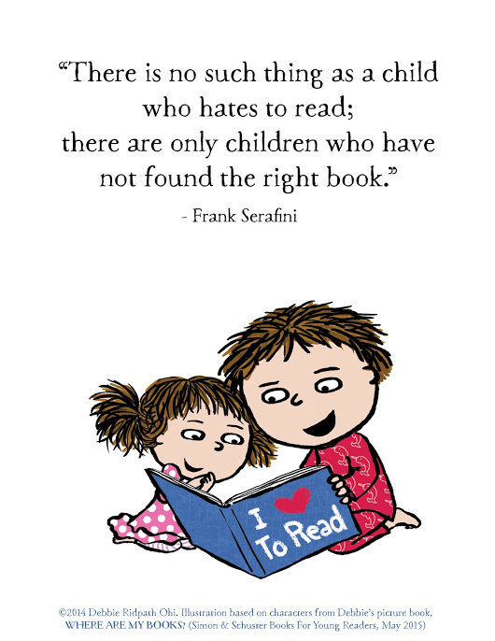

Slide 8
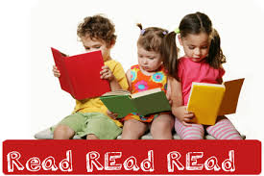
The Principles
Let them choose the material that they want to read which can attract the child's attention to read the book

Slide 9
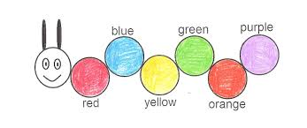
Provide the interesting material and example about color

Slide 10
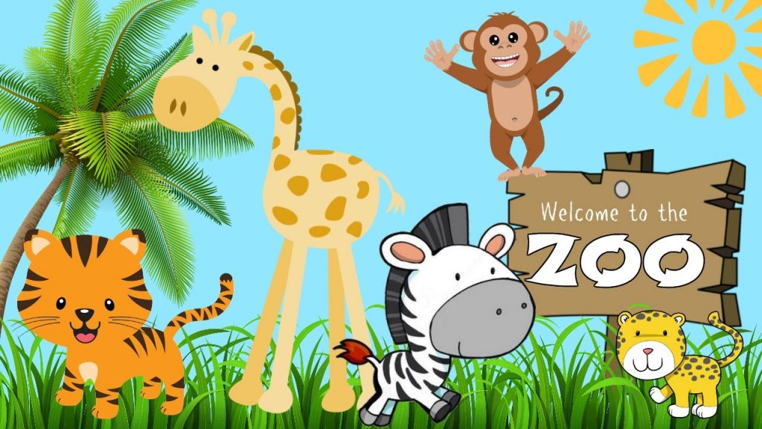
ABOUT ANIMALS (ZOO)

Slide 11
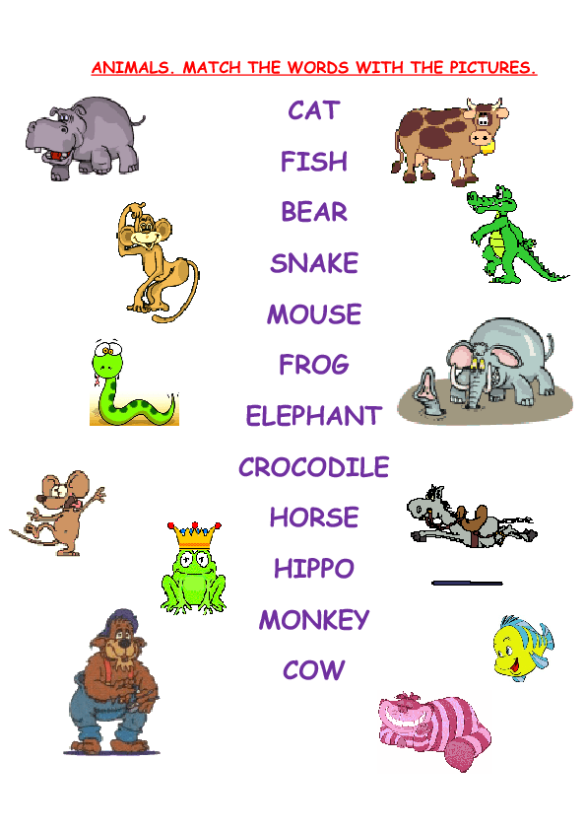

Slide 12
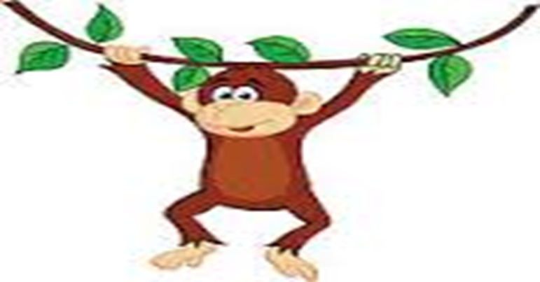
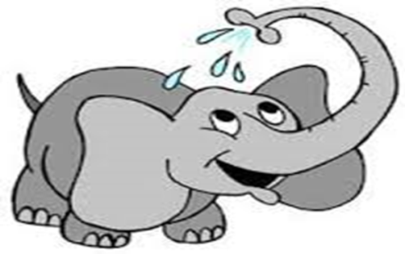
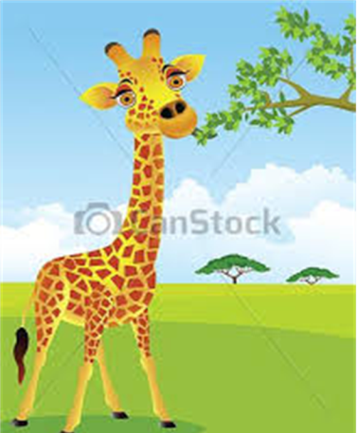

Slide 13
Read the text and answer the questions!
It is a zoo. There are so many animals there. They are elephant, monkey, zebra and giraffe. The monkey can limb. The giraffe can take leaves high. The elephant can take water with its long nose.
Where are the animals?
What animals are there?
What can the monkey do?
What does the giraffe take?
How does the elephant take water?

Slide 14
Reference
https://www.google.co.id/url
https://www.slideshare.net/chindynade1/teaching-reading-to-young-learners

