Slide 1
Sesi Perkuliahan 2
What do you know about graphs?

Slide 2
Steps to explain graphs
Put the title of the graph in the middle of the graph
Explain the horizontal axis or vertical axis
Explain complete information based on the data in graphs.

Slide 3
Pie Chart

Slide 4
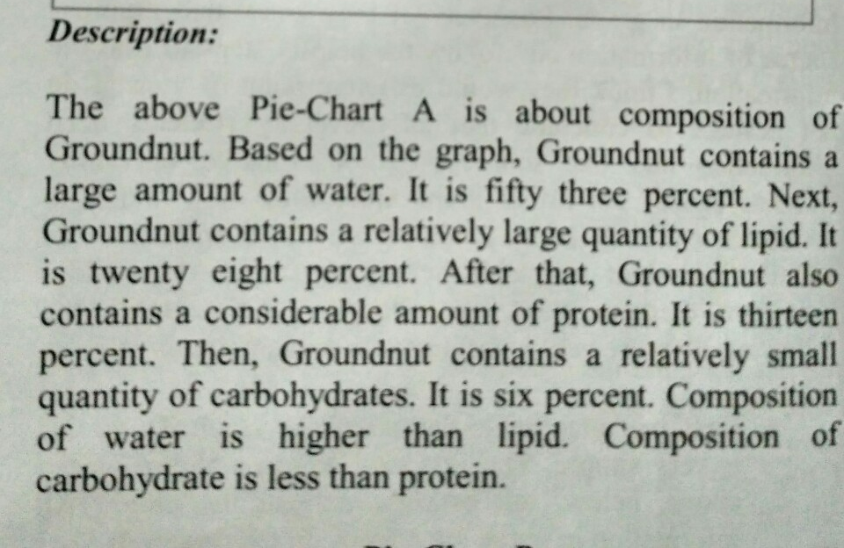

Slide 5
Bar Chart

Slide 7
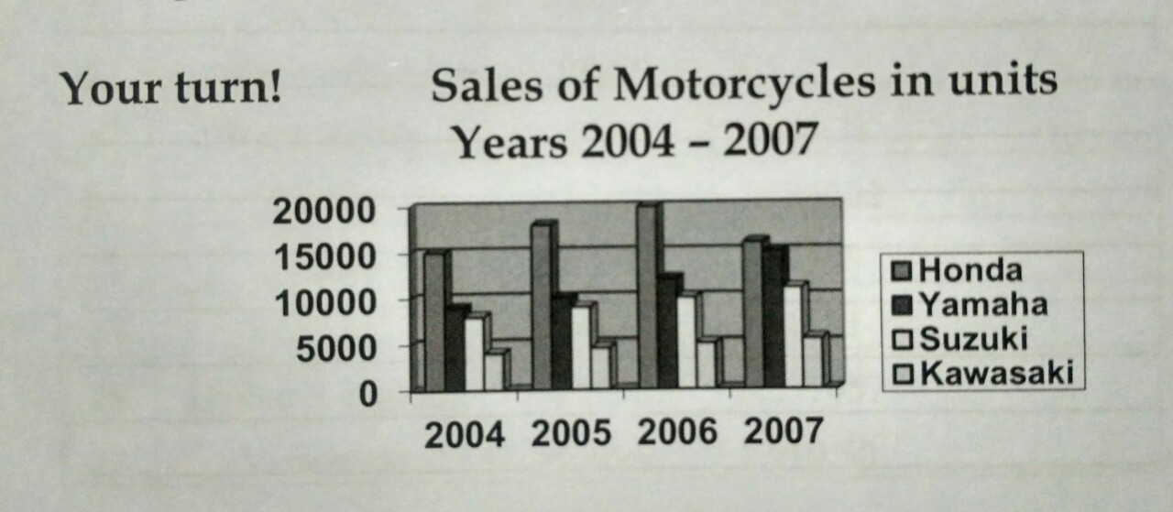
Practice
Pointers

Slide 8
Thank you

