Slide 1
Gizi Kebugaran
Mury Kuswari | Nazhif Gifari
Pertemuan 8

Slide 2
WEIGHT MANAGEMENT
“Weight management is a struggle for many people, but controlling body weight has many health benefits”

Slide 3
Body Mass Index Classification

Slide 4
Energy balance: calories consumed versus calories expended

Slide 5
Weight Management
Weight Management
Maintain
Fat Loss
Weight Loss
Weight Gain

Slide 6
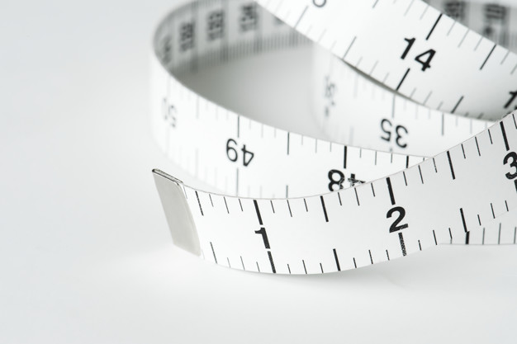
Managing Your Weight After Weight Loss
Consume a low-calorie, low-to moderate-fat diet
Limit consumption of fast food
Eat breakfast every morning
Have consistent food intake from day to day
Eat smaller meals four or five times per day
Weigh themselves regularly and take corrective action as needed
Watch TV less than 10 hours per week
Participate in moderate-intensity exercise for 60 to 90 minutes per day

Slide 7
WHAT IS THE KEY?
Two key points to take away from these findings are the importance of regular physical activity and portion control
Portion control helps ensure that you do not consume excessive calories; this is actually more important than the relative distribution of carbohydrates, proteins, and fats in the diet.

Slide 8
Macronutrient Intake
Carbohydrate’s Effect on Weight
The primary function of dietary carbohydrate is to fuel body activities. The simplest form of carbohydrate found in the human body is glucose (a sugar). Glucose is the sole fuel source for your brain and central nervous system, so it is absolutely critical in your diet.
Glucose also powers skeletal muscle contractions, particularly during intense physical activity. Glucose essentially has three fates in the body: (a) It powers cellular activity; (b) it is stored in the muscles and liver in a different form of carbohydrate called glycogen; and (c) it is converted to fat and stored in adipose tissue throughout the body. Although all three fates occur simultaneously, the third tends to predominate only when carbohydrate ingestion exceeds the body’s energy needs.

Slide 9
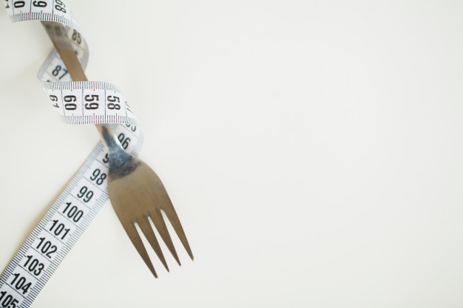
Insulin also has a role in promoting fat storage in the body. Insulin is a hormone released by the pancreas (a small organ located in your abdomen) that helps to store carbohydrate in body cells in response to eating carbohydrates. The higher the concentration of carbohydrate consumed, the greater the amount of insulin secreted into the blood. If you consume a diet high in carbohydrate but not in excess of your energy needs, you will not gain weight.
Many diet books promote a low-carbohydrate diet for weight loss, but current scientific evidence does not support this approach. Most research using low-carbohydrate diets shows significant short-term weight loss, but the long-term success rate is not well established. The failure to exhibit sustained success probably is the result of a very restrictive diet coupled with insufficient lifestyle changes.

Slide 10
Protein’s Effect on Weight
Normally, dietary carbohydrate and fat supply the body with virtually all the fuel it needs, thereby sparing protein for its other important functions. Protein contributes significantly as a fuel source only when blood glucose drops to very low levels, such as during the late stages of very long-duration exercises
Adults should consume protein equal to 10 to 35 percent of their total energy intake. Because dietary protein tends to keep you feeling fuller longer, you should consume protein with each meal and snack in order to curb overeating

Slide 11
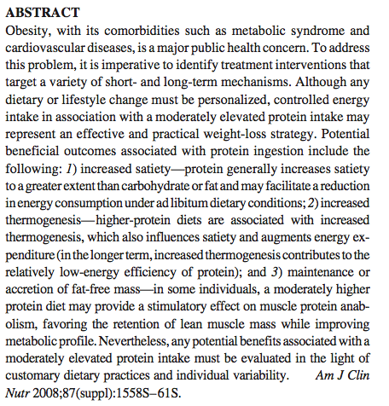

Slide 12
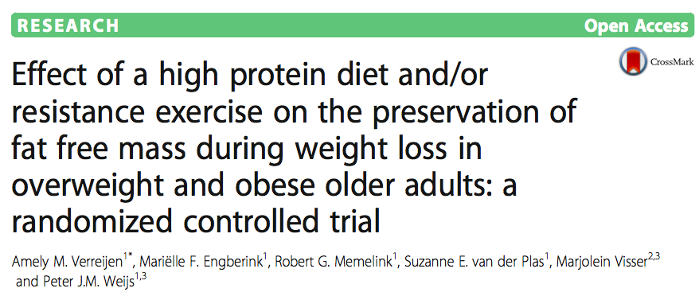
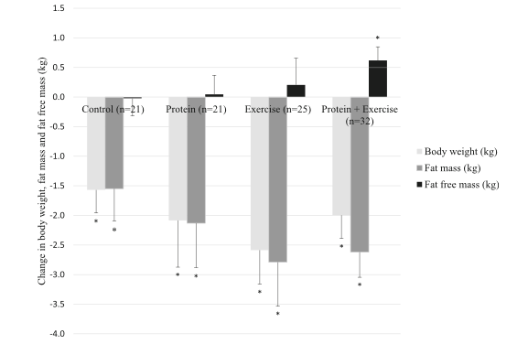
Change in body weight, fat mass and fat free mass in the four study groups
Verreijen et al. Nutrition Journal (2017) 16:10 DOI 10.1186/s12937-017-0229-6

Slide 13
Fat’s Effect on Weight
Similar to carbohydrates, dietary fat provides the body with fuel. The current recommendation for adults is to consume 20 to 35 percent of total energy intake in the form of dietary fat. Also like carbohydrate, fat consumed in the diet has three metabolic roles:
It is used to power the body’s activities,
It is stored in adipose tissue as body fat,
It is converted to an entirely different form called ketones, which some cells can use in place of glucose.
The first two roles are the most common; the third tends to occur only when dietary carbohydrate intake is too low and blood glucose levels fall below normal levels.

Slide 14
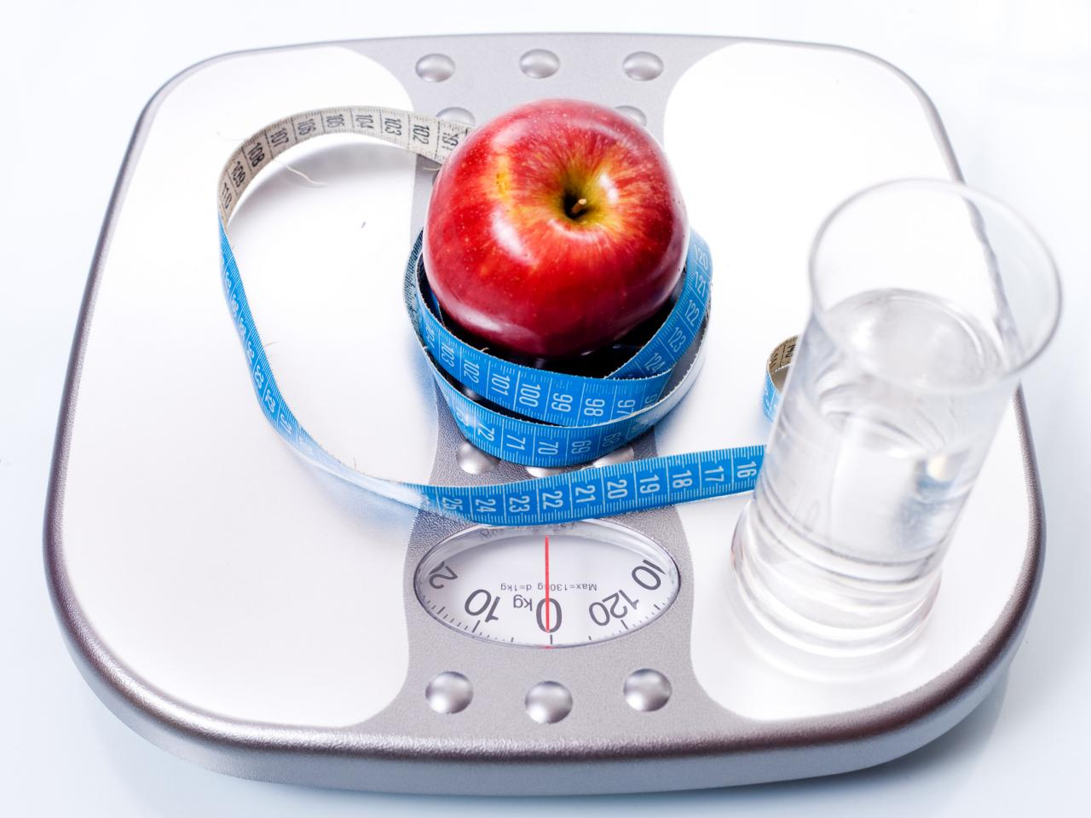
Obesity and Inflammation
New scientific evidence suggests that there may be a relationship between obesity and inflammation.
Anti-inflammatory eating is probably a good idea for the prevention and management of many chronic diseases.
Anti-inflammatory eating includes choosing healthy fats like olive oil, canola oil, nuts, seeds, fatty fish, and omega-3–enhanced products and consuming whole grains, legumes, fruits, and vegetables.
A low-fat diet can be a useful strategy as long as you are not overconsuming other macronutrients. A word of caution about low-fat diets: Low fat does not mean no fat! Some dietary fats are absolutely essential to human life; without them, body cells would literally break apart. This is why current recommendations set a floor at 20 percent of total energy intake.

Slide 15
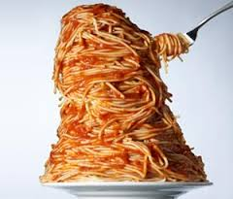
Other Nutritional Strategies for Successful Weight Management
Avoid Fad Diets New diet books appear on the market regularly. If the diets were as easy as promised and resulted in weight loss and long-term maintenance, obesity would not be such a problem. Many of these efforts are just marketing gimmicks without any credible scientific research to support the claims. If the diet seems too good to be true, it probably is.
No single macronutrient distribution works best for everybody. If you find a plan that eliminates or severely limits one of the macronutrients, it is probably a fad diet that will likely fail in the long term.

Slide 16
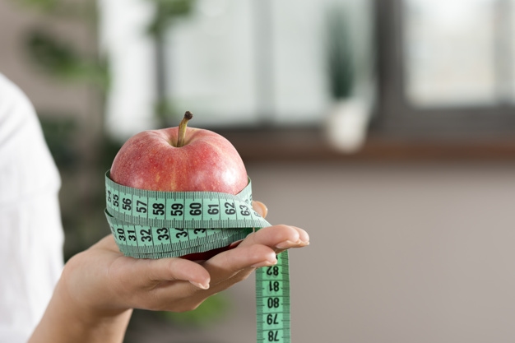
Other Nutritional Strategies for Successful Weight Management
Set Realistic Goals Both weight loss and weight maintenance take work and planning, so be sure to set and regularly revaluate your goals in order to succeed
Pay Attention to Portions There is much evidence that portion control is an effective method for weight loss and maintenance. At first it may seem burdensome to weigh or measure items, but eventually it becomes a habit. A great place to start learning about portions is the Choose Tumpeng Gizi Seimbang.

Slide 17
How to Identify a Fad Diet
They tend to advertise quick and easy weight loss
They have limited food selections or eliminate entire food groups altogether
They use testimonials instead of discussing and referencing sound scientific studies
They may recommend expensive supplements
They are hard to plan for and follow since they require change in habits overnight
They ignore the need to make permanent lifestyle changes
They criticize credentialed health professionals or the scientific community.

Slide 18
Focusing on Physical Activity
Physical activity is important for overall health as well as for long-term weight management
For many years now, it has been widely accepted that physical activity is an important part of any weight management program; however, recent research suggests that more physical activity than previously thought may be required to modify body weight
Aerobic Exercise People desiring simply to prevent weight gain over the long term should engage in moderate-intensity physical activity roughly 150 to 250 minutes per week. This is equal to about 1,200 to 2,000 calories per week. From a practical stand-point, this means exercising at a moderate intensity for 30 to 50 minutes five days per week, burning 240 to 400 calories in each session

Slide 19
Resistance Training
The physical activity guidelines discussed aerobic activities, such as walking or cycling, but resistance training activities are a very important component of physical fitness that should not be ignored.
Although a session of resistance training burns far fewer calories than a session of aerobic exercise does, resistance training has the potential to promote skeletal muscle growth, which contributes to resting metabolism. Although the addition of resistance training to dietary restrictions may not have a major impact, resistance training may improve your muscular strength and physical function, as well as conferring other health benefits
The recommended amount of resistance training is not particular to weight management, so you should follow the guidance, performing resistance training two to three days per week.

Slide 20
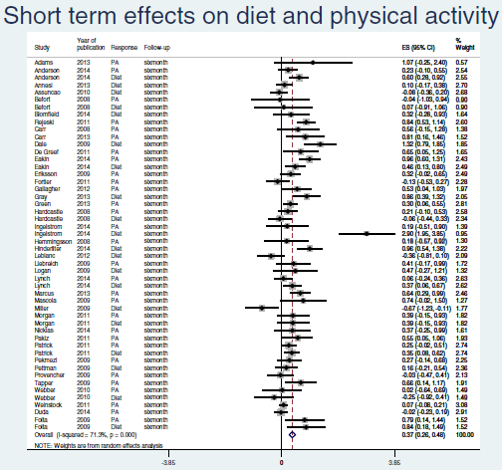
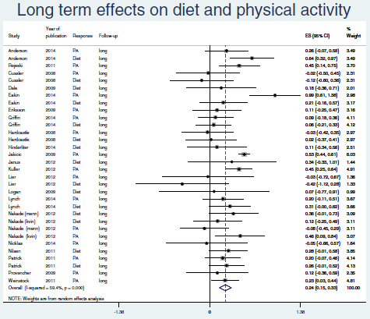

Slide 21
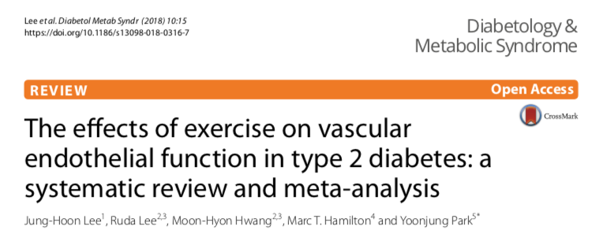
Our results suggest that in patients with T2D, lower intensity exercise has physiological meaningful effects on EF, in support of the emerging concept that the lower efforts of exercise are not necessarily less cardioprotective than higher intensity training.

Slide 22
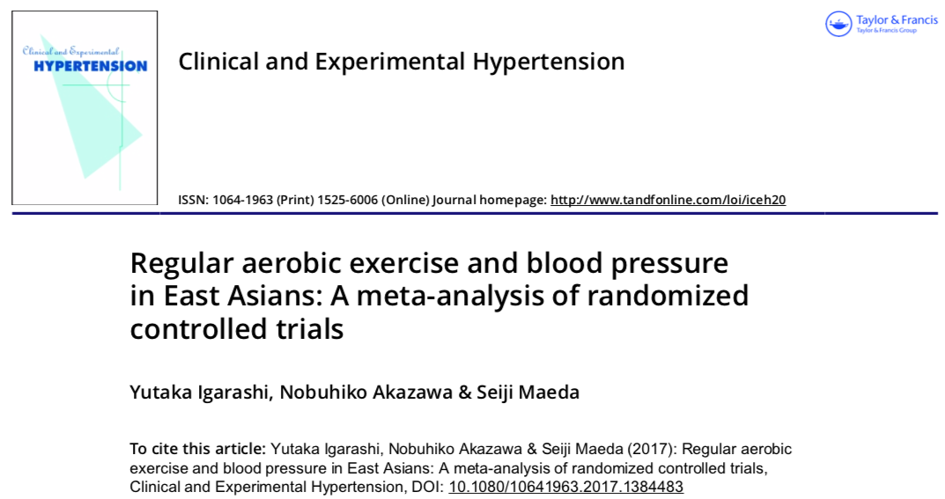
Meta-regression indicated that the change in systolic blood pressure was significantly related to “exercise time × exercise frequency.” The ideal volume of exercise is that for a long time at a high frequency, such as the volume recommended in the America Heart Association and American College of Sports Medicine guidelines: moderate intensity and >150 min per week.

Slide 23
Frequent moderate-intensity aerobic exercise should be recommended for sedentary subjects to avoid risks associated with dyslipidaemia
Regular moderate aerobic exercise is link to reducing the risks of cardiovascular disease.

Slide 24
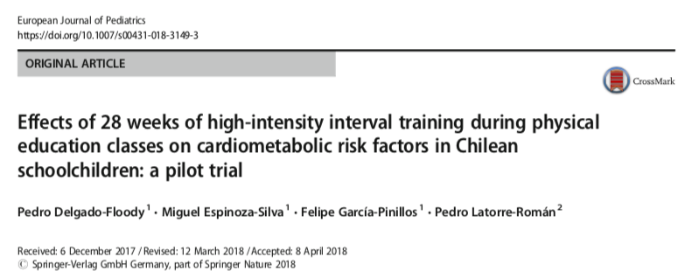
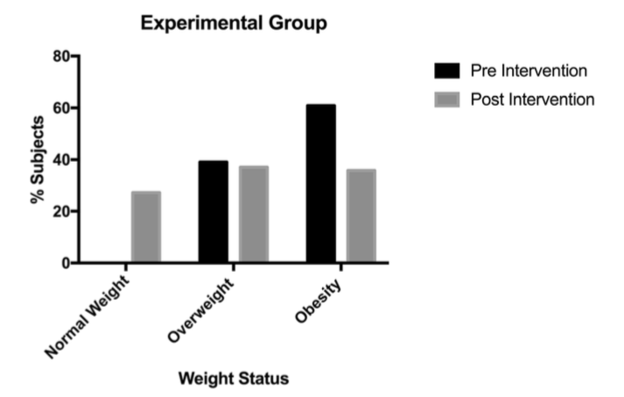

Slide 25
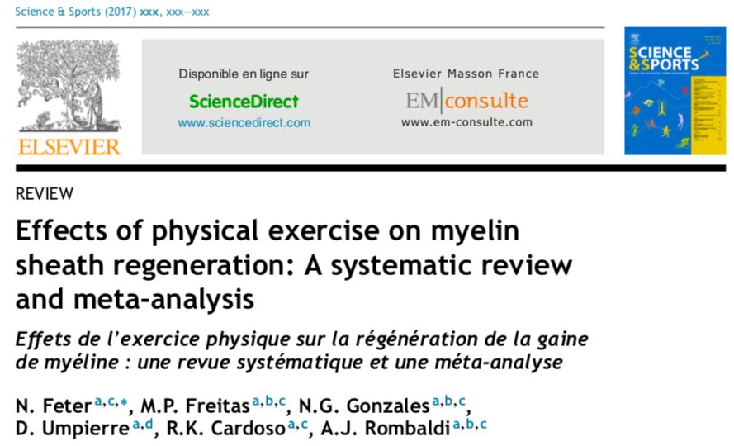
The results suggest that moderate continuous exercise could potentially enhance MSR and improve concentration of myelination-related proteins and as a result, its practice is encouraged to both prevent and treat demyelination.

Slide 26
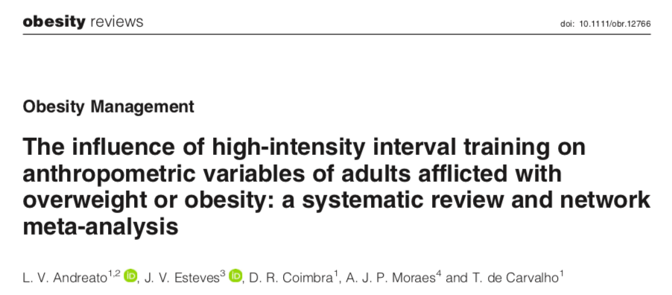
“HIIT promoted results similar to those of MICT, particularly when these two methods were equalized. Although HIIT promoted greater reductions in body mass than did MICT”

Slide 27
High-intensity interval training has the potential to be used as a treatment modality for individuals with prediabetes or T2D. This intervention induces cardiometabolic adaptations similar to those of MICT and provides greater benefits to functional capacity in patients with T2D

Slide 28
@murykuswari
The results obtained with a wide range of HIIT protocols involving normal-weight and overweight/obese subjects suggest that HIIT, especially running, is a time-efficient strategy to decrease fat-mass deposits, including abdominal and visceral fat mass

Slide 29
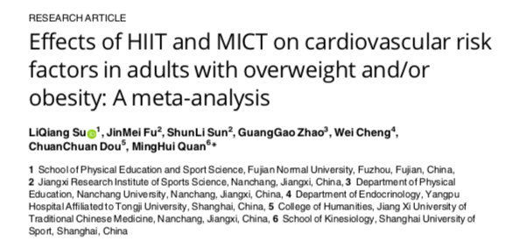
HIIT appears to provide similar benefits to MICT for improving body composition, VO2max and TC, but HIIT spent less time than MICT by 9.7 min on one session of training
HIIT can be considered as a time-efficient exercise mode for managing overweight and obese individuals
HIIT resulted instatistically significant reductions in LDL but not in MICT
HIIT is superior to MICT in improving cardiopulmonary fitness when durations of HIIT training interval > 2 min

Slide 30
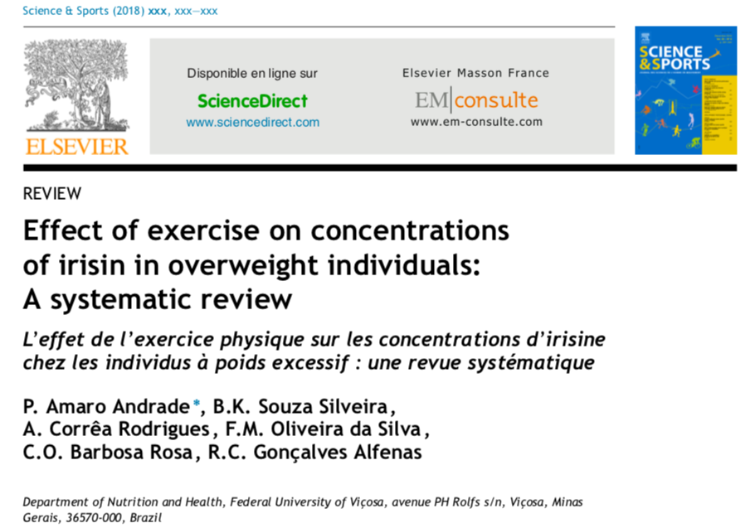
The irisin concentrations in individuals with excess weight increased with acute exercise and remained the same with chronic exercise.
The maximum concentration of irisin occurred between 1 and 2 hours after the exercise was completed.
The protocols of resistance and high-intensity training were more effective.

Slide 31
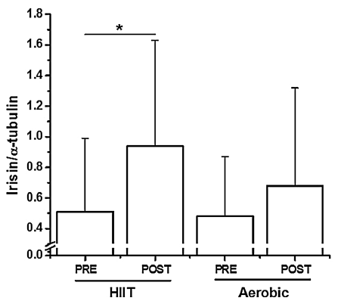

Slide 32
Thank You

