Slide 1
Powerful Marketing Public Relations
Hifni Alifahmi
Email: alifahmi21@yahoo.com

Slide 2
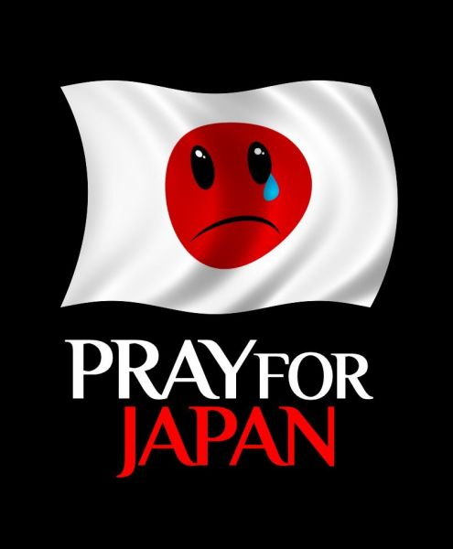
Lifetime Messages
Lifetime Songs:
Pray (Justine Bieber)
Everybody Hurts
We are the World
Another Day in Paradise
You Raise Me Up (Josh Groban)

Slide 3
Marketing Public Relations
Awards,
Anniversaries
Sense of
Marketing
Kolaborasi
CPR-MPR
Corporate
Ad, PSA
Community
Marketing PR
Powerful
Marketing
PR
Marketing PR
Planning
Marketing PR
Strategy
Cause-Related
Marketing
Event
Marketing
Newsworthy
Marketing PR
Sense of
Public Relations
Sponsorship Marketing
Virtual/Interactive Marketing PR

Slide 4
Outline Marketing PR #1
Kronologi dan Konsep Marketing PR (MPR).
Publicity, Marketing & Relationship, Historical PR, Segitiga Emas MPR, Sense of PR in Advertising.
Fungsi dan Posisi Marketing PR.
Era Marketing PR, Fungsi Harmonisasi Iklan dan PR, Lima Model Kolaborasi Marketing dan PR.
Marketing PR Tactics.
A to Z Marketing PR Tactics.

Slide 5
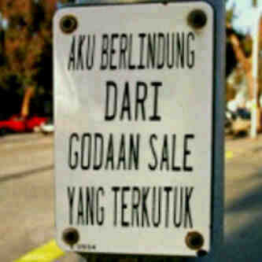
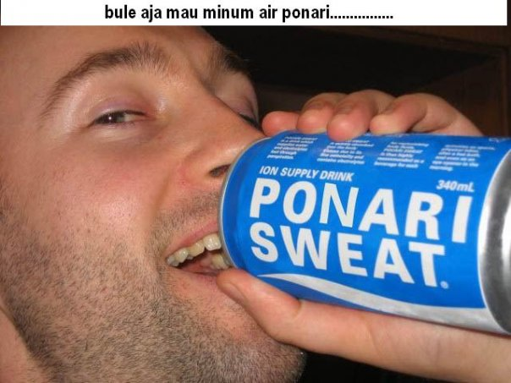
Negative & Bad Publicity/PR

Slide 6
Mengapa Perlu Marketing PR?
Pemasaran dan iklan hanya sebatas mengenalkan, membujuk dan menciptakan preferensi konsumen;
Iklan dan promosi tidak bisa berjalan sendiri-sendiri;
Perlu dukungan kredibilitas pesan-pesan kehumasan terhadap muatan informasi iklan dan promosi;
Kini saatnya kolaborasi insan iklan dan promosi dengan pelaku kehumasan dalam merumuskan strategi dan taktik Humas Pemasaran yang efektif.

Slide 7
Marketing & Relationship
Marketing is organizational function and a set of process for creating, communicating and delivering value to customers and for managing customer relationship in ways that benefit the organization and its stakeholders (American Marketing Association).
The focus on customer relationships and value has led many companies to emphasize relationship marketing, which involves creating, maintaining, and enhancing long-term relationships with individual customers as well as other stakeholders for mutual benefit.
Source: Kotler & Keller, Marketing Management, 12e, 2006: 6.
Belch & Belch, Advertising & Promotion: an IMC Perspective, 2007: 8.

Slide 8
Historical Models of PR
Characteristic | Press Agentry*) | Public Information | Managerial Discipline
Purpose Nature of communication Communications model Nature of research Quote Communications disciplines involved Period | Propaganda One way complete, truth is not essential Source → Receiver Little if any Public be damned Publicity (propaganda) 1800-1899 | Dissemination of information One-way, truth is important Source → Receiver Little, readership readability Public be informed Publicity, media relations 1900-1940 | Persuasion and/or mutual understanding/ accommodation Two-way, (im)balanced effects Source → Receiver ←Feedback, Actor←→Actor Formative attitude evaluation Public be influenced, involved/accommodated Publicity, media relations, employee communications, investor relations, general counsel, government affairs 1940-1990
*) Press Agentry = Publicity
Source: Cornelissen (2004: 35).

Slide 9
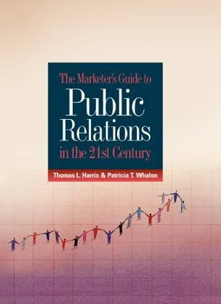
Marketing Public Relations
Marketing Public Relations is the use of public relations strategies and techniques to achieve marketing objectives. The purpose of MPR is to gain awareness, stimulate sales, facilitate communication, and build relationship between consumers and companies & brands.
The principal functions of MPR are the communication of credible information, the sponsorship, and the support of causes that benefit society.
Thomas L. Harris, Value-Added Public Relations: the Secret Weapon of Integrated Marketing, 1998.
Thomas L. Harris, The Marketer’s Guide to Public Relations in the 21st Century, 2006.

Slide 10
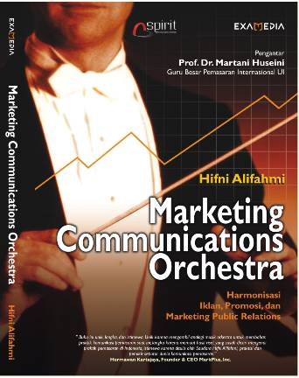
Segitiga Emas Marketing PR
Spirit
Sense
Strategic
Strategic
Marketing Public Relations
Marketing
Public Relations
Sense
Spirit

Slide 11
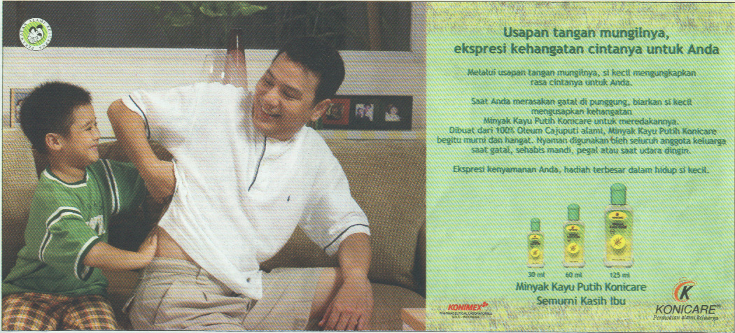
Sense of PR in Advertising

Slide 12
Era Marketing Public Relations
MegaMarketing (Philip Kotler, 1986)
PR in the Marketing Mix, (Jordan Goldman, 1990)
PENCILS: Publications, Events, News, Community Involvement, Identity Media, Lobbying, Social Investment (Philip Kotler, 1991)
Relationship Marketing (Regis McKenna, 1993)
Marketing Corporate Image (James R Gregory, 1993)
Image Marketing (Joe Marconi, 1996)
Reputation Marketing (Joe Marconi, 2002)
Marketing Public Relations, Thomas L. Harris, 1991/1998/2006.

Slide 13
Kriteria Marketing PR
Sentuhan pemasaran simpatik, humanis, peduli sehingga meraih dukungan publik:
Mengundang empati-simpati masyarakat
Bernilai berita tinggi sehingga muncul dalam publikasi media massa
Nuansa spiritual 3N: Naluri, Nalar, Nurani
Mengundang keterlibatan khalayak atau konsumen: stakeholder involvement
Pedang bermata-dua: dua pistol penyampai pesan kehumasan dan kampanye pemasaran

Slide 14
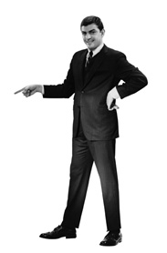
Fungsi Harmonisasi Iklan-PR
Harmonisasi iklan dan public relations, bukan rivalitas dalam strategi, anggaran dan implementasi program
The Rise of PR?
The Fall of Ads?
Advertising is
the wind, uses the big bang, visual, reaches everybody, self-directed, dies, expensive, favors line extensions, likes old names, funny, incredible, brand maintenance.
Public Relations is
the sun, uses the slow buildup, verbal, reaches somebody, other-directed, lives, inexpensive, favors new brands, likes new names, serious, credible, brand building.
Source: Al Ries & Laura Ries, 2002

Slide 15
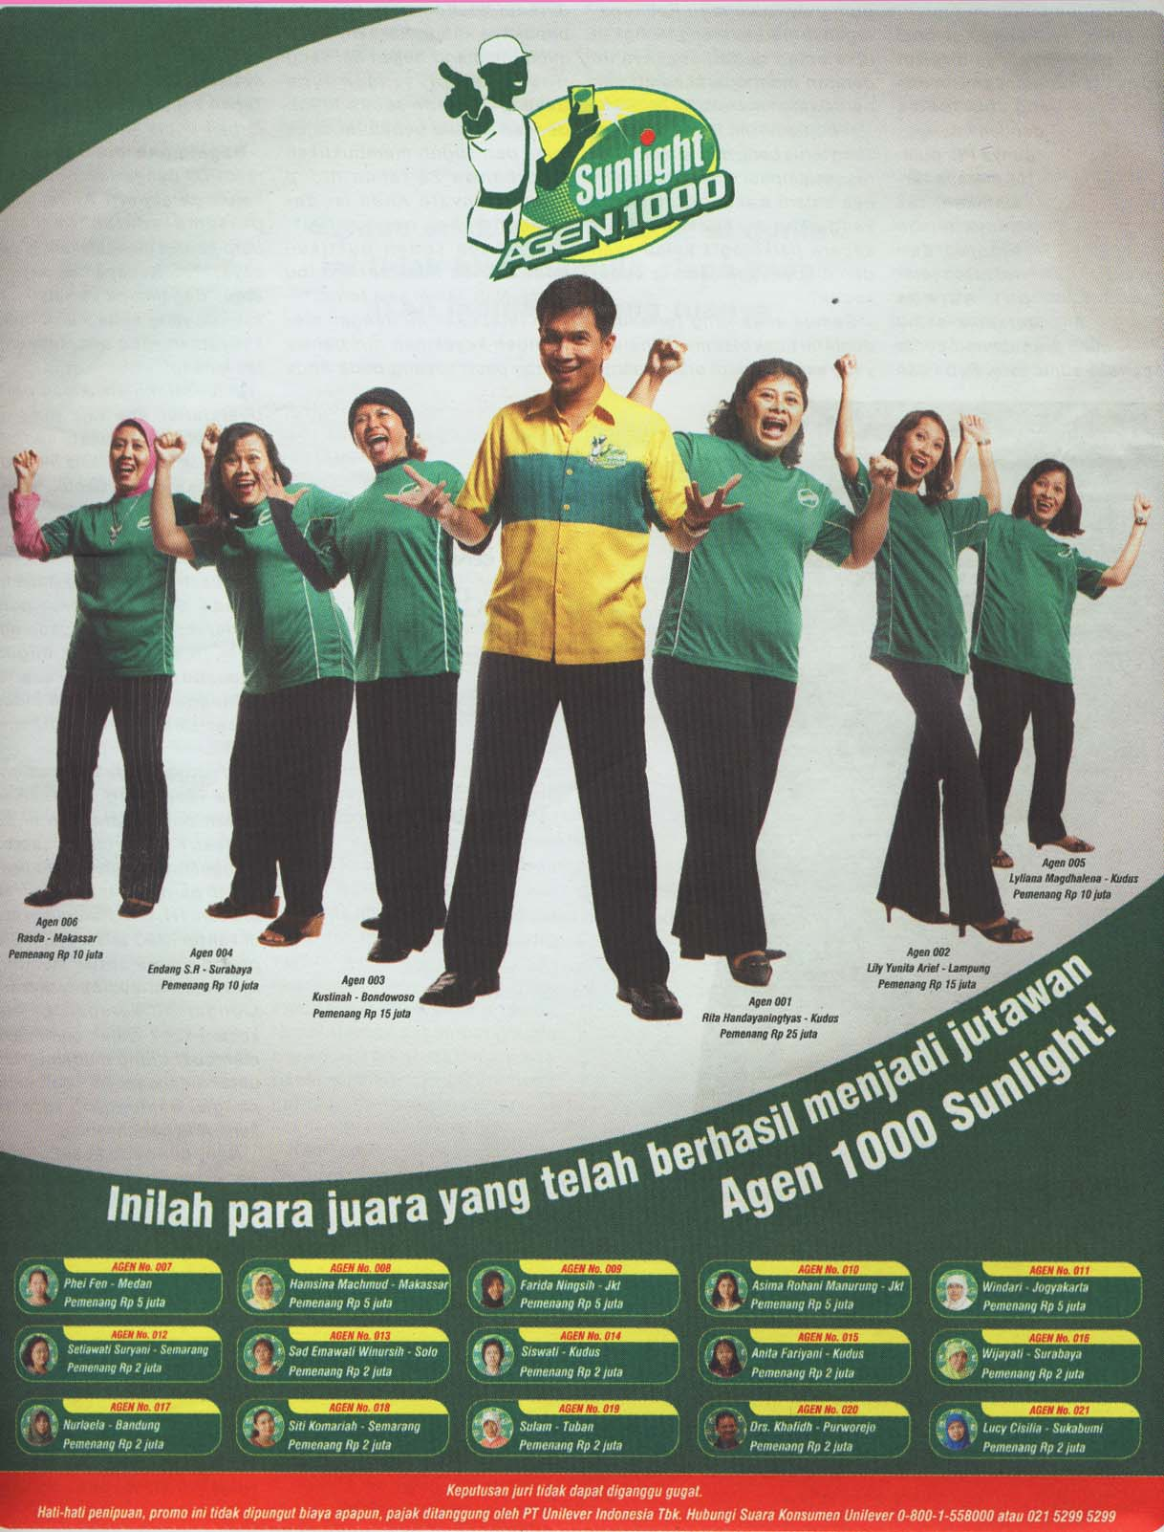
Marketing PR Sunlight
Publikasi negatif
bintang iklan Krishna Murti yang masuk penjara karena kasus. Brand endorser diganti oleh Syahrul Gunawan. Program promosi yang menggaet pelanggan secara berantai dan membangun komunitas ini bernilai PR.

Slide 16
Lima Model Kolaborasi
Marketing & PR
Mkt
PR
Mkt
PR
Separate but equal functions
Equal but overlapping functions
Mkt
PR
PR
Mkt
Mkt=PR
Marketing as the dominant function
PR as the dominant function
Marketing & PR as the same function

Slide 17
Marketing PR: Multivitamin?
Marketing PR perlu dimulai pada jaman normal atau saat aman/berjaya, bukan saat krisis.
MPR dirancang untuk jangka panjang sebagai program berkesinambungan.
MPR bukan antibiotik di masa genting/krisis.
MPR adalah ibarat multivitamin untuk menjaga stamina yang prima.

Slide 18
A to Z Marketing PR Tactics
Advertising, Anniversaries
Annual Reports, Awards
Audio-visual, Brochures
Charities, Conferences
Contests, Case Studies
Books, Success Stories
Demonstrations, E-mail
Event Support, Direct-mail
Fan Clubs, Festivals
Grand Openings, Hotlines
Interactive Software, Kits
Interviews, Launching
Letters to the Editors
Mall Campaign, Milestones
Media Tours, Multimedia
News Conference/Release
Open House, Endorsement

Slide 19
A to Z Marketing PR Tactics
Personal Appearances
Photos, Polls, Posters
Product Placement
Press Kits, Publications
Public Service Ads
Radio Promo, Road-shows
Sampling, Software
Special Events, Speeches
Survey, Sponsorships
Exhibitions, Icons/Mascot
Newsletters, Newsgroups
Promo Materials, Reprints
Press Gathering, Sampling
Seminars, Symposiums
Spokespersons, Signage
Video/Teleconferences
Video News Release
Trade-show, Website

Slide 20
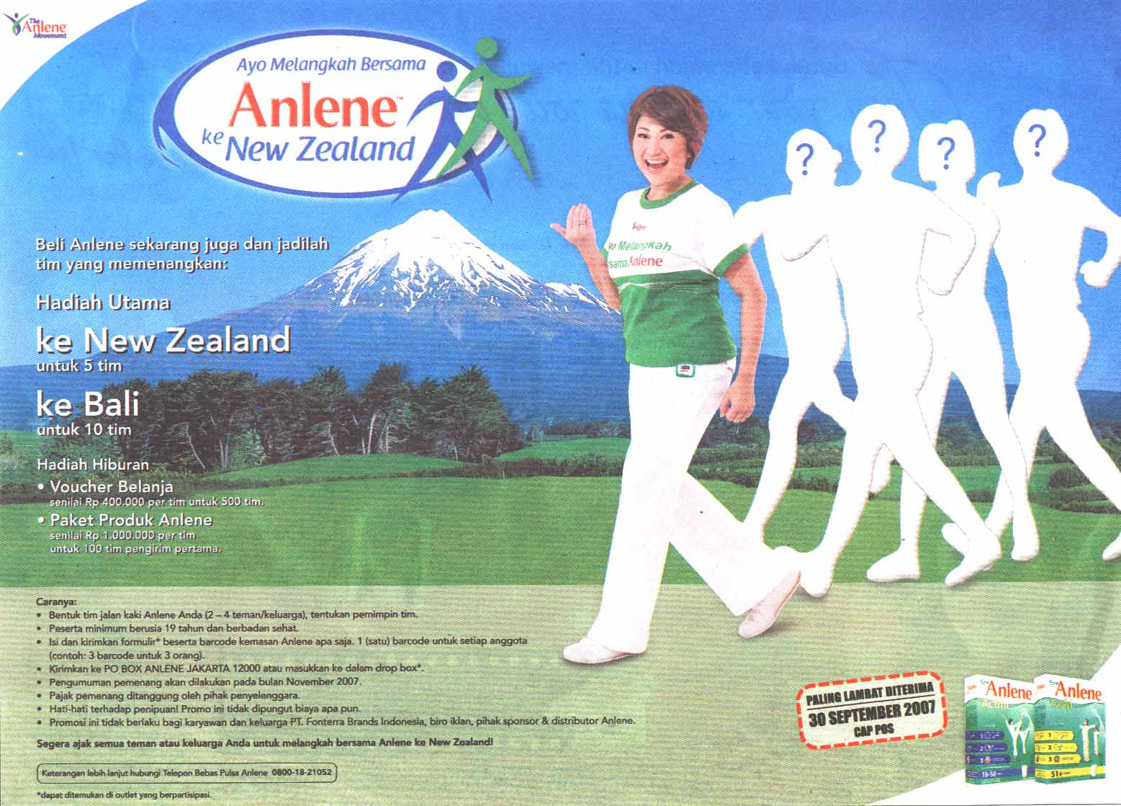
Sports Marketing PR

