Slide 1
TEACHING WRITING FOR CHILDREN
SESSION 9
DR. FEBRIYANTINA ISTIARA, M.PD.
PENDIDIKAN BAHASA INGGRIS, FKIP

Slide 2
Teaching writing for young learners
Writing as a process :
The writing process consist of the steps we take when we produce a piece of writing . The process may include some or all of the following:
Brainstorming (making a note of ideas, words and phrases related to the topic , in the order they come to mind)
Planning (categorizing and ordering the ideas according to the task)
Drafting ( a first attempt to write the ideas as a continuous text)
Revising (deciding how to improve the first draft in terms of both content and accuracy)
Rewriting ( writing the text again including the improvements)

Slide 3
Writing Activities
Controlled writing activities
Straight copying
Matching
Organizing and copying
Delayed copying

Slide 4
Writing Activities
Guided writing activities
Fill-in exercises
Dictation
Letters/cards/invitation

Slide 5
Writing Activities
Free writing activities
Pre-writing activities
Word stars
Vocabulary chart
Description
Letters
Dialogue

Slide 6
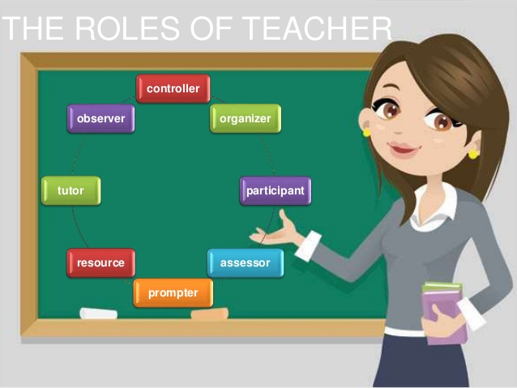

Slide 7
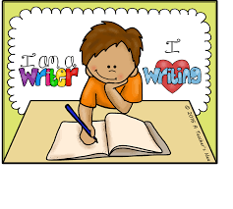
How can you teach very young learners to write?
Letters
Phonics : Put letters together into words
Memorizing words / sight words and other common words

Slide 8
Writing not always easy
You can’t make the same use of body language , intonation tone, eye contact, and all the other features which help you to convey meaning when you talk.
Very little of what you write is concerned with the here and now, which is where many young children exist for a lot of the time.
Many children take a long time to master the skill of writing.
The last comment reflects the fact that writing in a foreign language is all too often associated with “correcting errors”.

Slide 10
How do you teach writing to young EFL learners?
In many classes, attention to writing is very limited.
The teacher gives the learner a title or a topic.
The learner produces a text, and the teacher marks the grammar, vocabulary and spelling mistakes in it.
Writing is then merely a testing tool.
This is perhaps the reason for writing’s “bad reputation” which we mentioned earlier.
Here are some tips for improving this reputation
Pay attention to the writing process by providing opportunities for learners to brainstorm, plan, draft.

Slide 11
REFERENCE
Kay, Penny Mc and Jenni Guse. 2007. Five-minute activities for young learner. UK: Cambridge handbook for language.
Scott, Wendy and Lisbeth Ytreberg. 2010. Teaching English to children. USA: Longman
http://hancockmcdonald.com/sites/hancockmcdonald.com/files/file-downloads/Teaching%20Writing%20to%20School%20Children.pdf

