Slide 1
Best Practise IT Risk Management
Oleh : Yulhendri
Pertemuan - Sesi 13
Sistem Informasi - Fakultas Ilmu Komputer

Slide 4
ENTERPRISE RISK MANAGEMENT

Slide 13
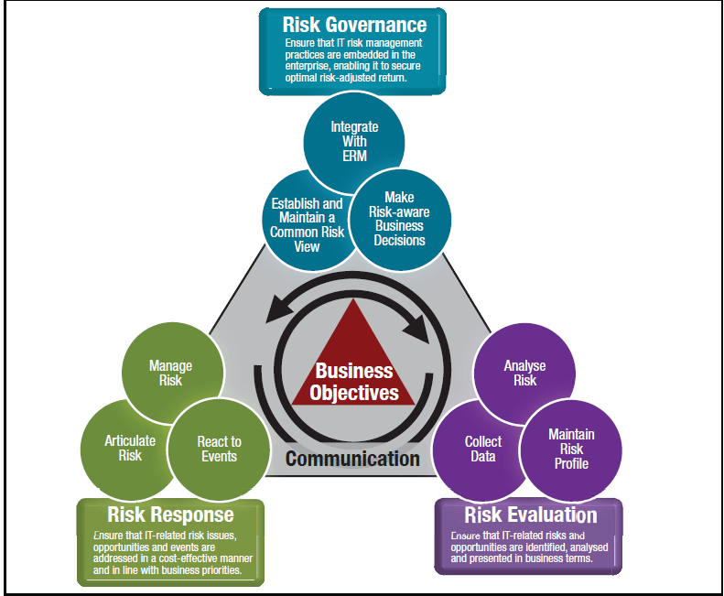
IT RISK FRAMEWORK

Slide 14
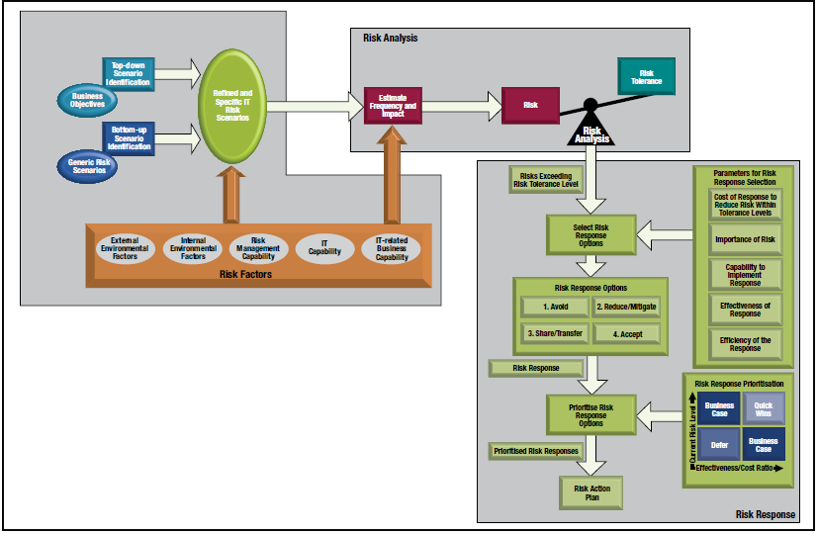
RISK ANALYSIS AND RISK RESPONSE OVERVIEW

Slide 15
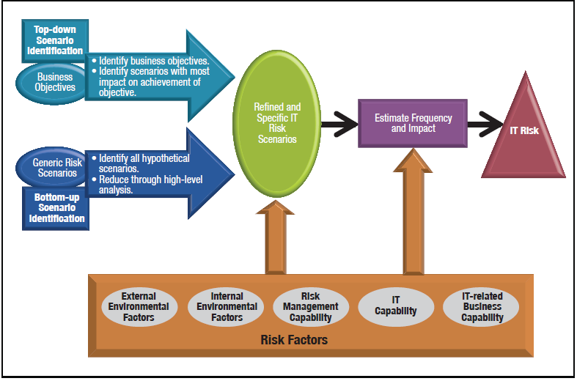
IT RISK SCENARIO DEVELOPMENT

Slide 16
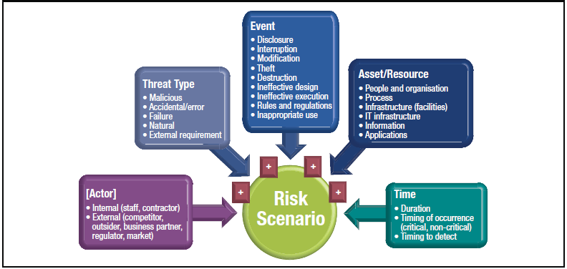
IT RISK SCENARIO COMPONENT

Slide 17
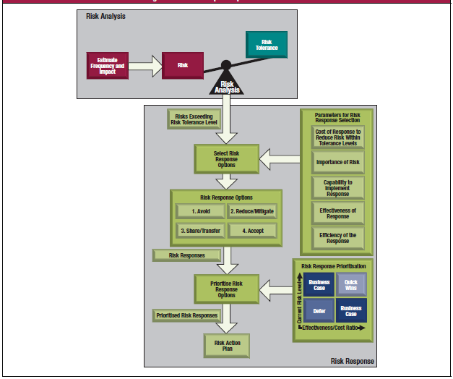
RISK RESPONSE SELECTION AND PRIORITIZATION

Slide 18
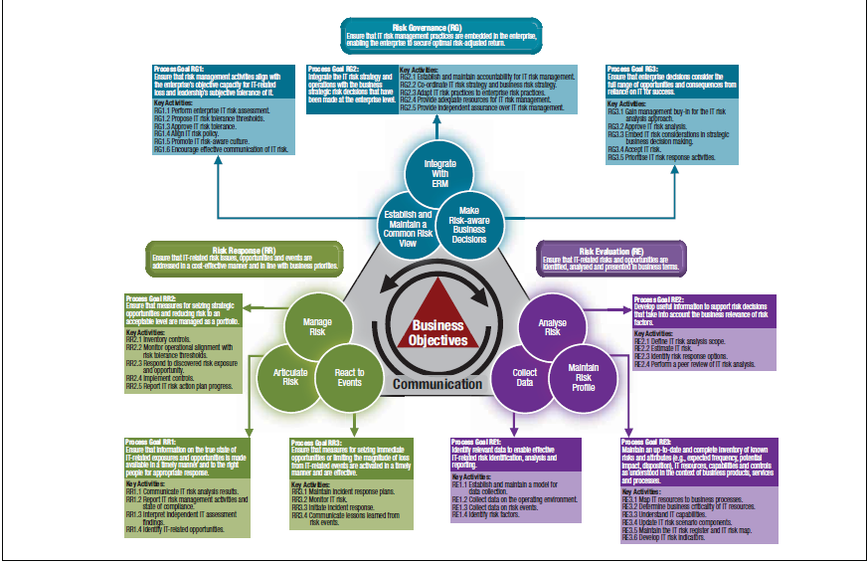
RISK IT PROCESS MODEL OVERVIEW

Slide 19
Terimakasih

