Slide 1
GIZI KEBUGARAN
PERTEMUAN XIII
Program Studi Gizi
Fakultas Ilmu-ilmu Kesehatan

Slide 2
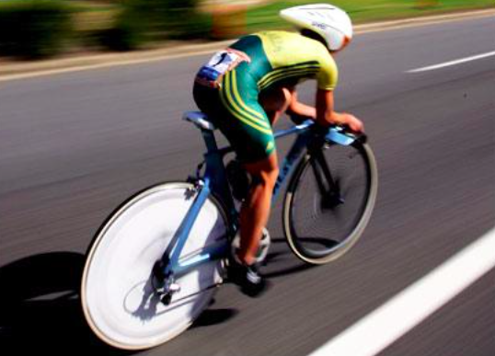
NUTRITION FOR CYCLING

Slide 3
The Olympic Cycling Disciplines
International cycling involves eight disciplines (road, track, mountain bike, cyclocross, BMX, trial, indoor, para-cycling) including a total of 30 different events.
Determinants of performance are very different between the events, of course. In some events, maximum power output is pivotal to success (e.g., track sprint), while in others endurance is of primary importance (e.g., road races and mountain biking). Hence nutrition strategies also vary considerably between the events.

Slide 4
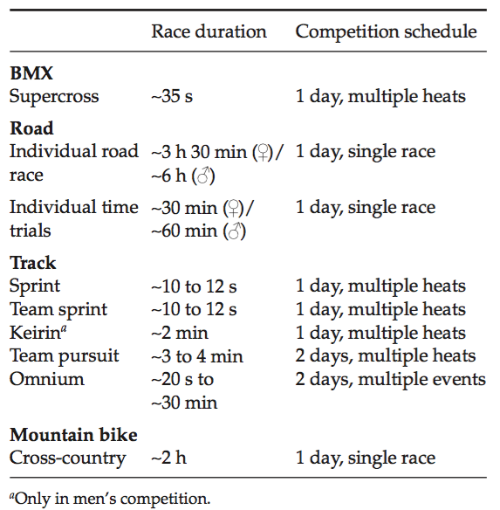
Overview of Olympic cycling events (London 2012)

Slide 5
Goal Sport Nutrition
Prevent (or delay) fatigue
Stay healthy (no colds, flu, etc.)
Enhance Training

Slide 6
Delay Fatigue
Adequate calories
Adequate carbohydrates
Adequate fluids
Adequate sleep

Slide 7
Considerations for Cycling
Rides > 2 hours – need to get calories while on the bike
Calorie needs affected by road surface, terrain, weather, wind resistance, speed or intensity and rider’s fitness level

Slide 8
Carbohydrate for Cyclist
55 – 65% of total calories from Carb
3 – 4 g/kg BB for most athletes

Slide 9
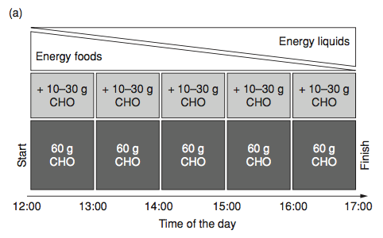
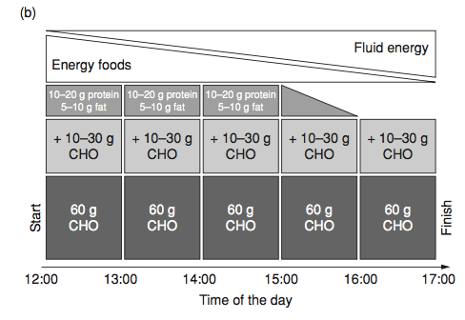
Time plan of carbohydrate intake throughout a 5-hour road race starting at noon in a one-day race (a) versus a stage race (b)

Slide 10
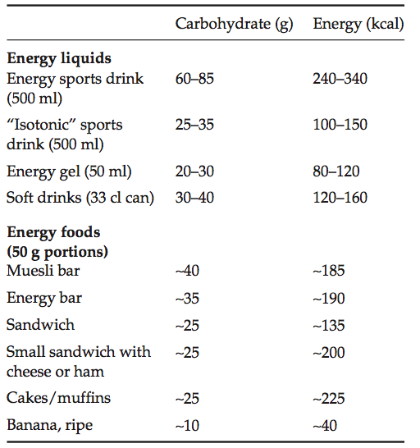
Suggested carbohydrate content and energy values of some typical drinks and foods used during races in elite road cycling

Slide 11
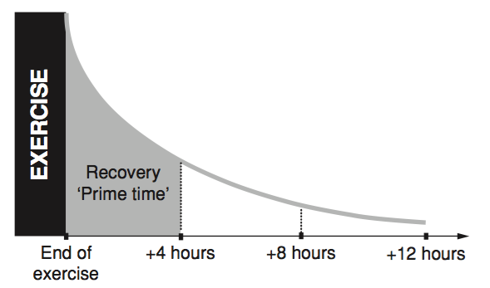
Rapid decline of muscle recovery rate after exercise

Slide 12
Eating to Prevent Fatigue
Quality carbohydrate at each meal
More Fruit and vegetables

Slide 13
Fluid Goals
Drink before thirsty
Watch for signs of dehydration
Dark urine, small volume of urine
not urinating every 2-4 hours
Irritability, headache, fatigue
Weak, dizzy, nausea

Slide 14
Conclusion
Nutrition plays an important role in cycling performance in both training and competition, but nutrition demands between the different cycling events.
In any cycling discipline, the initial 4 hours following exercise are pivotal to facilitate recovery and stimulate training adaptations by deliberate intake of carbohydrates and high-quality proteins. Riders must develop and train a nutrition plan which delivers the amounts of carbohydrates, water, and sodium needed to support optimum performance on race days.
However, in stage races, extra energy intake in the form of proteins and fats is essential to maintaining energy balance and performance capacity against the face of excessive daily energy expenditure.

Slide 15
TERIMA KASIH

