Slide 1
GIZI KEBUGARAN
PERTEMUAN XI
Program Studi Gizi
Fakultas Ilmu-ilmu Kesehatan

Slide 2
ELITE ATHLETE

Slide 3
ELITE ATHLETE
This session addresses the nutritional needs of athletes who have reached the professional, world-class, or Olympic rank in their respective sports.

Slide 4
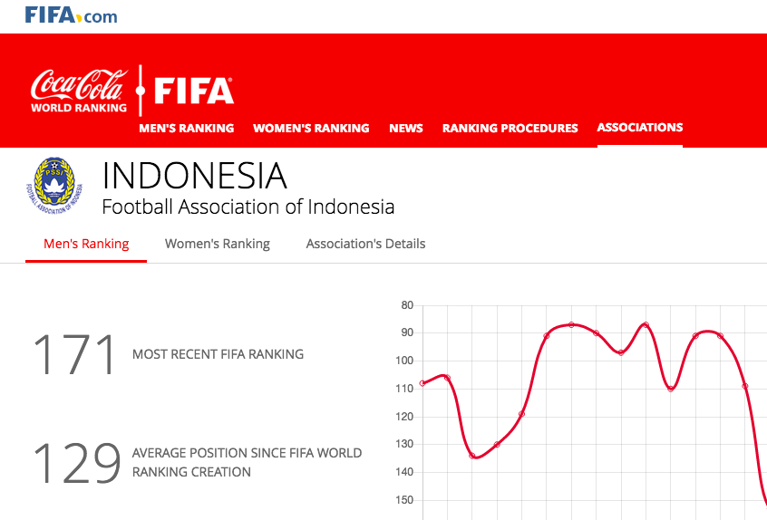
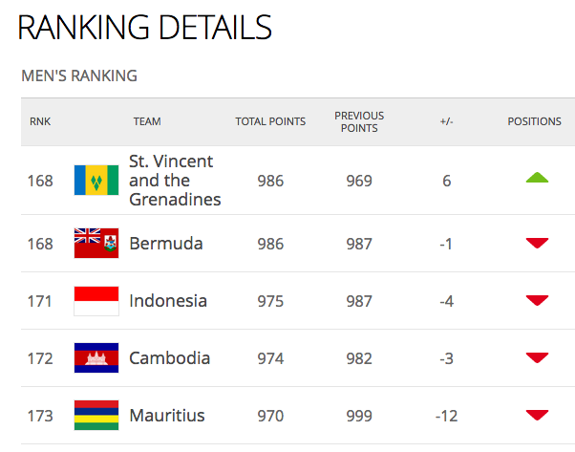

Slide 5
THE STRUCTURE OF HIGH-LEVEL SPORT IMPLICATIONS FOR NUTRITIONAL NEEDS AND PRACTICE

Slide 6
There are several characteristics of high-level sports that create special nutritional needs or challenges for the athletes involved. These include:
Heavy training load
Demanding competition schedule
Frequent travel
Unusual environments for training adaptations or competition preparation (heat, altitude)
The culture of sport (the price and rewards of fame and publicity)
The influence and power of coaches and other personnel involved with the athlete

Slide 7
Elite Athlete Competition Schedules
In general, athletes organize their training to peak at one to three major competitions each year; however, most will compete in many other events each year. Athletes use these lesser competitions to practice and fine-tune their strategies for key events or to provide high-quality training sessions for more important competitions.
During each competition phase, athletes are usually focused on acute issues of refueling and rehydration— undertaking special eating strategies before, during, and after an event to meet the needs of their event.

Slide 8
NUTRITIONAL ISSUES

Slide 10
Nutritional Issues
Elite athletes would meet their increased energy needs and nutrient requirements with well-chosen and varied diets.
Athletes at risk are those involved in weight-controlled or weight-division sports, such as boxing, wrestling, weight lifting, and lightweight rowing, for which preparation for competition often involves severe energy restriction.

Slide 12
An athlete’s energy intake is of interest for several reasons
It sets the potential for achieving the athlete’s requirements for energy-containing macronutrients (especially protein and carbohydrate) and the food needed to provide vitamins, minerals, and other non–energy-containing dietary compounds required for optimal function and health.
It helps the athlete manipulate muscle mass and body-fat levels to achieve the specific body composition ideal for athletic performance.
It affects the function of many body systems related to health and performance.
It challenges the practical limits to food intake set by such issues as food availability and gastrointestinal comfort.

Slide 13
Guidelines to Help Elite Athletes Achieve High Energy Intakes
Meal Spacing
Use a food diary to identify actual intake rather than perceived intake.
Consume carbohydrate during prolonged exercises to provide fuel and additional energy.
Eat a carbohydrate and protein snack after exercise to enhance recovery and increase total daily energy intake.

Slide 14
Guidelines to Help Elite Athletes Achieve High Energy Intakes
Food Availability
Shop for food and prepare meals in advance of hectic periods.
Overcome post-exercise fatigue by preparing meals and snacks in advance.
When traveling, take snacks that can be easily prepared and eaten (eg, cereal and powdered milk, granola and sports nutrition bars, liquid meal supplements, and dried fruit and nuts).
Have snacks and light meals available at home (eg, fruit, fruit smoothies, yogurt, and sandwiches).
Consider specialized products such as sports drinks, gels, and bars during exercise and sports nutrition bars and liquid meal supplements after exercise

Slide 15
Guidelines to Help Elite Athletes Achieve High Energy Intakes
Appetite Management and Gastric Comfort
Reduce gastric discomfort with small, frequent meals.
Drink liquid meal supplements, flavored milk, fruit smoothies, sports drinks, soft drinks, and juices to provide energy, nutrients, and fluids.
Choose energy-dense meals and snacks
Avoid excessive intake of high-fiber foods, which may limit total energy intake or lead to gastrointestinal discomfort.
Overcome appetite suppression with small pieces of food or easy-to-eat foods that do not require considerable cutting and chewing
Consider post-exercise environmental conditions.

Slide 16
Strategies to Cope with the Challenges of Traveling
1. Planning ahead
2. Supplies to supplement the local fare
3. Eating and drinking well en route
4. Taking care with food and water hygiene
5. Adhering to the food plan

Slide 17
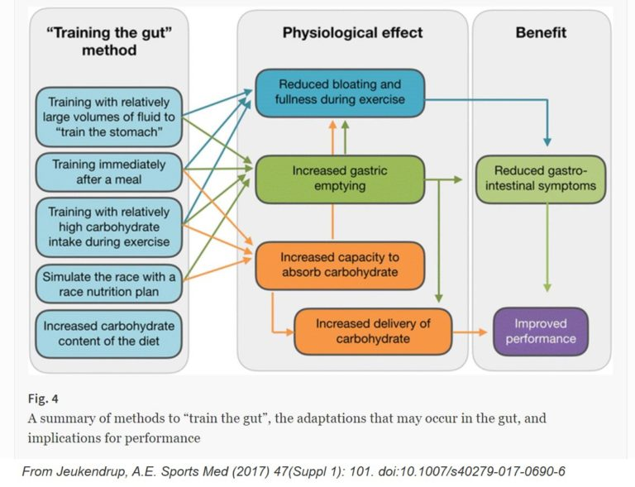

Slide 18
SUMMARY
Working with elite athletes provides an opportunity for the sports dietitian to test his or her sports science knowledge and creativity in solving practical challenges faced by athletes pushing to their extreme limits.
The elite environment can be both high pressure and high return. The sports dietitian will need to remain up to date with the latest scientific information and adhere to a code of conduct that includes understanding of the ethics of sport, respect for confidentiality, and care for his or her own well-being

Slide 19
TERIMA KASIH

