Slide 1
GIZI KEBUGARAN
PERTEMUAN V
Program Studi Gizi
Fakultas Ilmu-ilmu Kesehatan

Slide 2
LEARNING OBJECTIVES
Define the term micronutrient and explain the different categories of micronutrients
Describe the role of electrolytes in athletic performance
List the micronutrients most commonly deficient in athletes
Describe the benefit or lack of benefit of vitamin and mineral supplementation
Explain the importance of water for health and athletic performance.

Slide 3
VITAMIN DAN MINERAL

Slide 4
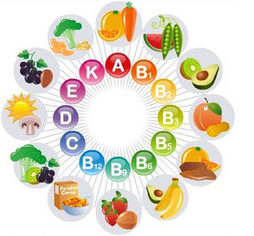
What are vitamins?
Vitamins are required in tiny amounts for growth, health and physical well-being. Many form the essential parts of enzyme systems that are involved in energy production and exercise performance.
Others are involved in the functioning of the immune system, the hormonal system and the nervous system.

Slide 5
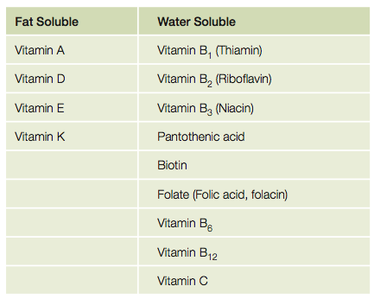

Slide 6
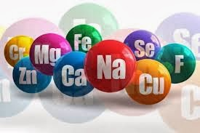
What are minerals?
Minerals are inorganic elements that have many regulatory and structural roles in the body.
Others are involved in controlling the fluid balance in tissues, muscle contraction, nerve function, enzyme secretion and the formation of red blood cells.
Like vitamins, they cannot be made in the body and must be obtained in the diet.

Slide 7
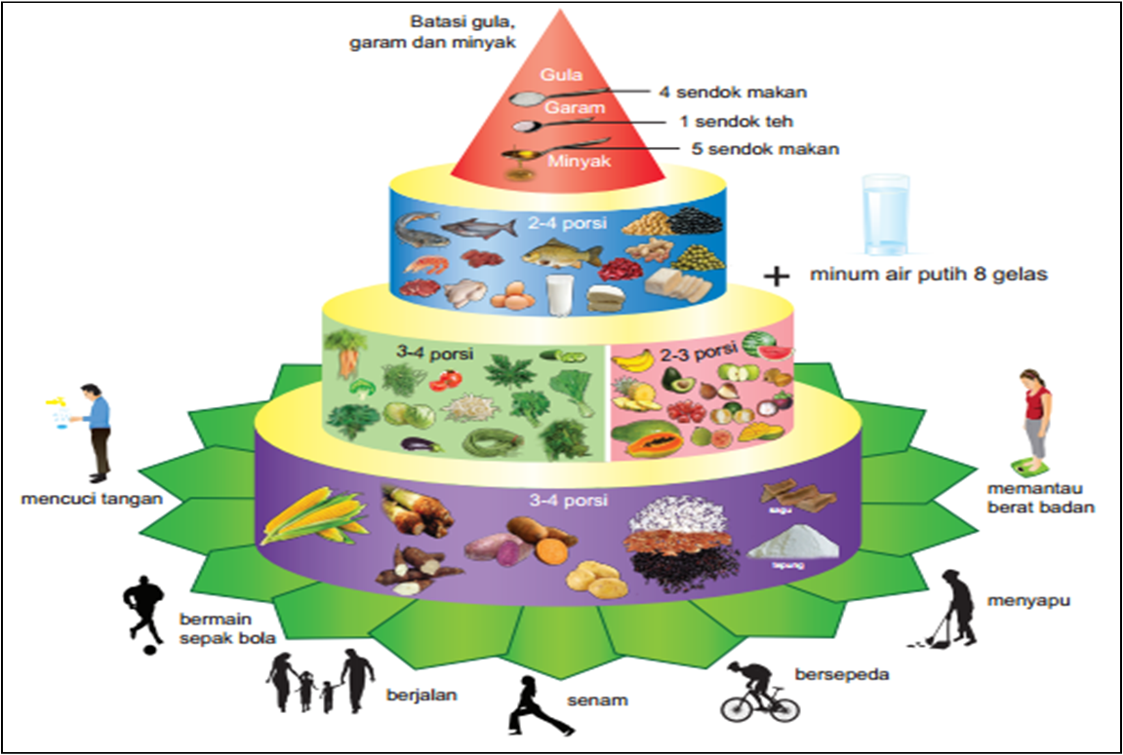

Slide 8
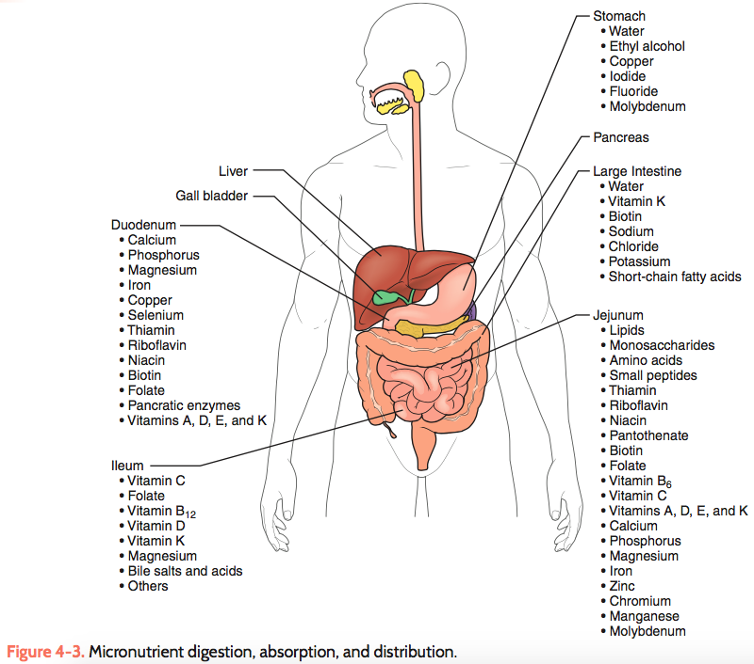

Slide 9
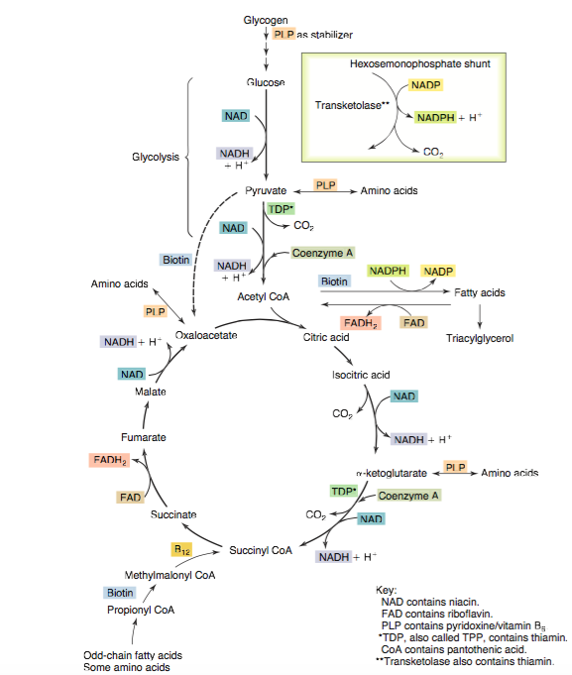

Slide 10
How does exercise increase my requirements of vitamins and minerals?
Vitamin E
is a powerful antioxidant, which prevents the oxidation of fatty acids in cell membranes and protects the cell from damage. Indeed, a study with élite cyclists showed that vitamin E supplementation reduced the amount of free radical damage following prolonged intense cycling to exhaustion, compared with a placebo (Rokitzki et al).
Vitamin C
Vit C has several exercise related functions. It is required for the formation of connective tissue and certain hormones. the University of North Carolina, US found that vitamin C before and after resistance exercise reduced post- exercise muscle soreness and muscle damage and promoted recovery (Bryer & Goldfarb).

Slide 11
The B vitamins thiamin (B1), riboflavin (B2) and niacin (B3)
There are involved in releasing energy from food. Since requirements for these are based on the amount of carbohydrate and calories consumed, athletes do need more than sedentary people.
Vitamin B6
Vit B6 is involved in protein and amino acid metabolism. It is needed for making red blood cells and new proteins so the right amount of vitamin B6 is very important to athletes.
Pantothenic acid (vitamin B5)
is necessary for making glucose and fatty acids from other metabolites in the body. It is also used in the manufacture of steroid hormones and brain chemicals.

Slide 12
Folic acid and vitamin B12
are both involved with red blood cell production in the bone marrow. They are also needed for cell division, and protein and DNA manufacture. Clearly, exercise increases all of these processes and therefore your requirements for folic acid and vitamin B12
Beta-carotene
Is one of 600 carotenoid pigments which give fruit and vegetables their yellow, orange and red colours. Beta-carotene enhances the antioxidant function of vitamin E.
Calcium
Is an important mineral in bone formation, but it also plays an important role in muscle growth, muscle contraction and nerve transmission.

Slide 13
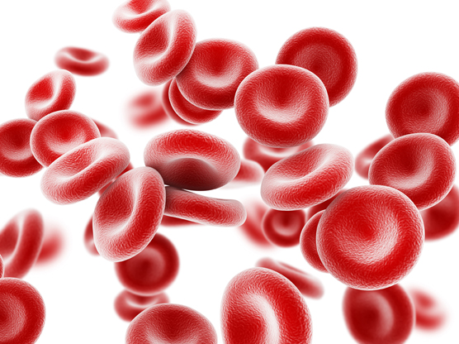
Iron
Is important for athletes. Its major function is in the formation of haemoglobin (which transports oxygen in the blood) and myoglobin (which transports oxygen in the muscle cells). Many muscle enzymes involved in energy metabolism require iron.

Slide 14
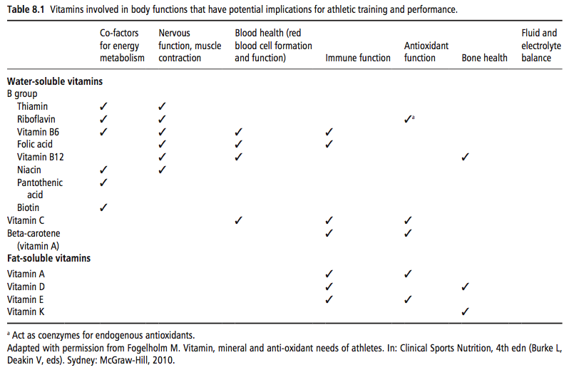

Slide 15
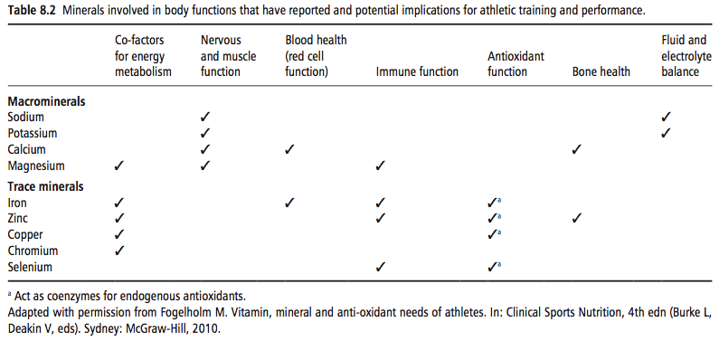

Slide 16
MINERAL

Slide 17
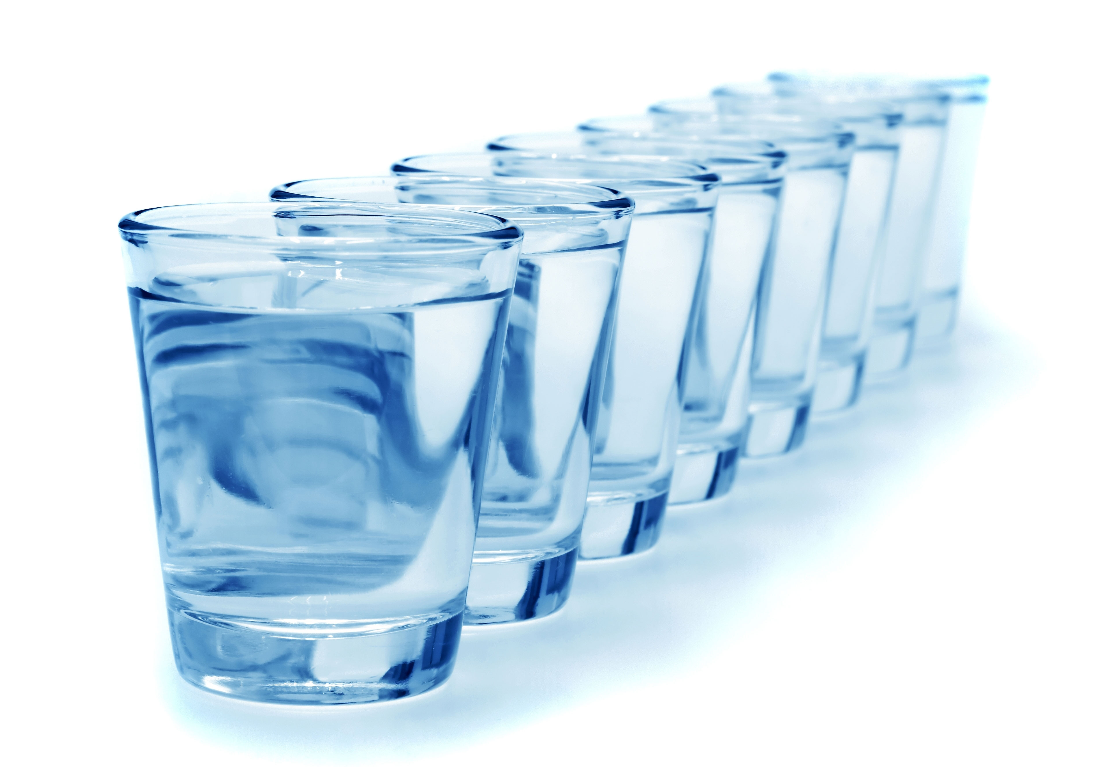
AIR
Water is one of the most important nutrients in your sports diet.

Slide 18
Water & Body fluid regulation by the electrolytes: Sodium, Potassium, Chloride
H⁺
H⁺
H⁺
O⁻ ⁻
H⁺
H⁺
H⁺
H⁺
H⁺
H⁺
H⁺
O⁻ ⁻
O⁻ ⁻
O⁻ ⁻
H⁺
H⁺
H⁺
O⁻ ⁻
O⁻ ⁻
H⁺
O⁻ ⁻
K⁺
H⁺
H⁺
H⁺
H⁺
H⁺
H⁺
H⁺
O⁻ ⁻
Na⁺
H⁺
O⁻ ⁻
O⁻ ⁻
H⁺
H⁺
H⁺
O⁻ ⁻
H⁺
O⁻ ⁻
Cl⁻
O⁻ ⁻
H⁺
H⁺
H⁺
H⁺
O⁻ ⁻
O⁻ ⁻
H⁺
H⁺
H⁺
H⁺
H⁺
H⁺
O⁻ ⁻
O⁻ ⁻
O⁻ ⁻
H⁺
H⁺
H⁺
H⁺
O⁻ ⁻
H⁺
H⁺
H⁺
H⁺
H⁺
H⁺
H⁺
O⁻ ⁻
O⁻ ⁻
H⁺
H⁺
O⁻ ⁻
O⁻ ⁻
H⁺
O⁻ ⁻
O⁻ ⁻

Slide 19
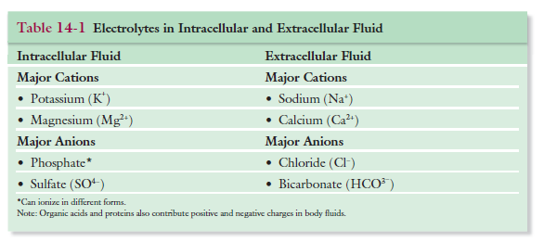

Slide 20
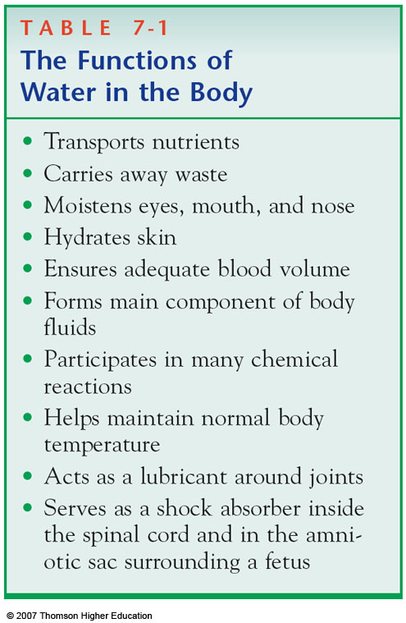
Function
Important functions of water
Makes up plasma, which transports and delivers nutrients to tissues
Maintains body temperature and pH
Maintains blood circulation and pressure
Supports energy processes

Slide 21
Benefits of Water
Athletes lose concentration, coordination, and endurance capacity when they don’t replace water lost from sweat
Water helps regulate body temperature
Helps maintain proper muscle tone by giving muscles their natural ability to contract and by preventing dehydration
Rids the body of excess salt and other wastes

Slide 22
TERIMA KASIH

