Slide 1
GIZI KEBUGARAN
PERTEMUAN VIII
Program Studi Gizi
Fakultas Ilmu-ilmu Kesehatan

Slide 2
TUJUAN:
Atlet anak dan remaja:
Kebutuhan gizi, masalah gizi olahraga anak dan remaja, kebutuhan gizi atlet anak dan remaja, dan konseling gizi khusus atlet anak dan remaja serta masalah kesehatan dan gizi

Slide 3
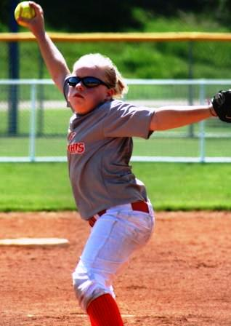

Slide 4
Introduction
Pembinaan atlet secara jangka panjang (LTAD – Long term athletes development), suatu model yang telah dikembangkan dan diterapkan di British Columbia. LTAD adalah hasil pemikiran dari Dr.Istvan Balyi, seorang pakar dalam bidang perencanaan, periodisasi latihan dan peningkatan prestasi melalui program latihan jangka pendek dan jangka panjang

Slide 5
BENEFITS OF YOUTH SPORTS
The benefits of youth sports are numerous and are both physical and psychosocial. Physical activity should be considered an essential component of normal growth and development and should be routinely assessed as a vital sign in the electronic medical record.
Sports can provide an outlet for youth to begin and maintain physical activity. Regular physical activity in the formative years has been shown to be a predictor of a healthier body weight and regular exercise patterns in adulthood.

Slide 6
Bone Density
Regular physical activity is also essential for the development and maintenance of bone mineral density. The osteogenic force of physical activity is related to the local and specific mechanical loading of the bone. The tensile and compressive forces of specific resistance or strength-producing programs can promote bone development.

Slide 7
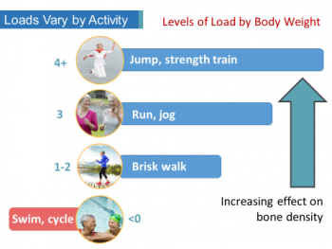

Slide 8
Physical Activity and Obesity
Multiple studies have highlighted the known benefits of physical fitness and nutrition on health, including lower body fat, improved lipids, lower blood pressure, and improved insulin sensitivity in youth. Over the past 25 years, the rate of obesity in US youth has doubled, and the rate in adolescents is even more alarming.

Slide 9
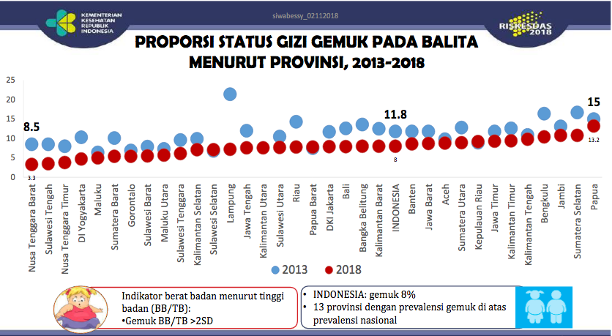

Slide 10
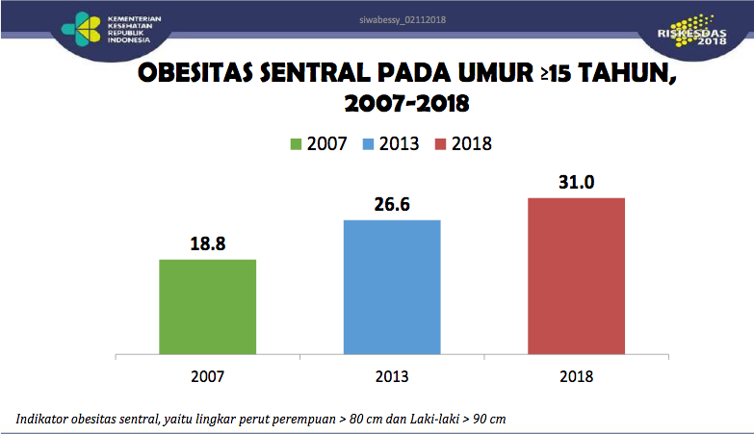

Slide 11
PHYSICAL GROWTH AND DEVELOPMENT

Slide 12
Pre-pubertal Stage
In the pre-pubertal phase or sexual maturity rating, boys and girls share many physical attributes. Body composition analyses are similar between girls and boys, with a percent body fat of 16% to 17% fat and relatively similar amounts of lean weight.
Height, weight, injury risks, hemoglobin levels, and physical attributes of strength and endurance are similar between boys and girls. During the pre-pubertal phase, rate of growth is about 5 cm/y in boys and girls.

Slide 13
Pubertal Development
Puberty is the process of physical and psychological maturation from childhood to adulthood. It is characterized by physical and psychological changes that influence nutritional needs and food choices.
The biological changes include increases in height and weight, body composition changes, increases in calorie and protein needs, sexual development, and increases in skeletal mass and density.

Slide 14
Pubertal Changes Affecting Sports Performance in Females
Increase in percent body fat
Reduced hemoglobin levels
Lung volume and aerobic capacity reduced
Early maturers have increased levels of adiposity
Improved balance and flexibility

Slide 16
NUTRITION ASSESSMENT AND NUTRIENT NEEDS
Calcium & Vitamin D
Iron, Zinc, Magnesium
B Vitamins
Vitamin C, E, Beta carotene, selenium
Sodium, chloride, potassium
Omega 3 Fatty Acids
Use of a multivitamin supplement does not improve performance in athletes consuming nutritionally adequate die

Slide 17
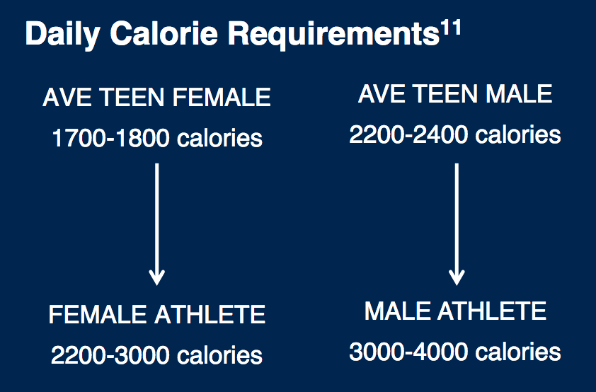

Slide 18
Barriers to Optimal Nutrition in Teen Athletes
Poor knowledge base
Poor organization of food and meal times
Pubertal body changes
Body dissatisfaction
Lack of parental supportLack of financial resources
Obesogenicsociety
Interest in supplements & fad diets
School challenges

Slide 19
TERIMA KASIH

