Slide 1
Pertukaran informasi kesehatan secara spatial untuk populasi kesehatan klinis
Electronic medical record, electronic health record, sharing health record

Slide 2
Introduction of emr
Medical chart or medical record
Comes from the idea of patient information
Why should a doctor write these notes?
Too recall observations, to inform others, to instruct students, to gain knowledge, to monitor performance, to justify interventions
Start from a basic paper (1960)
Used mainly by doctor
Notes:
The data that forms part of an interaction between clinician and patient is stored in a medical chart or medical record. This idea of a medical chart stems from the times of the ancient Greeks. The Greeks used to record all information about the interaction between doctor and patient. They however had to chisel this information onto stone slabs. This as you can imagine was cumbersome and involved lots of effort. It become much easier to record patient information with athe advent of paper by the Chinese.
This all leads to the question why is it important for clinicians to record medical information. Some reasons are To recall observations, to inform others, to instruct students, to gain knowledge, to monitor performance, to justify interventions

Slide 3
Definitions of emr
An electronic medical record (EMR) is a digital version of the traditional paper-based medical record for an individual. The EMR represents a medical record within a single facility, such as a doctor's office or a clinic.
Single computer application for recording and viewing data related to patient care, typically ambulatory
Digital version of the paper charts in the clinician’s office. An EMR contains the medical and treatment history of the patients in one practice.

Slide 4
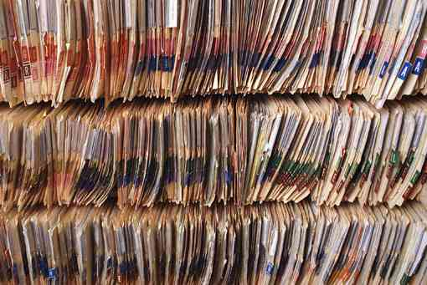
Disadvantages of paper records
Organisational:
Information storage and retrieval
Logistical:
Wear and tear
Back-ups
Can only be at one place at a time
Research
Passive nature
Notes:
In the new century the use of paper poses it challenges. Many of these disadvantages are intrinsic to paper. These disadvantages can be divided into four sections: Organizational, Logistical, Research and the Passive nature of paper. Organizational refers to means in which the data is stored in the chart and also deals with the mechanisms to retrieve the data. In other words I deals with the manner in which we organize the data in such a way that it may be easily retrieved. Logistical refers to the actual use of the data. It deals with concepts like wear and tear, backups and communication of the data. Research refers the way in which data can be used to perform research and the passive nature of data refers to the fact that paper can not actively point out mistakes that may have happened in data entry.
These four aspects will be illustrated with an example. This example is a bit elaborate but there are elements that have actually happened to me. I go to my family doctor in Newcastle, a small town in South Africa. I go to the receptionist and say I want to see the doctor. She then goes to look for my file. Imagine the difficulty of trying to find a chart in a room where there are thousands of charts. Yes in an ideal world it will all be in alphabetical order, but we all know that never happens. I can not keep my single drawer in order, imagine keeping a room full of paper in order. What happens if she cant find my file? A new file is made, but all the data in the old file is lost. Lets assume she has found my file and she gives it to the doctor. I wait a while and then she signals the doctor will see me.
While walking I see a piece of paper on the floor. I pick it up and notice that it is my ecg printout (this is a true story). This poses a confidentiality and privacy problem. What if I did not pick it up? what if it was more sensitive information like the results of an hiv test? Thus the nature of paper may result in security issues.
I finally made my way to the doctors office and his desk was full of heaps of paper charts and pieces of paper. He looks at the chart, diagnoses me, writes on a piece of paper and puts it the the cart. What happens in that piece of paper is not put in the correct order in the chart and the next time the doctor cant find it. The doctor may not be able to read his handwriting. What happens if he makes a mistake while entering data in the chart.

Slide 5
Advantages of emr compare to paper record
Track data over time
Easily identify which patients are due for preventive screenings or checkups
Check how their patients are doing on certain parameters—such as blood pressure readings or vaccinations
Monitor and improve overall quality of care within the practice

Slide 6
electronic health record
Do all those things that EMR do and more.
EHRs focus on the total health of the patient (Medical Record and More)
EHR are built to share information with other health care providers, such as laboratories and specialists, so they contain information from all the clinicians involved in the patient’s care.
Systematized collection of patient and population electronically-stored health information in a digital format

Slide 7
Share health record
The information moves with the patient—to the specialist, the hospital, the nursing home, the next state or even across the country.
The Share Health Records represents the ability to easily share medical/health information among stakeholders and to have a patient’s information follow him or her through the various modalities of care engaged by that individual.
Designed to be accessed by all people involved in the patients care—including the patients themselves.

Slide 8
Benefit of share health records
The information gathered by the primary care provider tells the emergency department clinician about the patient’s life threatening allergy, so that care can be adjusted appropriately, even if the patient is unconscious.
A patient can log on to his own record and see the trend of the lab results over the last year, which can help motivate him to take his medications and keep up with the lifestyle changes that have improved the numbers.
The lab results run last week are already in the record to tell the specialist what she needs to know without running duplicate tests.
The clinician’s notes from the patient’s hospital stay can help inform the discharge instructions and follow-up care and enable the patient to move from one care setting to another more smoothly.

Slide 9
Contoh pengaplikasian share health record

Slide 10
Contoh pengaplikasian share health record

Slide 11
Tantangan dari “share health record”
Hukum
Fasilitas Kesehatan
Fragmentasi
SDM

Slide 12
Common data Elements Included in a Shared Health Record
Tipe Data | Deskripsi
Data Terstruktur | Observasi Klinis
 | Catatan Pelayanan
 | Allergi
 | Resep Dokter
 | Laporan Laboratorium
 | Immunisasi
 | Data Gizi
 | Action Plans
 | Medical History
Data Tidak Terstruktur | Medical Imaging Documents
 | Text Narasi

Slide 13
Indicator of health population
What:
Ukuran yg digunakan untuk membantu menjelaskan situasi yang ada dan mengukur perubahan atau kecenderungan dari waktu ke waktu
Indikator kesehatan merupakan pengukuran kuantitatif, terkadang kualitatif
Diperlukan:
Melakukan analisa situasi terkini
Membuat perbandingan
Mengukur perubahan dari waktu-waktu
Menganalisa komitmen terhadap kebijakan-kebijakan sosial ekonomi & yankes dasar
Memantau kemajuan dari implementasi program kes
Mengevaluasi dampak terhadap status kesehatan dari populasi.

Slide 14
Fungsi indikator kesehatan
Alat untuk membandingkan perbedaan antar daerah dan mengukur kemajuannya→meningkatkan status kesehatan
Dapat menunjukkan perbedaan status kesehatan antar kelompok dlm populasi: antara kaya dan miskin, atau urban dan rural.

Slide 15
Model arsitektur SHR menggunakan openmrs software

Slide 16
Contoh Model share health record di indonesia
LINTAS
SEKTOR
KEMENTERIAN
KESEHATAN
BPJS
KESEHATAN
Optimalisasi Aliran dan Integrasi Data
DINKES
PROV
DINKES
KAB
RUMAH
SAKIT
(FKTR)
PUSKES
MAS
(FKTP)
JARINGAN
PUSKES
MAS
JEJARING
FASYANKES
(FKTP)
Penataan
Data Transaksi
Peningkatan
Pemanfaatan
Data/Informasi
Masyarakat/Keluarga

Slide 17
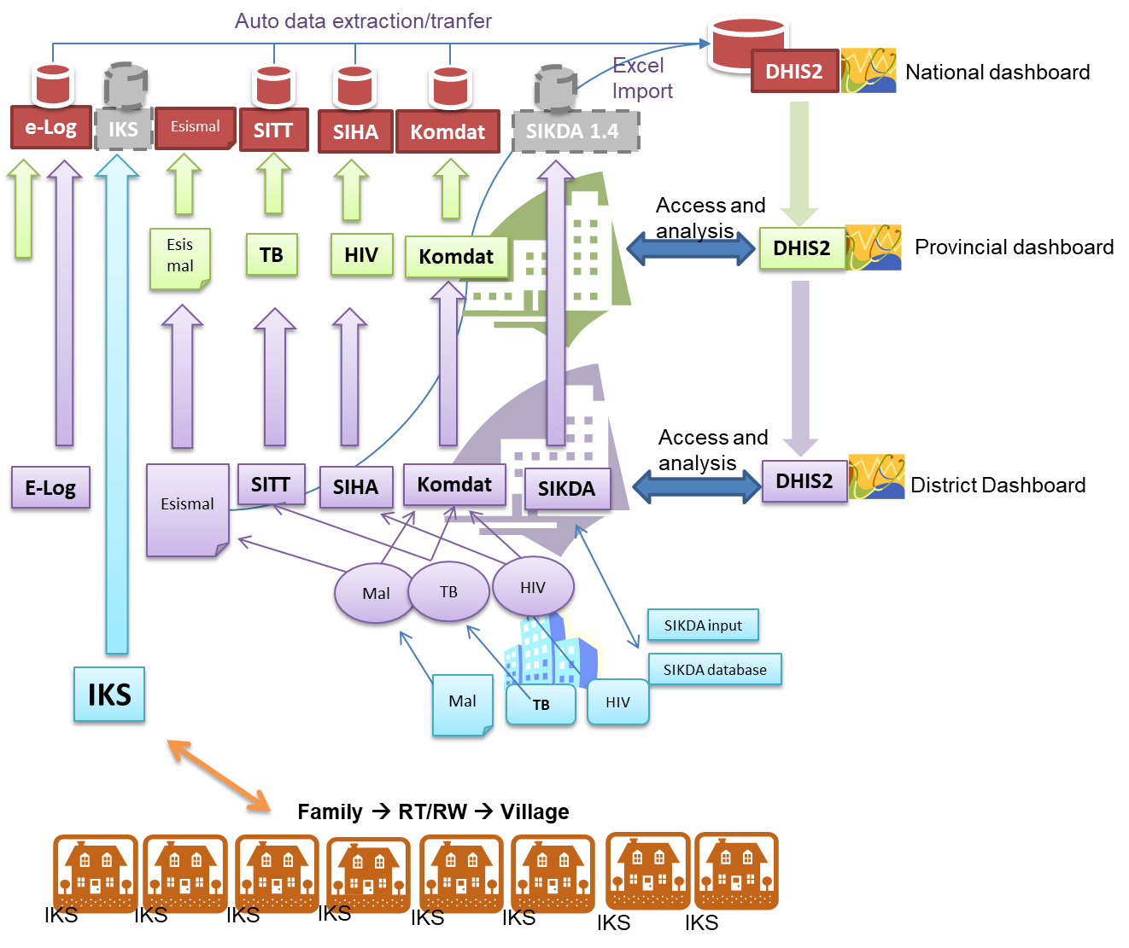
Model sharing/ integrasi data kesehatan di indonesia

