Slide 1
GIZI KEBUGARAN
PERTEMUAN X
Program Studi Gizi
Fakultas Ilmu-ilmu Kesehatan

Slide 2
The Vegetarian Athlete

Slide 3
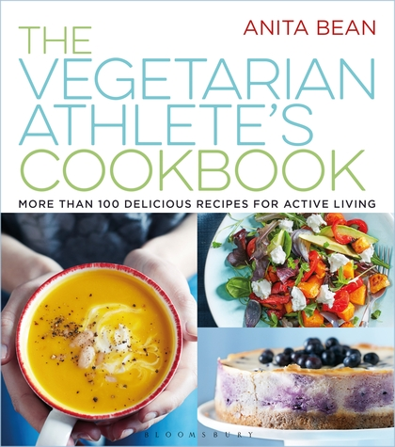
All athletes, vegetarian or non-vegetarian, need to consume a diet that includes a wide variety of foods in moderation from all food groups in order to obtain the essential nutrients needed for health and sports performance

Slide 4
Classification of various vegetarian diets
DIET | FOOD PATTERN
Semi-vegetarian | Avoids some but not all groups of animal-derived food. Red meat is most often excluded or consumed in limited amounts
Lacto-ovo vegetarian | Consumes milk and milk products as well as eggs. Avoids meat, poultry, fish, and seafood
Ovo vegetarian | Eggs are included but meat, poultry, fish, seafood, and dairy products are avoided
Lacto vegetarian | Dairy products are included but does not eat meat, poultry, fish, seafood, or eggs
Vegan | Avoids all animal-derived foods including meat, poultry, fish, seafood, eggs, milk, and milk products

Slide 5
Untuk memenuhi kebutuhan zat gizi pada atlet vegetarian maka dalam perencanaan menu seorang vegetarian harus memperhatikan hal – hal berikut ini:
Memilih bahan makanan yang bervariasi dan terdiri dari serealia, kacang-kacangan, biji-bijian, sayur dan buah.
Kebutuhan asam lemak esensial dapat dipenuhi dengan mengutamakan pemilihan bahan makanan seperti kacang-kacangan, biji-bijian dan alpukat.
kebutuhan vitamin B12, kalsium, zat besi, serta beberapa asam amino esensial.

Slide 6
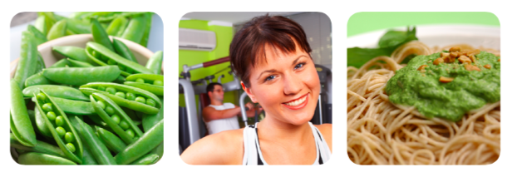
Pada atlet vegetarian yang membutuhkan energi dalam jumlah tinggi, jika semua kebutuhan dipenuhi dari makanan yang bersumber nabati, berisiko menyebabkan terjadinya bulky. Pada kondisi ini disarankan untuk mengatasi defisiensi beberapa zat gizi seperti tersebut diatas sebagian dapat dipenuhi dalam bentuk suplemen.

Slide 7
Optimal exercise training and performance depend on good nutrition
For optimal performance, the athlete’s diet should contain mostly whole or minimally processed foods and be high in carbohydrate, low to moderate in fat and adequate in protein, vitamins, minerals and fluid.
A vegetarian diet easily meets these requirements and may offer additional health and even some performance advantages. For example, vegetarian diets are linked to decreased risk for chronic diseases including cardiovascular disease, type 2 diabetes, and certain cancers, while their naturally high carbohydrate and phytochemical content may help athletes optimize their training, performance and recovery.
The key is choosing a variety of whole- and minimally-processed grains and cereals, fruit, vegetables, legumes, soy products, nuts and seeds, and if desired, dairy and eggs.

Slide 8
Carbohydrate: The Fuel of Choice
Carbohydrate should make up the bulk of the athlete’s diet. Carbohydrate is needed to feed our muscles and brain. Research shows that carbohydrate—which is converted to instant fuel— helps athletes perform their best.
A vegetarian diet is naturally carbohydrate-rich with whole grains, pasta, rice, bread, cereal, vegetables (including high starch vegetables like corn, winter squash and sweet potatoes), and fresh and dried fruit.

Slide 9
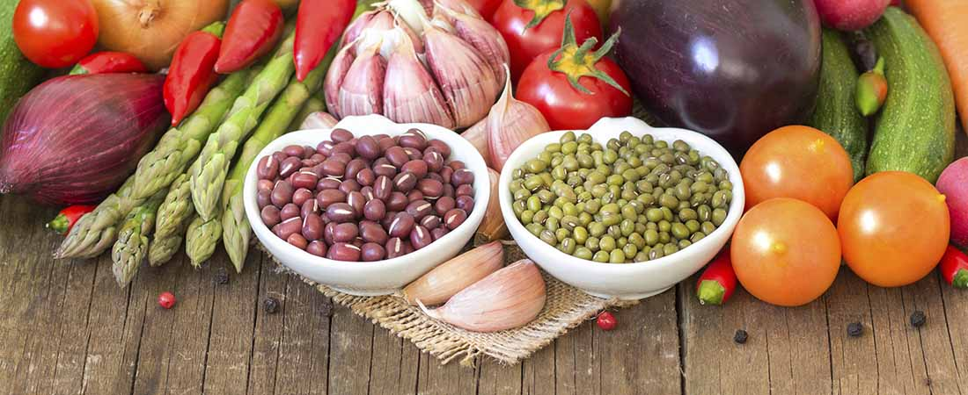
Protein
Vegetarian athletes can easily meet protein needs as long as the diet meets energy (calorie) needs and contains a variety of protein-rich plant foods such as legumes, soy foods, nuts, seeds and whole grains. Egg and dairy foods can be included as desired.
Vegetarian athletes who restrict calories to lose weight should include protein- rich foods at most meals. All athletes should eat a snack or meals rich in protein and carbohydrates after hard training to enhance recovery and replace glycogen stores. Recommendations for endurance and strength-trained athletes range from 1.2-2.0 g/kg body weight per day.

Slide 10
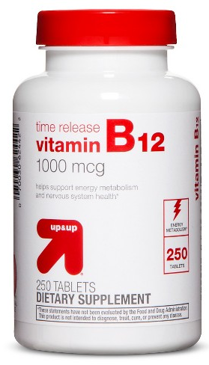
B vitamins
Regularly eating legumes and whole- or enriched-grain products helps meet the requirement for the B vitamins. Vegan athletes avoiding animal foods should take a B12 supplement or eat B12-fortified foods (such as soy or rice milk, meat analogs)

Slide 11
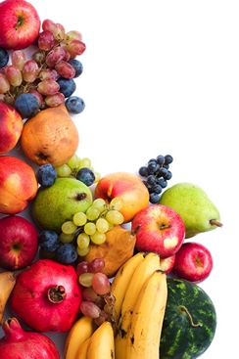
Antioxidant
A varied diet with fruit, vegetables, nuts, seeds and whole grains provides antioxidants vitamins C, E and beta carotene as well as phytochemicals. Many antioxidants and phytochemicals reduce damage to muscle and other tissue and enhance recovery after exercise. Vegetarians eat more plant foods, therefore can be expected to consume more phytochemicals.

Slide 12
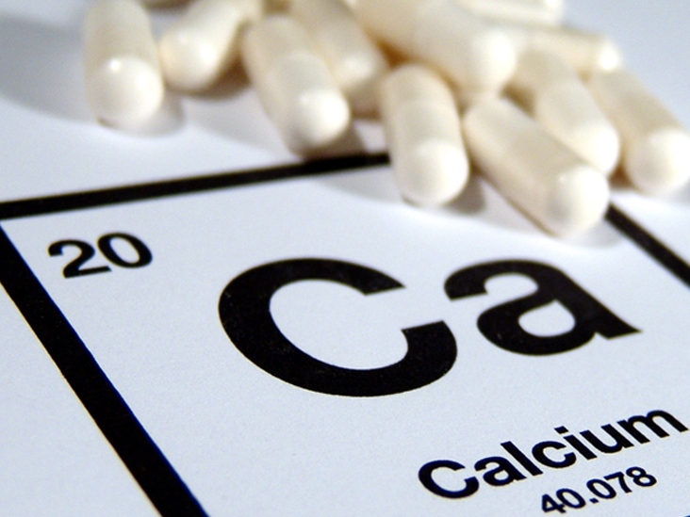
Calcium
Calcium builds healthy bone and muscles. Fortified soy or rice milk, calcium-set tofu, fortified fruit juice, collards, broccoli, kale, mustard greens, turnip greens, milk, cheese, yogurt, dried figs, and blackstrap molasses are good calcium sources that are easy to pack into an active lifestyle.

Slide 13
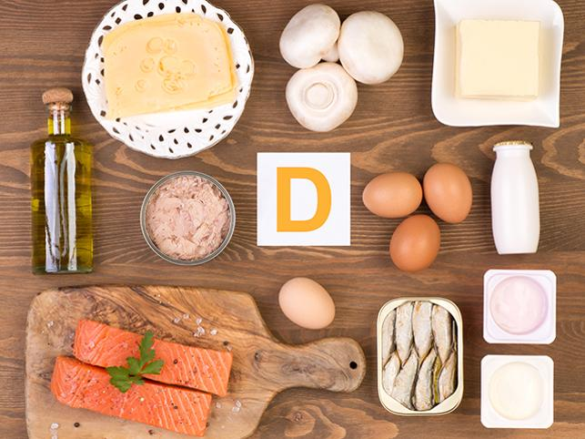
Vitamin D
Vitamin D is needed for healthy bones and a healthy immune system. Athletes who live in northern latitudes, train indoors, or use sunscreen may lack vitamin D.
Experts recommend 1000 to 2000 IU per day of vitamin D3 or vitamin D2 (vegan vitamin D). Spending just 10-30 minutes outside in exercise shorts several times a week will let athletes make enough vitamin D in their body.
Lighter-skinned athletes may require only about 10 minutes whereas darker-skinned athletes may need up to 30 minutes.

Slide 14
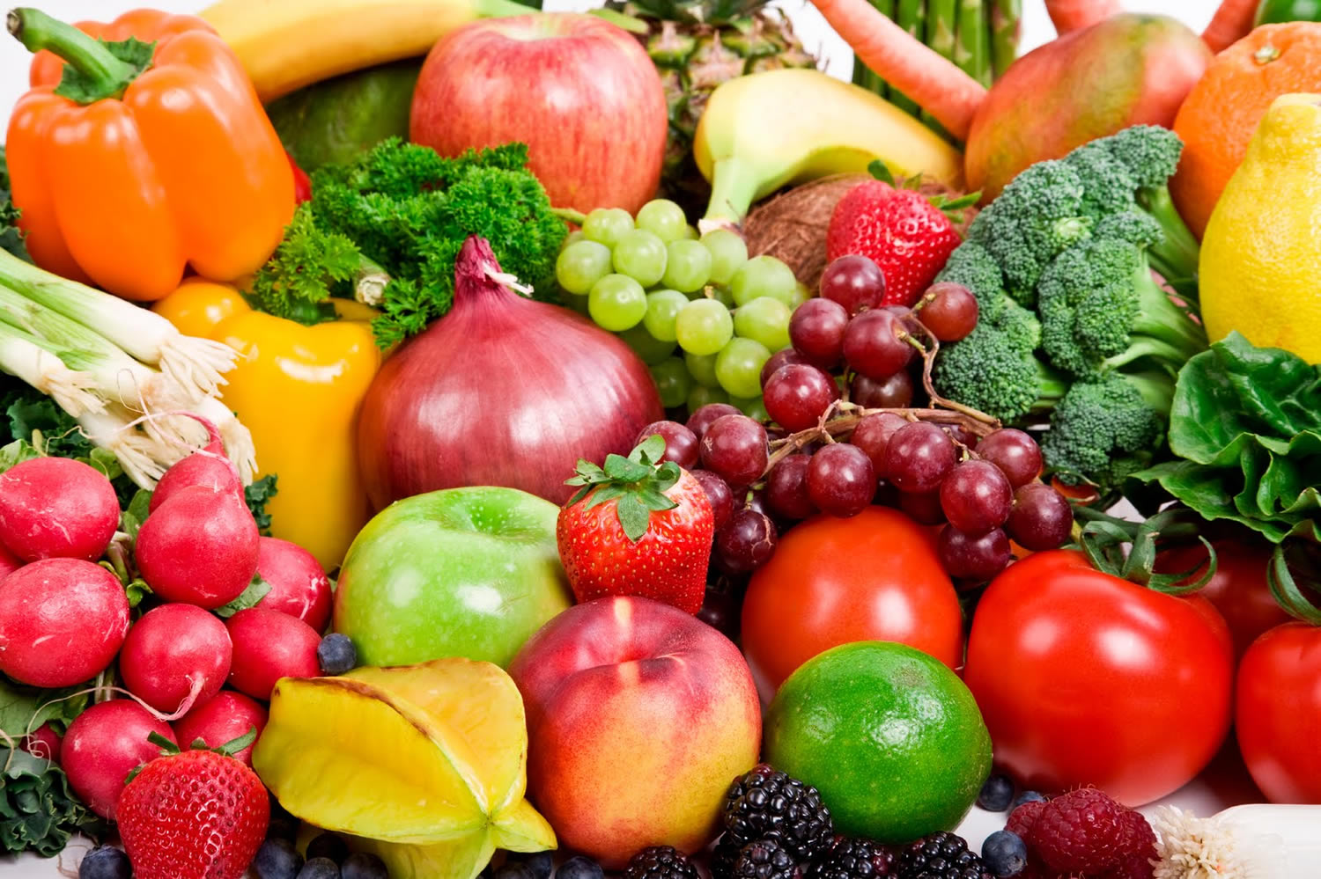
Iron
Vegetarian athletes can meet their iron needs without supplements if they choose iron-rich plant foods daily.
These foods include legumes, dark green vegetables, prunes, blackstrap molasses, and enriched breads. Combining these with foods high in vitamin C, such as tomatoes, citrus fruit, melon, kiwifruit, broccoli, or peppers, boosts iron absorption from plant based sources.
Avoid tea with meals or large servings of whole wheat crackers and unleavened whole grain breads as these contain “phytate” which decreases iron absorption. A wise tip cooking in cast iron skillets adds iron to certain foods like tomato sauce.

Slide 15
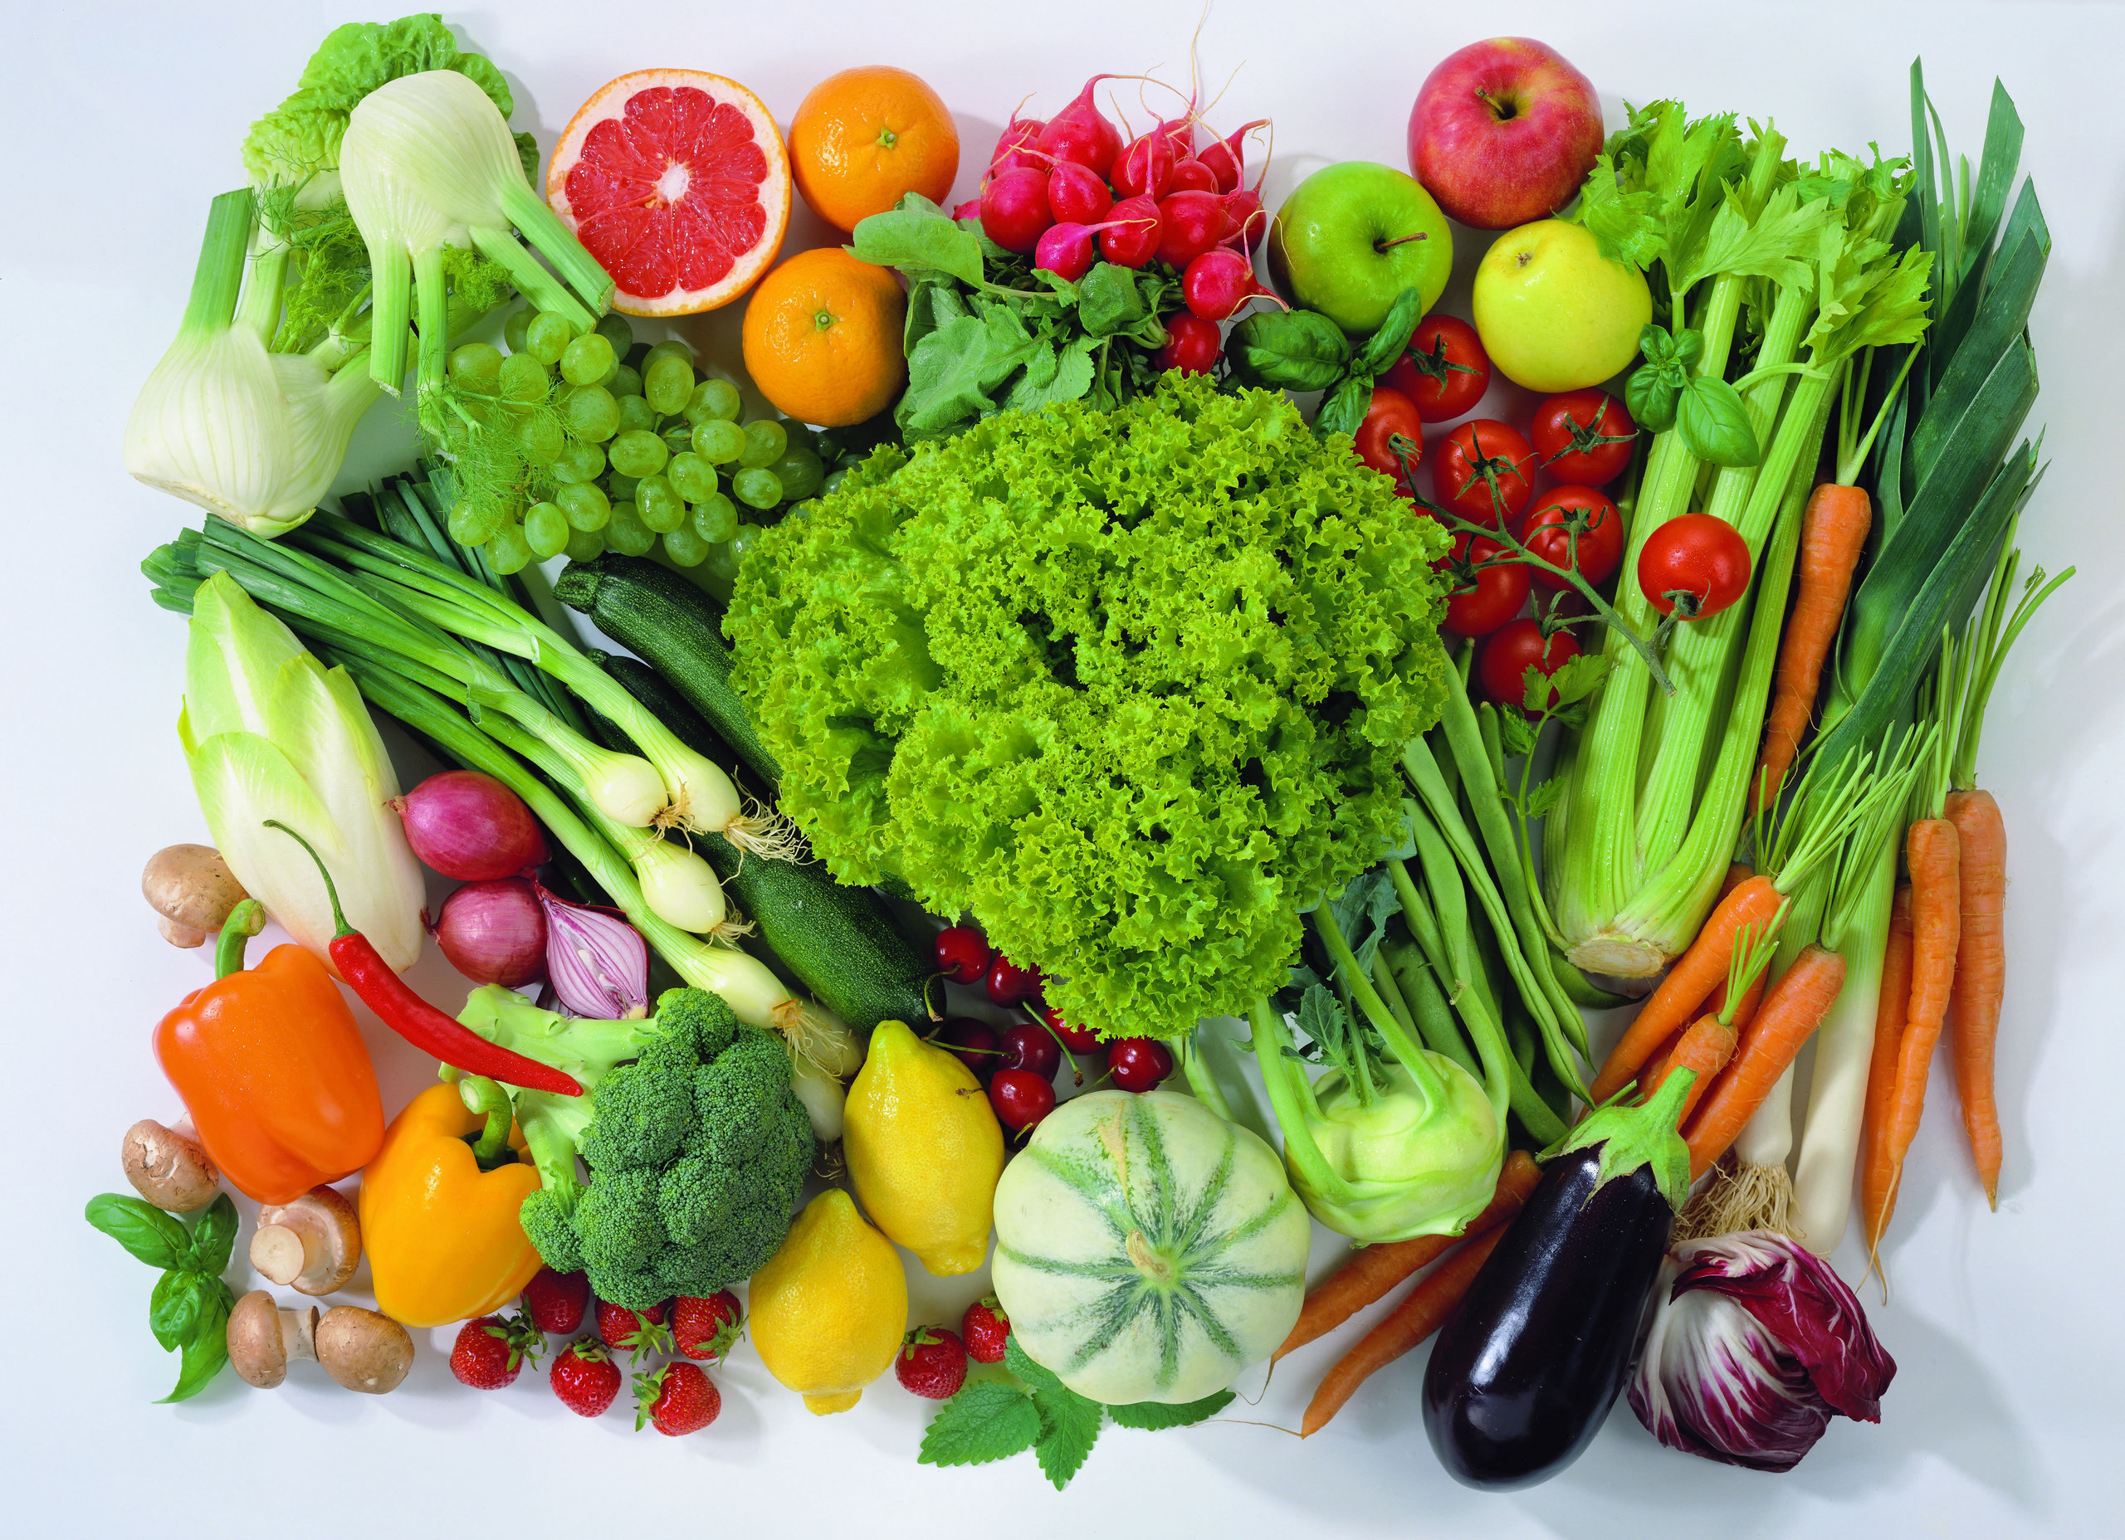
Concluding Guidelines
To recap the health and possible performance advantages of a vegetarian diet, remember to select a diet containing a variety of mostly whole and minimally processed vegetarian foods which should include whole grains, pasta, rice, whole- grain bread, cereal, fruit, vegetables, legumes, nuts and seeds, and if desired, dairy products and eggs.

Slide 16
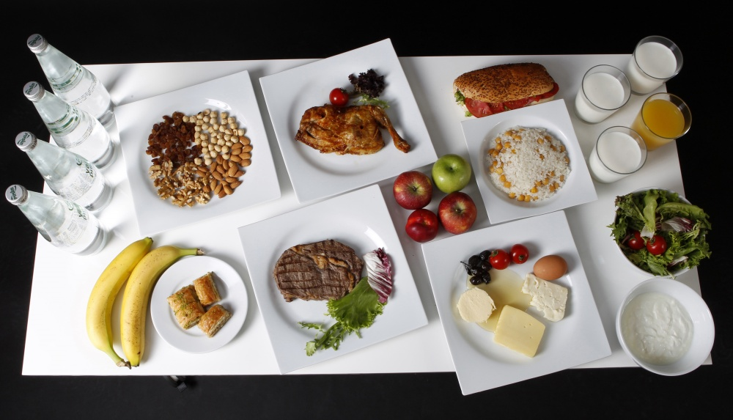

Slide 17
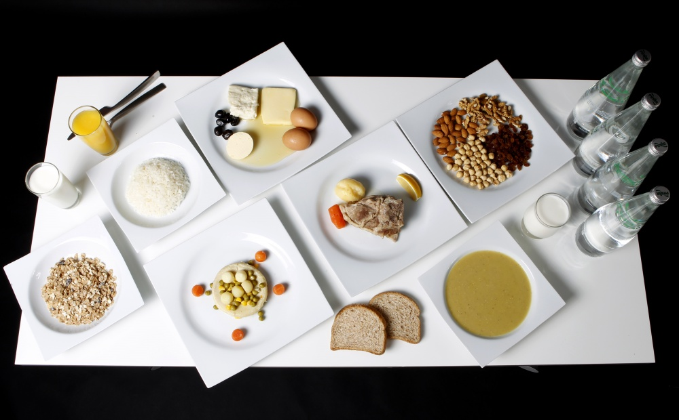

Slide 18
TERIMA KASIH

