Slide 1
PENGUKURAN STATUS GIZI ANTROPOMETRI
BASIC SPORTS NUTRITION GUIDLINESS FOR FITNESS PROFESSIONAL
Nazhif Gifari, SGz, MSi
2019

Slide 2
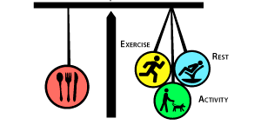
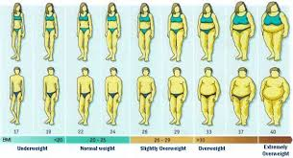
Nutritional Status
The condition of the body in those respects influenced by the diet; the levels of nutrients in the body and the ability of those levels to maintain normal metabolic integrity
The spectrum of nutritional status spread from severe undernutrition to obesity

Slide 3
Consequences of Nutritional Status
The Nutritional Status of an Individual Person, has a health Consequences
Undernutrition
Increased the risk of infection disease
Decreases in physical and mental development
Optimal Nutritional Status
Powerful factor for Health and Well Being
Improving Quality of Life
Preventing and Treating Disease
Overnutrition
Lead to Obesity
Metabolic Syndrome
Non communicable Disease

Slide 4
How To Measure it?
Anthropometric Measurement
Biochemichal Assesment
Clinical Assesment

Slide 5
Measurement of Body Proportions
Indicate Nutritional Status in General
The measure values reflect the current Nutritional Status
Body Weight anad Height, Body Mass Index, Circumferences, WHR, Skinfold Thickness
Reference Data (Standards) of The Same Age and Sex Group

Slide 6
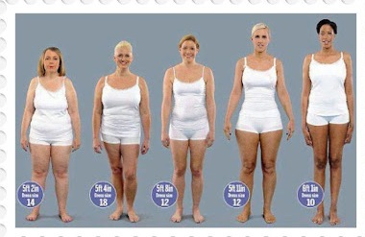
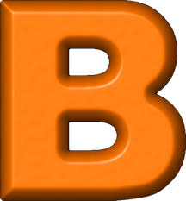
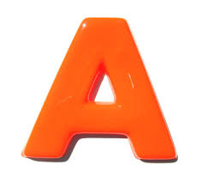

Slide 7
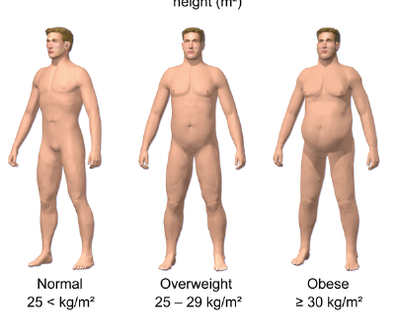
Body Mass Index
The body mass index (BMI) is a value derived from the mass (weight) and height of an individual
The best proxy for body fat percentage, but not a diagnostoc for body fatness
As a screening tools for weight categories that may lead to health problems.

Slide 8
Classification of Body Mass Index
WHO For ASIA |  | RISKESDAS
Category | BMI (kg/m²) | Category | BMI (kg/m²)
Underweight | <18,50 | Thin | <18,50
Normal | 18,50-22,99 | Normal | 18,50-24,99
Overweight | >23,00 | Overweight | 25,00-27,00
At Risk | 23,00-24,99 | Obesity | >27,00
Obese I | 25,00-29,99
Obese II | >30,00

Slide 9
Varied Classification Across Ethnicity
WHO recommends lowering the normal/overweight threshold for South East Asian body types to around BMI 23
Can not be use for children nnutritional Assesment
The amount of body fat and body composition will change along with the growth and development
Does not differentiate between muscle
mass and fat mass
BMI is particularly inaccurate for people who are very fit or athletic, as their high muscle mass can classify them in the overweight category by BMI

Slide 10
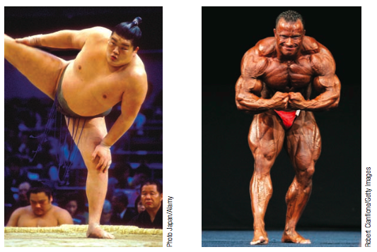
The sumo wrestler and the bodybuilder have similar body weight yet dramatically different body composition.

Slide 11
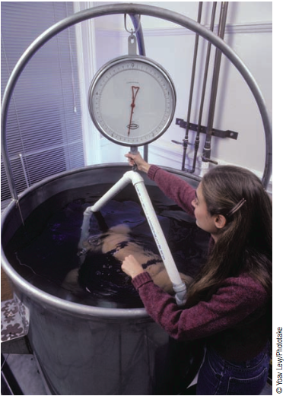
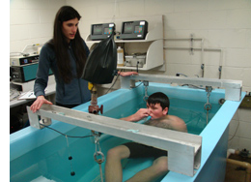
How to Measure it?
UNDERWATER WEIGHING
Body density can be determined by completely submerging a person in water and calculating the volume of the displaced water from the weight of the displaced water.
Gold Standard

Slide 12
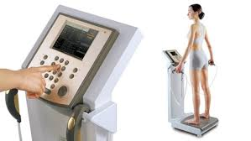
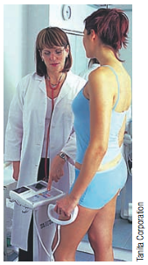
Bioelectrical Impendance Analysis
Two or more conductors are attached to a person’s body and a small electric current is sent through the body.
The resistance between the conductors will provide a measure of body fat between a pair of electrodes, since the resistance to electricity varies between adipose, muscular and skeletal tissue.
Fat-free mass (muscle) is a good conductor as it contains a large amount of water (approximately 73%) and electrolytes

Slide 13
The body fat percentage (BFP) adalah jumlah kandungan lemak dalam tubuh seseorang dari total berat tubuhnya
Free Fat Mass (FFM) adalah semua bagian dari tubuh yang bukan lemak (otot, tulang, air, jaringan, dsbnya.
Muscle Mass adalah berat otot dalam tubuh seseorang, termasuk otot rangka maupun otot dalam organ-organ tubuh.
Total body water percentage (TBW%) is the total amount of fluid in the body expressed as a percentage of your total body weight

Slide 14
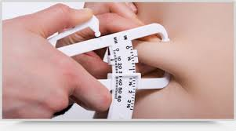
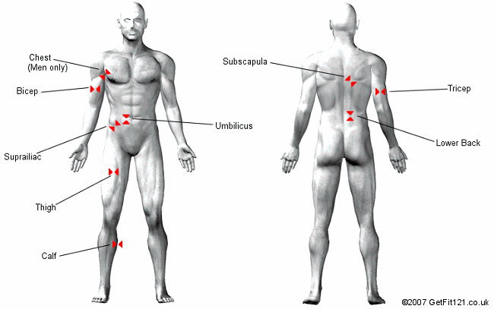
SKINFOLD METHOD
Laki-laki: 1,0913-0,00116 (trisep+subscapula)
Wanita : 1,0897-0,00133 (trisep+subscapula)

Slide 15
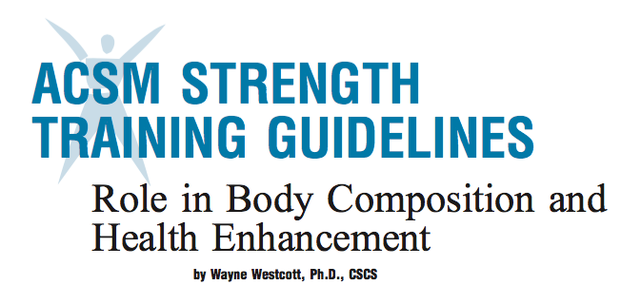

Slide 16
TERIMA KASIH

