Slide 1
BUSINESS ENGLISH
SESSION 1
Noni Agustina, M.Pd.
PAMU

Slide 2
VISI DAN MISI UNIVERSITAS ESA UNGGUL

Slide 3
First Session
INTRODUCTION
Regular Versus Parallel Class
Some Essential Notes
Topics to Be Covered
Grading System

Slide 4
First Session
5. Esa Unggul University
6. PAMU’S Rules
7. Draft of Introduction
8. Writing Exercise

Slide 5
Grading System
Mid-Term Test : 30 %
Final Test : 40%
Quiz: 10%
Assignment : 20%

Slide 6
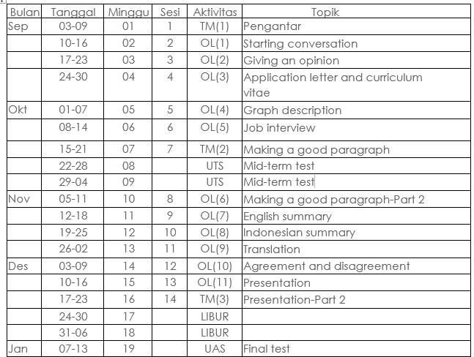
Material Coverage

Slide 7
RULES OF THE GAMES
Try your best to speak English in the classroom
Come to the class on time
Bring the dictionary (digital or printed)
Submit assignment on time

